Slide 1
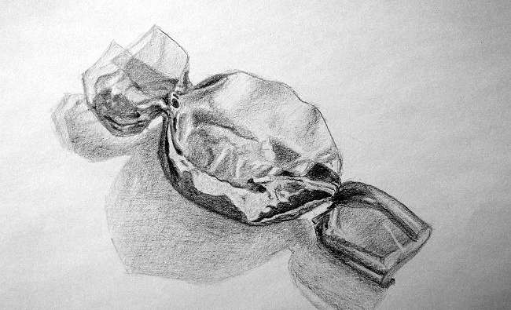
Copy one or both of the images in the boxes below using pencil/pencil crayon. You can print this sheet out or draw the boxes onto a piece of paper.
You will need:
Sweet images (on this slide)
A4 paper
Pencil/ coloured pencils
Year 10 Drawing Task- Reflections
Instructions:
Start by sketching out the main shapes lightly with a pencil so that you can rub out if you make a mistake (we all make them!). Take your time so you get the proportions right.
Look at the light and dark areas and think about how you will create tone using your pencil.
Try and use different shading techniques to create texture.

