Slide 1
NAME:
Teacher: Class:

Slide 2
UNIT TITLE
Page: 2
BASELINE CONFIDENCE CHECKER
BEFORE LEARNING THE UNIT | 1 | 2 | 3 | 4 | 5 | 6 | 7 | 8 | 9 | 10
I can identify a wide range of jobs
I understand that each sector in society contains many career opportunities
I know how to plan for my future career
I understand what Labour Market Information is
I can explain how Brexit may impact local Labour Markets in the UK
I can identify the main factors that impact Labour Market Information
I can identify a range of different UK Job sectors
I know the starting salaries of a range of jobs
I can explain my dream job or career
I can reflect on my careers journey so far
I understand what should be taken into account when making important decisions
To understand how our current choices can impact our future choices
I understand my schools core curriculum at KS4
I understand my option choices at KS4
I know what I would like to study at KS4
I understand post 16 progression routes available to me
I understand the links between qualifications and pay
I understand post 18 progression routes available to me
I am able to set myself meaningful goals
I know what subjects I would like to study at KS4
I understand the qualities and skills employers look for
KEY
Learning
Before:
Progress
Made:

Slide 3
Lesson title: Career interests and job ideas
Page: 3
Starter Questions–_______________________________________________________________________________________________________________________________________________________________________________________________________________________________________________________________________________________________________________________________________________________________
Quick Quiz
Identify the Job. Score = /6
A___________________ D___________________
B___________________ E____________________
C___________________ F____________________
Quick Quiz
Identify the Job. Score = /6
A___________________ D___________________
B___________________ E____________________
C___________________ F____________________
Jobs
Person | Job | Skills or Qualifications Required

Slide 4
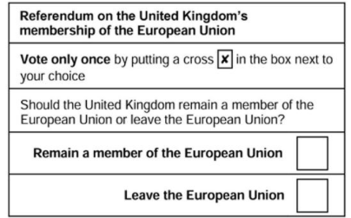
Lesson title: Labour Market Information
Page: 4
How will Brexit impact the economy and jobs market?
How could a recession impact the economy and jobs market?
Why is high employment good for the country?
How can labour market information help you?–____________________________________________________________________________________________________________________________________________________________________________________________________________________________________________________________________________________________________________________________________________________________________________________________________________________________________________________________________________________________________________________________________________________________________________________________________________________________________
Did you know?
Labour Market Information (LMI) provides statistics, research and analysis about current and future economic and job trends so that business and YOU can plan for the future
 | Employment Sector | Examples of Employers
1 | Advanced Automotive
2
3
4
5
6
7
How might Brexit impact future job markets and job trends in the UK?–_______________________________________________________________________________________________________________________________________________________________________________________________________________________________________________________________________________________________________________________________________________________________________________________________________________________________________________________________________________________________________________________________________________________________________________________________
Which way do you think the following people may have voted? and why? what issues would have been important to them?
Small Business owner
David Cameron
Nigel Farage
Londoner
CEO of McDonalds
E) Student wanting to travel and work abroad
F). Elderly member of the community
G). University Student
H). NHS Manager

Slide 5
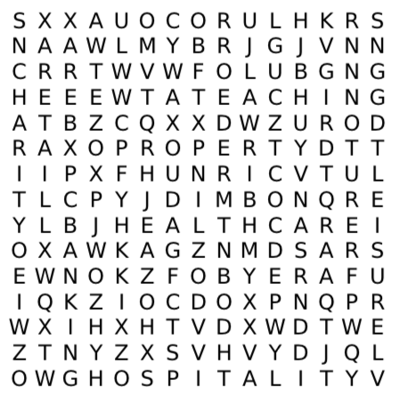
Lesson title: Exploring Careers
Page: 5
Name 3 jobs that didn’t exist 10 years ago
1.
2.
3.
Name 3 jobs that you would never want to do
1.
2.
3.
Name 3 jobs that begin with the Letter R
1.
2
3.
What would your dream job be?
HELP BOX
Create your job title __________________
What five things / qualities / duties would your job include?
1.. 2.. 3.. 4.. 5..
e.g. Earn lots of money, fly spaceships, bossing people about
What would be the perks of the job?
(freebies or extra benefits) e.g free car
“If you don’t like you job you can always just quit and find a new one”
Arguments For | Arguments Against
Your personal opinion :

Slide 6
Lesson title: Exploring Careers
Page: 6
Look around the classroom and try to complete the A-Z with your own ideas for jobs
For the five of the most difficult letters you can write ‘I don't spy’ instead
Once you have completed your own ideas go around the class and find different ideas for each letter and complete as much of the table as possible
Letter | My Job | Friends Job | Friends Job
A
B
C
D
E
F
G
H
I
J
K
L
M
N
O
P
Q
R
S
T
U
V
W
X
Y
Z
I SPY A JOB WITH MY LITTLE EYE
Clue: Think about who makes many of the things in the room, parents jobs, role in a school etc.

Slide 7
Lesson title: Making decisions about KS4
Page: 7
What do you think each persons job is in the picture to the left?
What kind of subjects might they have studied in school?
What skills do you think they might posses?
 | Buying a new mobile phone contract
Consider the issues What will you need to think about?
Get information What information? Where will you get it?
Use the information What do you need the information for?
Ask advice Who can give it? Will they be biased?
Weigh up & decide What will influence you? What are the pros and cons?
Check results How could you do this?
“You should pick subject options your parents tell you to pick”
Arguments For | Arguments Against
Your personal opinion :
“You should pick subject options that your friends are all picking”
Arguments For | Arguments Against
Your personal opinion :

Slide 8
Lesson title: Making decisions about KS4
Page: 8
PROGRESS PASSPORT 2021
SCHOOL:
Attach Photo
TARGET SETTING 2021
Target 1
Target 2
Target 3
Who can help you to achieve these targets?
SURNAME:
FORENAME:
PREFFERED NAME:
DATE OF BIRTH:
NATIONALITY:
AGE:
FAVOURITE SPORT
FAVOURITE FOOD:
Attach School logo
How are you feeling?
What are you most excited about this year? | 1
 | 2
 | 3
Best friends name(s)
What are you most nervous about? | 1
 | 2
 | 3
ACADEMIC PROFILE
Favourite Subjects | 1
 | 2
 | 3
Strongest subject
Subjects you would like to improve | 1
 | 2
 | 3

Slide 9
Lesson title: Option Subjects
Page: 9
Starter Questions–__________________________________________________________________________________________________________________________________________________________________________________________________________________________________________________________________________________________________________________________________________________________________________________________________________________________________________________________________
What option subjects do you think your personal qualities and skills would be suited to?
1…………………………………………
2…………………………………………
3…………………………………………
Are you interested in any of these options?
Have you ever given them any thought before?
What jobs might link to your option choices?
SUBJECTS | I am good at this subject Yes/No/OK | I like this subject Yes/No/OK | What skills has this subject taught me? What A levels would follow this subject? What careers might link to this subject?
Geography
History
French
Spanish
RS
ICT
Citizenship
Art
Drama
Music
Business
Sport
Technology
Currently the 3 subjects I achieve my best grades in are
…………………………………. 2…………………………………. 3………………………………….
Currently the 3 subjects I like studying best are
…………………………………. 2…………………………………. 3………………………………….
CLASS DISCUSSION
Is there a link between subjects you are good at and subjects you like?
Is there a link between subjects you are good at and whether you will consider studying them in the future?
Is there a link between the subjects you like and whether you will consider studying them in the future?
What impact will your current ideas have on your KS4 Option choices?

Slide 10
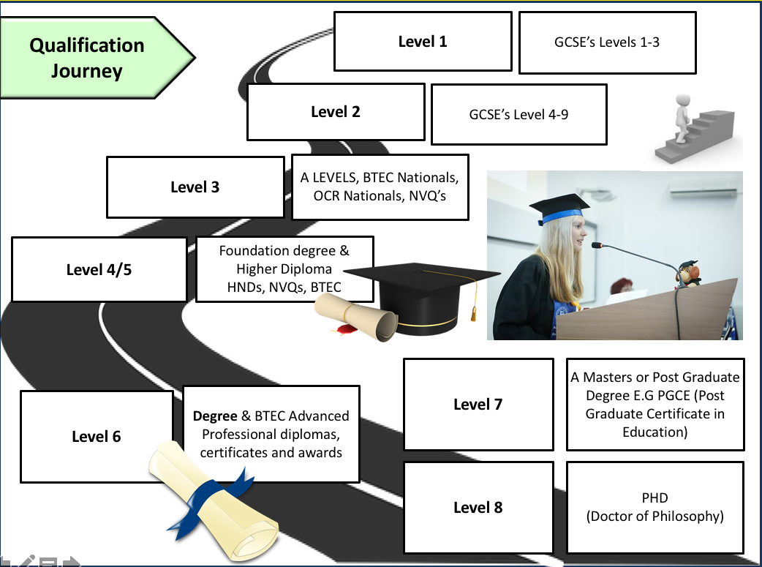
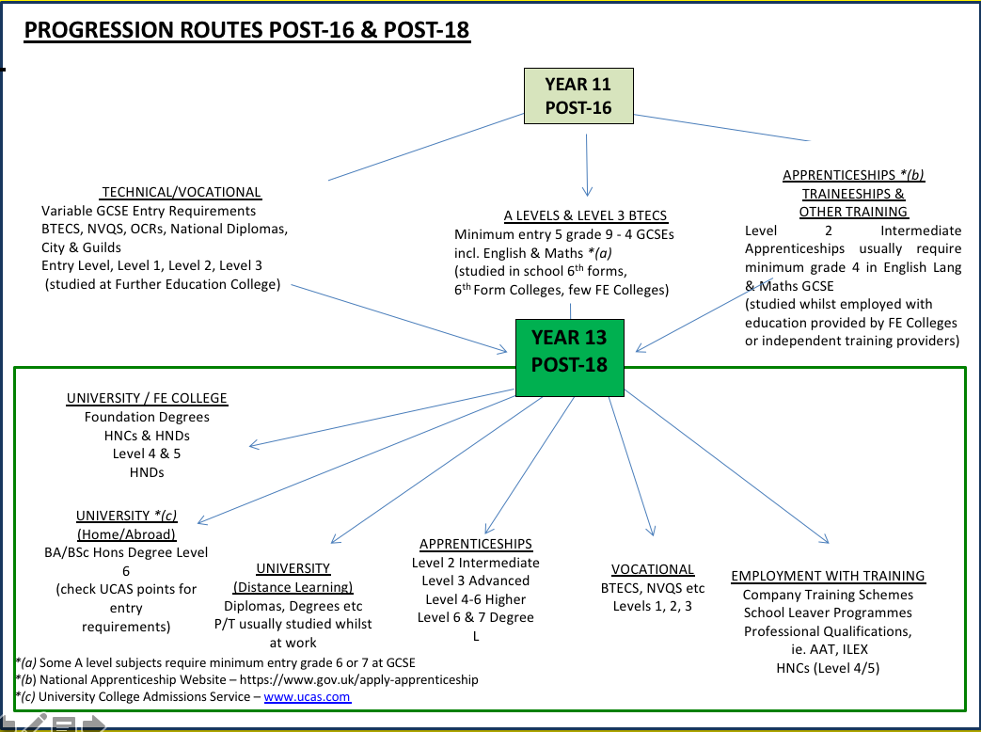
Lesson title: Qualifications and Pathways
Page: 10
What qualification level do you currently aspire to?
Why do you think this?
What post-16 progression pathway are you thinking about at the moment?
Why do you think this?
Video Reflection – What do you learn from the video clip? (Information, Statistics, advice, risks)
_________________________________________________________________________________________________________________________________________________________________________________________________________________________________________________________________________________________________________________________________________________________________________________________________________________________________________________________________________________________________________________________________________________________________________________

Slide 11
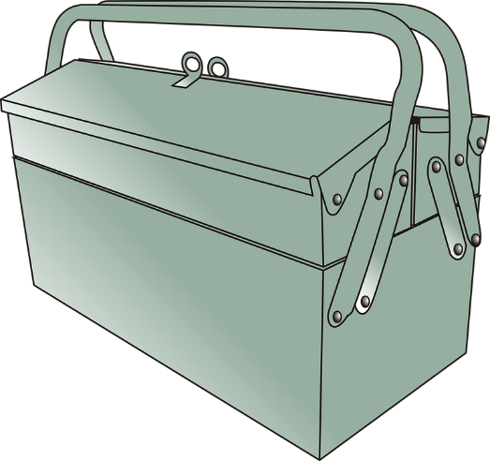
Lesson title: Qualities and Skills revisited
Page: 11
What is the person sat next to you good at?
1. 2. 3.
What is your teacher good at?
What are you good at?
What is in your skills tool box?
A Skill is……
A Quality is….
How will you achieve this future?
My future
Write your 3 most important skills:
………………………….
………………………….
………………………….
If you could choose a skill that someone else
has, what would it be and why?
I would choose ……………………that …………………..
has because ………………………………….
Write your 3 most important qualities:
………………………….
………………………….
………………………….
If you could choose a quality that someone else
has, what would it be and why?
I would choose ……………………that …………………..
has because ………………………………….
“Your qualities are more important than your skills”
Arguments For | Arguments Against
Your personal opinion :

Slide 12
FEEDBACK
Page: 12
PROJECT & WORK BOOKLET | Grade |  |  | Target Grade |  | Effort
What went well | All tasks in work booklet have been completed You participate fully in the lessons / respond to questions Fantastic evidence seen on project work You consistently displayed the ‘Blenheim Behaviours’ Your work booklet has attention to detail |  |  |  | You have a positive attitude towards your learning Your behaviour is exemplary You show great team work / Leadership skills You are a critical and thoughtful learner You are a reflective student inside and outside the classroom
Next Steps | Ensure all tasks are completed in work booklet Participate more in lessons Explain how you will improve your project work Which ‘Behaviours’ could you focus on? Add further detail to your responses in the work booklet |  |  |  | Explain how you can improve your attitude to LSW Explain how you can improve your behaviour How can you show better leadership and teamwork skills? Improve SPAG (refer to SPAG Targets) Set yourself two SMART target for self improvement.
SPAG | Below Threshold |  | Threshold |  | Intermediate |  | Advanced
Evidence of Next Steps (complete here or refer to where it can be seen)
FINAL - PRESENTATION & SPAG FEEDBACK
SPAG Performance | Descriptor | Targets to move SPAG and presentation of work booklet on
Below Threshold | Common errors in Spelling Punctuation and Grammar hinder written communication. Response does not relate to Q’s asked or no response to tasks in booklet. Work booklet is untidy. | Complete unfinished tasks Copy out misspelled vocabulary 3 times Neatly colour code tasks Complete Progress Tracker Add punctuation (Capital Letters, full stops etc)
Threshold | Able to spell and punctuate with reasonable accuracy. Some grammatical errors but they don’t significantly hinder the work booklet. Limited range of specialist key terms used. Work booklet is untidy and incomplete in places | Complete unfinished tasks Replace slang terms with more formal English Fully develop your points of view in your responses Proof read work and check for SPAG errors Use a wider range of specialist vocab
Intermediate | Able to spell and punctuate with considerable accuracy. Learners use rules of grammar with greater control of meaning . Good range of specialist key terms - Pride and care is taken in completion of the work booklet | Add to completed tasks Develop a wider range of more complex ideas Fully develop your points of view in your responses Ensure every activity is complete in you Work Booklet Use a wider range of punctuation including colons and semi colons Ensure your points made are supported by evidence and specific examples
Advanced | Perfectly accurate spelling and Grammar throughout . Grammar is effectively used at all points of the work booklet. A wide and accurate range of specialist key terms are used Work booklet is fully completed to the best of your ability. Professional presentation at all times | Add to completed tasks with extra specific details and examples Ensure your points made are supported by evidence and specific examples Use complex and varied techniques in your writing Ensure every extended written response balances viewpoints in order to fully come to a conclusion. Help support another student in improving their SPAG

