Slide 1
NAME:
Teacher: Class:

Slide 2
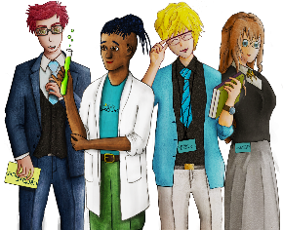
UNIT TITLE
Page: 2
BASELINE CONFIDENCE CHECKER
BEFORE LEARNING THE UNIT | 1 | 2 | 3 | 4 | 5 | 6 | 7 | 8 | 9 | 10
I can identify a range of people I trust in my life
I know a lot about other people in my class
I can identify positive character traits
I am aware of how important careers education is
I’m aware of how not to limit my future career options
I’m aware of future opportunities in learning and work
I understand the term transition
I can explain the different career transition points in secondary school and beyond
I am able to reflect on the feelings experienced during transition
I understand the difference between a skill and a quality
I can evaluate my own skills and qualities
I understand the importance of improving my skills ‘toolbox’
I understand where to go to access careers information
I can evaluate if a source is reliable and credible
I am able to use trustworthy careers website to research my dream job
I am able to set myself meaningful goals
I am able to construct a careers action plan
I take responsibility for making things happen in my own life
I Can set myself SMART Targets
I can describe my personal qualities and dispositions
I understand and can evaluate my own skills ‘tool box’
KEY
Learning
Before:
Progress
Made:

Slide 3
Lesson title: Careers and your future
Page: 3
Starter Answers–____________________________________________________________________________________________________________________________________________________________________________________________________________________________________________________________________________________________________________________________________________________________________
Work
School
Round 1
Identify the Job. Score = /6
A___________________ D___________________
B___________________ E____________________
C___________________ F____________________
When making decisions about your future what are things you should and should not take into account?
REFLECTION TIME
Why do you want to be a
------------------------?
How are you going to achieve it?
When you were 5 or 6, what did you imagine or pretend you would be?
At the moment, what is your ideal or dream job for the future?
_______________
Who can help you achieve it?
AIM HIGH
KEEP YOUR OPTIONS OPEN
SEEK OUT NEW IDEAS
BE FLEXIBLE/ADAPTABLE
What are going to be the crucial transition times?
Year
Year
Year
When will you know whether this is a realistic possibility?
What factors will shape your personal career ideas?
Your animal represents a personality type. Your animal type can help you be more aware of your natural strengths and offers a starting point for thinking about careers.
What animal are you?
What are your animal’s strengths?
What does it say about your animal as a young person?
What sectors does it say your animal works in?
Is your dream job in any of those work sectors?
Will my uniqueness as a person shape my career ideas?
Can understanding myself help me to start thinking about my career?

Slide 4
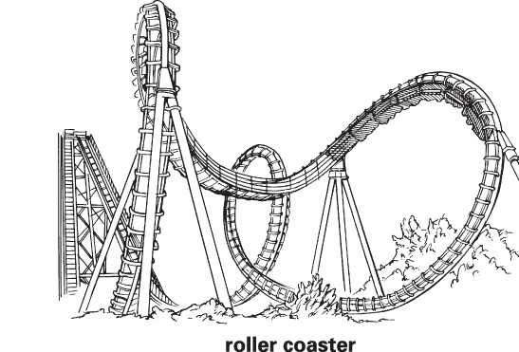
Lesson title: Transition points in your life
Page: 4
What are the most important decisions you will have you make in your life?
What will you consider when making those decisions?
Before | During | After
E.G Excited |  | E.G Energised
What is transition?
_________________________________________________________________________________________________________________________________________________________________________________________________________________________________________
_____________________________________________________________________________________________________________________
_____________________________________________________________________________________________________________________
Before | During | After
E.G Nervous |  | E.G
Career Transition Points | What are the Changes? | What can you do to make the transition more manageable?
Every new academic year
Key Stage(KS) 3 to KS4
KS4 to KS5 to 6th Form, College or Apprenticeship
KS5 to university, other higher education or apprenticeship
KS5 to getting a job

Slide 5
Lesson title: Transition points in your life
Page: 5
RESEARCH | What big choices have you ever had to make in your life? | When have you ever had to take a tough route? | What different jobs have you had over your working life? | What are the best things to look for when choosing a new job?
Family Member or Other Adult 1
Family Member or Other Adult 2
Family Member or Other Adult 4
Family Member or Other Adult 3
What did you notice from your research?

Slide 6
Lesson title: Personal Qualities and Skills
Page: 6
Subjects you can study at school
What is a skill?
__________________________________________________________________________________________________________________________________________________________________________________________________________________________________________What is a quality?
____________________________________________________________________________________________________________________
_____________________________________________________________________________________________________________________
Teamwork
Communication
Problem solving
Organised
Working under Pressure
Confident
Matching Activity
Showing that you can work productively and manage your time well, making sure you meet all deadlines.
Being able to talk clearly and get your message across to your audience and listening to others. Involves speaking to others face to face, and good writing techniques.
Good at working with others and getting a long with people you meet.
Being able to have belief in yourself and your work, without being arrogant, and having confidence in your colleagues.
Being able to find solutions when faced with difficult tasks and activities.
Keeping calm in a crisis and not becoming too stressed.
Star Qualities | Your Rating | Reasons for rating
Good Communicator (talker)
Artistic
Creative
Team Player
Problem Solving
Natural Leader
Interpersonal Skills – getting on well with others
Dynamic
Independent
Organised
Motivated
Confident
Numeracy skills
Resourceful
Excellent time management
Name and rank two other qualities you have

Slide 7
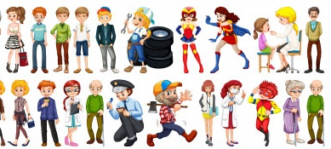
Lesson title: Finding Careers Information
Page: 7
What careers can you identify from this image?
Can you see any gender stereotypes being challenged?
What jobs might interest you when you are older?
GUESS THE JOBS
Dream Jobs of Modern Boys | Dream Jobs of Modern Girls
1. | 1.
2. | 2.
3. | 3.
=4. | 4
=4. | =5.
Quiz Round
True or False
A__________________ E__________________
B__________________ F__________________ C__________________ G__________________
D__________________ H__________________
Video Reflection – What do you learn from the video clip? (information, statistics, advice, risks)
_________________________________________________________________________________________________________________________________________________________________________________________________________________________________________
_____________________________________________________________________________________________________________________
______________________________________________________________________________________________________________________________________________________________________________________________________________________________________________________________________________________________________________________________________________________________
_____________________________________________________________________________________________________________________
_____________________________________________________________________________________________________________________
https://www.startprofile.com/
Websites including Government websites
TV
Newspapers
Did you know?
Libraries
Radio
Books and leaflets
Professional Trade Journals
A Good Careers Resource should contain some of the following:
Attractive to look at
Relevant content
Easy to use
Published/produced/updated recently
Unbiased, objective information
Signposting for further information
School Careers Lessons
Work Experience
Parents and Family members
Sector skills Council
Prospectuses
School Careers advisor
Social Media
Which source would be likely to give general information?
Which would give detailed information?
Which sources are merely advertising or promotional?
How might the information in a college prospectus differ from that produced for college magazine?

Slide 8
Lesson title: Finding Careers Information
Page: 8
JOB TITLE:
JOB DESCRIPTION / DUTIES
___________________________________________________________________________________________________________________________________________________________________________________________________________________________________________________________________________________________________________________________________________________________________________________________________________________________________________________
QUALIFICATIONS NEEDED – TICK THOSE THAT APPLY
GCSE’s and or A Levels
College
University
Apprenticeship
On the Job Training
No qualifications
Off the Job training / Other
Image / Picture of Job
STARTING SALARY:
AVERAGE SALARY:
SKILLS AND QUALITIES NEEDED
___________________________________________________________________________________________________________________________________________________________________________________________________________________________________________________________________________________________________________________________________________________________________________________________________________________________________________________
CAREER PROGRESSION OPPORTUNITIES:
RELATED CAREERS

Slide 9
Lesson title: Career Management
Page: 9
What kind of things does the government of the day have to think about and plan for in the future?
Quiz
Identify the Job
A___________________ D___________________
B___________________ E____________________
C___________________ F____________________
What will the world be like in 2070?
What are goals?
__________________________________________________________________________________________________________________________________________________________________________________________________________________________________________Why are they so important?
____________________________________________________________________________________________________________________
_____________________________________________________________________________________________________________________
Goals | Short 6 – 12 months | Medium 2 – 5 years | Long 5 years +
Be an engineer
Go to university
Pass my driving test first time
Get good end of year test results
Have a picture in Tate Modern
Get good grades in my GCSEs
Appear on ‘The Apprentice’
Make more friends
Buy a new mobile phone
Open a bank account
To go to Antarctica
Task: Create a ‘mood board’ style poster of your career dreams, ambitions and hopes.
S | Specific | Say exactly what needs to be done
M | Measurable | Easy to tell when achieved, can be proven
A | Achievable | Possible to achieve in the near future
R | Realistic | A sensible and relevant thing to do
T | Time-related | A date has been set for achieving the target
My smart Targets –1.________________________________________________________________________________________________________________________________________________________________________________________________________________________________________
2.___________________________________________________________________________________________________________________
_____________________________________________________________________________________________________________________
3.________________________________________________________________________________________________________________________________________________________________________________________________________________________________________

Slide 10
Lesson title: Career Management
Page: 10
PLANNING THE YEAR AHEAD
Name:
Form Tutor Group:
What makes you smile?
Favourite Subjects:
Write a quick text message to your future self saying what you want to achieve this year
Describe everything you are thankful and grateful for in life right now
Make a list of your biggest hopes and goals for this academic year
Four hashtags to summarise how you will approach the year ahead
#-----------------------------------------------
#-----------------------------------------------
#-----------------------------------------------
#----------------------------------------------
Favourite part of going to school
“-------------------------------------------------------------------------------------------------------------------------------------------------------------------------------------------- “
Create a quick mind map of the main people who can support you in achieving your goals
Reflecting on the year ahead has made me think about….
Would you recommend a good education?
How many stars of effort are you going to put in this year?

Slide 11
Lesson title: Character traits and Skills
Page: 11
Identify three things you are good at?
1. 2. 3.
What do you wish you were better at?
How you can become better at these things?
On a scale of 1 – 10 how much do you think the average person in the UK or USA has these positive character traits?
Courage
Honesty
Self-discipline
Compassion
Generosity
Gratitude
Video Reflection – What do you learn from the video clip? (information, statistics, advice, risks)
______________________________________________________________________________________________________________________________________________________________________________________________________________________________________________________________________________________________________________________________________________________________
______________________________________________________________________
UK
USA
Write your 3 most important skills:
………………………….
………………………….
………………………….
If you could choose a skill that someone else
has, what would it be and why?
I would choose ……………………that …………………..
has because ………………………………….
Write your 3 most important personal qualities:
………………………….
………………………….
………………………….
If you could choose a quality that someone else
has, what would it be and why?
I would choose ……………………that …………………..
has because ………………………………….
What are your skills and qualities now?. What are you good at?
What would the best job in world look like and involve?
What do you enjoy doing?
What would the worst job in the world look like and involve?
What do you want from your job and life as you get older?
What did you want to become (your dream job) when you were younger?

Slide 12
Lesson title: Character traits and skills
Page: 12
Tell me all about you! - Fill this page with everything your classmates and teachers should know about you
You must create the following:
A picture of you
Your favourite saying
Tell us what issues you are passionate about
Favourite Games and Apps
Mind map of your favourite films, TV programmes
List of all your favourite books or songs
What are the four things you would like to be better at
5
1
3
4
2
“-------------------------------------------------------------------------------------------------------------------------------------------------------------------------------------------- “
7
-----------------------------------------------------------------------------------------------------------------------------------------------.-------------------------------------------------
6

Slide 13
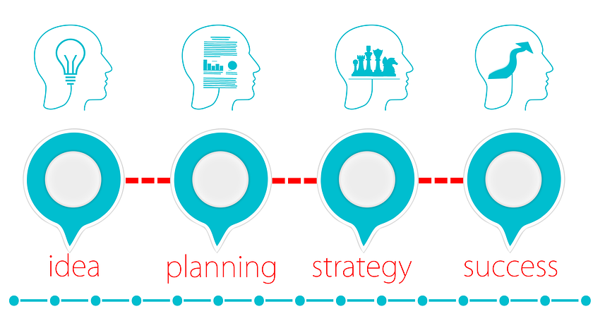
Lesson title: Action Points & Career Planning
Page: 13
Explain the process of how a teacher plans a lesson or how a school hires a new teacher to fill a vacancy. (Identify the action points and process)
Hired
Not hired
GOAL: To make informed choices about subject options at KS4 |  | Tick when Completed
ACTION POINT 1 | When will this be completed?
ACTION POINT 2 | When will this be completed?
ACTION POINT 3 | When will this be completed?
List the people and places you could go to seek further information, support help and guidance:
“The only person that can truly make someone happy is themselves”
Argument For | Arguments Against
Your personal opinion :

Slide 14
Lesson title: Action Points & Career Planning
Page: 14
GOAL: To make Informed Choices about Post 16 options SUCCESS: All applications completed and acknowledged |  | Tick when Completed
ACTION POINT 1 | When will this be completed?
ACTION POINT 2 | When will this be completed?
List the people and places you could go to seek further information, support help and guidance:
“The harder I work the luckier I am”
Arguments For | Arguments Against
Your personal opinion :
How are you feeling?
What are you most excited about this year? | 1
 | 2
 | 3
What is the most likely Post 16 route you will take?
What are you most nervous about? | 1
 | 2
 | 3
ACADEMIC PROFILE
Favourite Subjects | 1
 | 2
 | 3
Strongest subject (s)
Subjects you would like to improve | 1
 | 2
 | 3

Slide 15
Lesson title: -
Page: 15
I SPY A JOB WITH MY LITTLE EYE
Look around the classroom and try to complete the A-Z with your own ideas for jobs
For the five of the most difficult letters you can write ‘I don't spy’ instead
Once you have completed your own ideas go around the class and find different ideas for each letter and complete as much of the table as possible
Letter | My Job | Friends Job | Friends Job
A
B
C
D
E
F
G
H
I
J
K
L
M
N
O
P
Q
R
S
T
U
V
W
X
Y
Z
Clue: Think about who makes many of the things in the room, parents jobs, role in a school etc.

Slide 16
FEEDBACK
Page: 16
PROJECT & WORK BOOKLET | Grade |  |  | Target Grade |  | Effort
What went well | All tasks in work booklet have been completed You participate fully in the lessons / respond to questions Fantastic evidence seen on project work You consistently displayed the ‘Blenheim Behaviours’ Your work booklet has attention to detail |  |  |  | You have a positive attitude towards your learning Your behaviour is exemplary You show great team work / Leadership skills You are a critical and thoughtful learner You are a reflective student inside and outside the classroom
Next Steps | Ensure all tasks are completed in work booklet Participate more in lessons Explain how you will improve your project work Which ‘Behaviours’ could you focus on? Add further detail to your responses in the work booklet |  |  |  | Explain how you can improve your attitude to LSW Explain how you can improve your behaviour How can you show better leadership and teamwork skills? Improve SPAG (refer to SPAG Targets) Set yourself two SMART target for self improvement.
SPAG | Below Threshold |  | Threshold |  | Intermediate |  | Advanced
Evidence of Next Steps (complete here or refer to where it can be seen)
FINAL - PRESENTATION & SPAG FEEDBACK
SPAG Performance | Descriptor | Targets to move SPAG and presentation of work booklet on
Below Threshold | Common errors in Spelling Punctuation and Grammar hinder written communication. Response does not relate to Q’s asked or no response to tasks in booklet. Work booklet is untidy. | Complete unfinished tasks Copy out misspelled vocabulary 3 times Neatly colour code tasks Complete Progress Tracker Add punctuation (Capital Letters, full stops etc)
Threshold | Able to spell and punctuate with reasonable accuracy. Some grammatical errors but they don’t significantly hinder the work booklet. Limited range of specialist key terms used. Work booklet is untidy and incomplete in places | Complete unfinished tasks Replace slang terms with more formal English Fully develop your points of view in your responses Proof read work and check for SPAG errors Use a wider range of specialist vocab
Intermediate | Able to spell and punctuate with considerable accuracy. Learners use rules of grammar with greater control of meaning . Good range of specialist key terms - Pride and care is taken in completion of the work booklet | Add to completed tasks Develop a wider range of more complex ideas Fully develop your points of view in your responses Ensure every activity is complete in you Work Booklet Use a wider range of punctuation including colons and semi colons Ensure your points made are supported by evidence and specific examples
Advanced | Perfectly accurate spelling and Grammar throughout . Grammar is effectively used at all points of the work booklet. A wide and accurate range of specialist key terms are used Work booklet is fully completed to the best of your ability. Professional presentation at all times | Add to completed tasks with extra specific details and examples Ensure your points made are supported by evidence and specific examples Use complex and varied techniques in your writing Ensure every extended written response balances viewpoints in order to fully come to a conclusion. Help support another student in improving their SPAG

