Slide 1
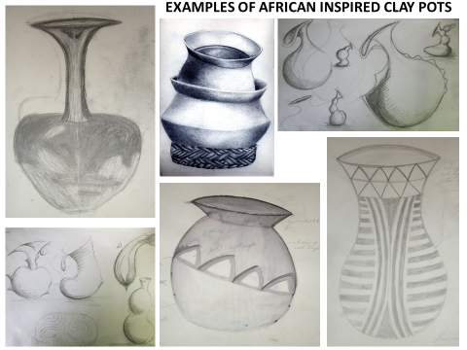
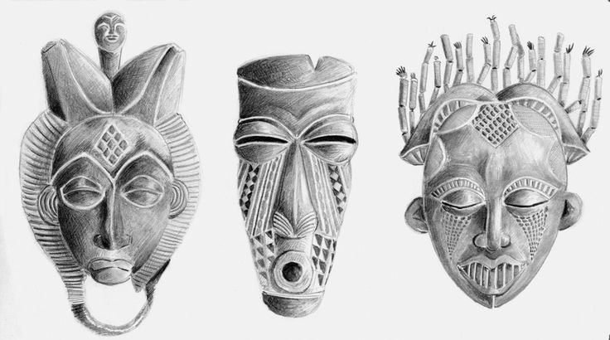
Today you will use your knowledge of Drawing and Shading to create a successful observational Drawing based on African Culture
CELEBRATING CULTURE
ADD DETAILS AND
TO YOUR DRAWING
KEYWORDS:
OBERVATION,
PROPORTION, DETAILS, MARK MAKING,
PATTERN, SHAPE, VESSEL, TRADITION, CULTURE, TONE, SHADE, 3D, DECORATION, CULTURE

Slide 2
SUCCESS CRITERIA
GET THE MOST OUT OF YOUR DRAWING!

