Slide 1
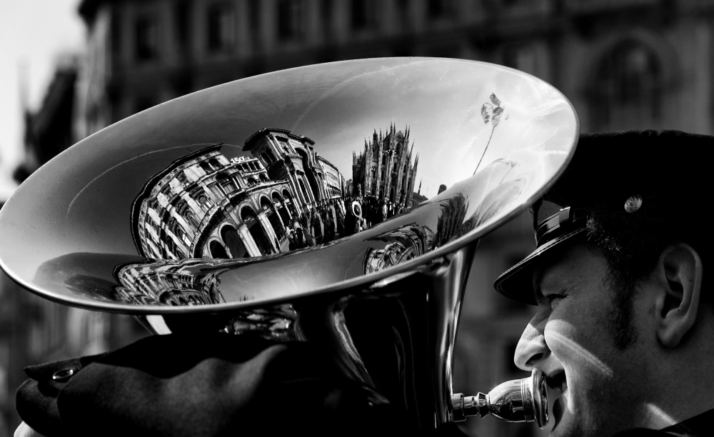
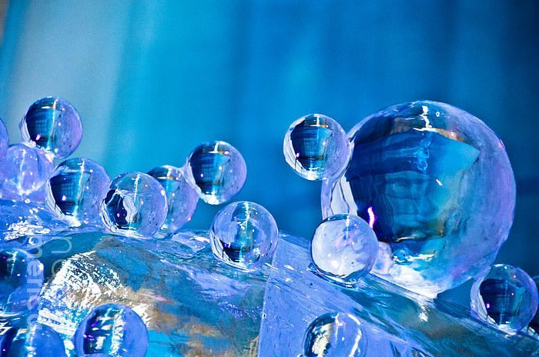
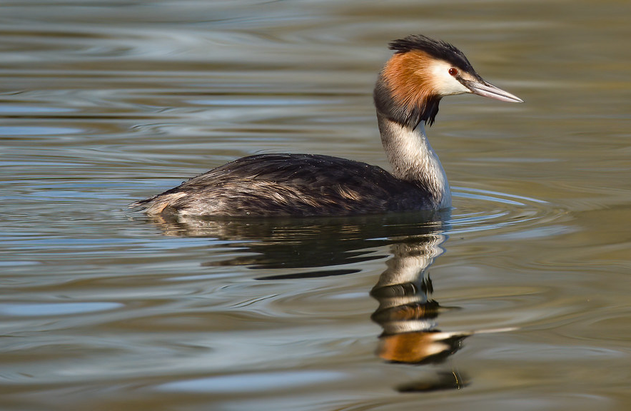
Complete one drawing a week of an image relating to your project theme ‘Reflections’.
You can use the images provided or make studies from your own photographs that you took for homework or draw from objects in front of you, for example a kettle, cutlery, tap, a can or a jar etc.
You can complete these in pencil, pen, pencil crayon, watercolour, acrylic or anything you have access to.

Slide 2
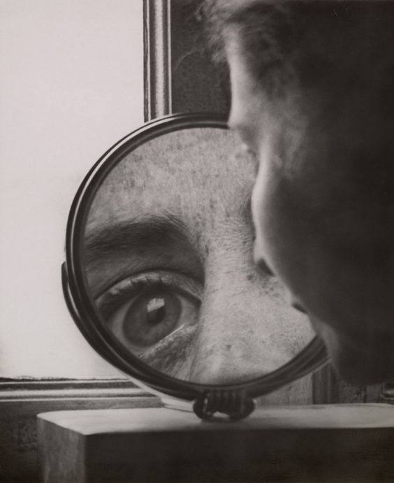
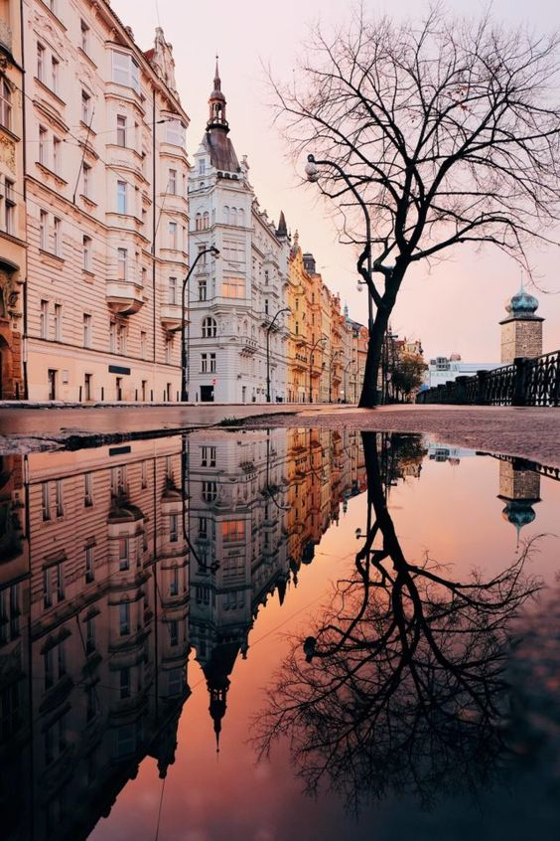
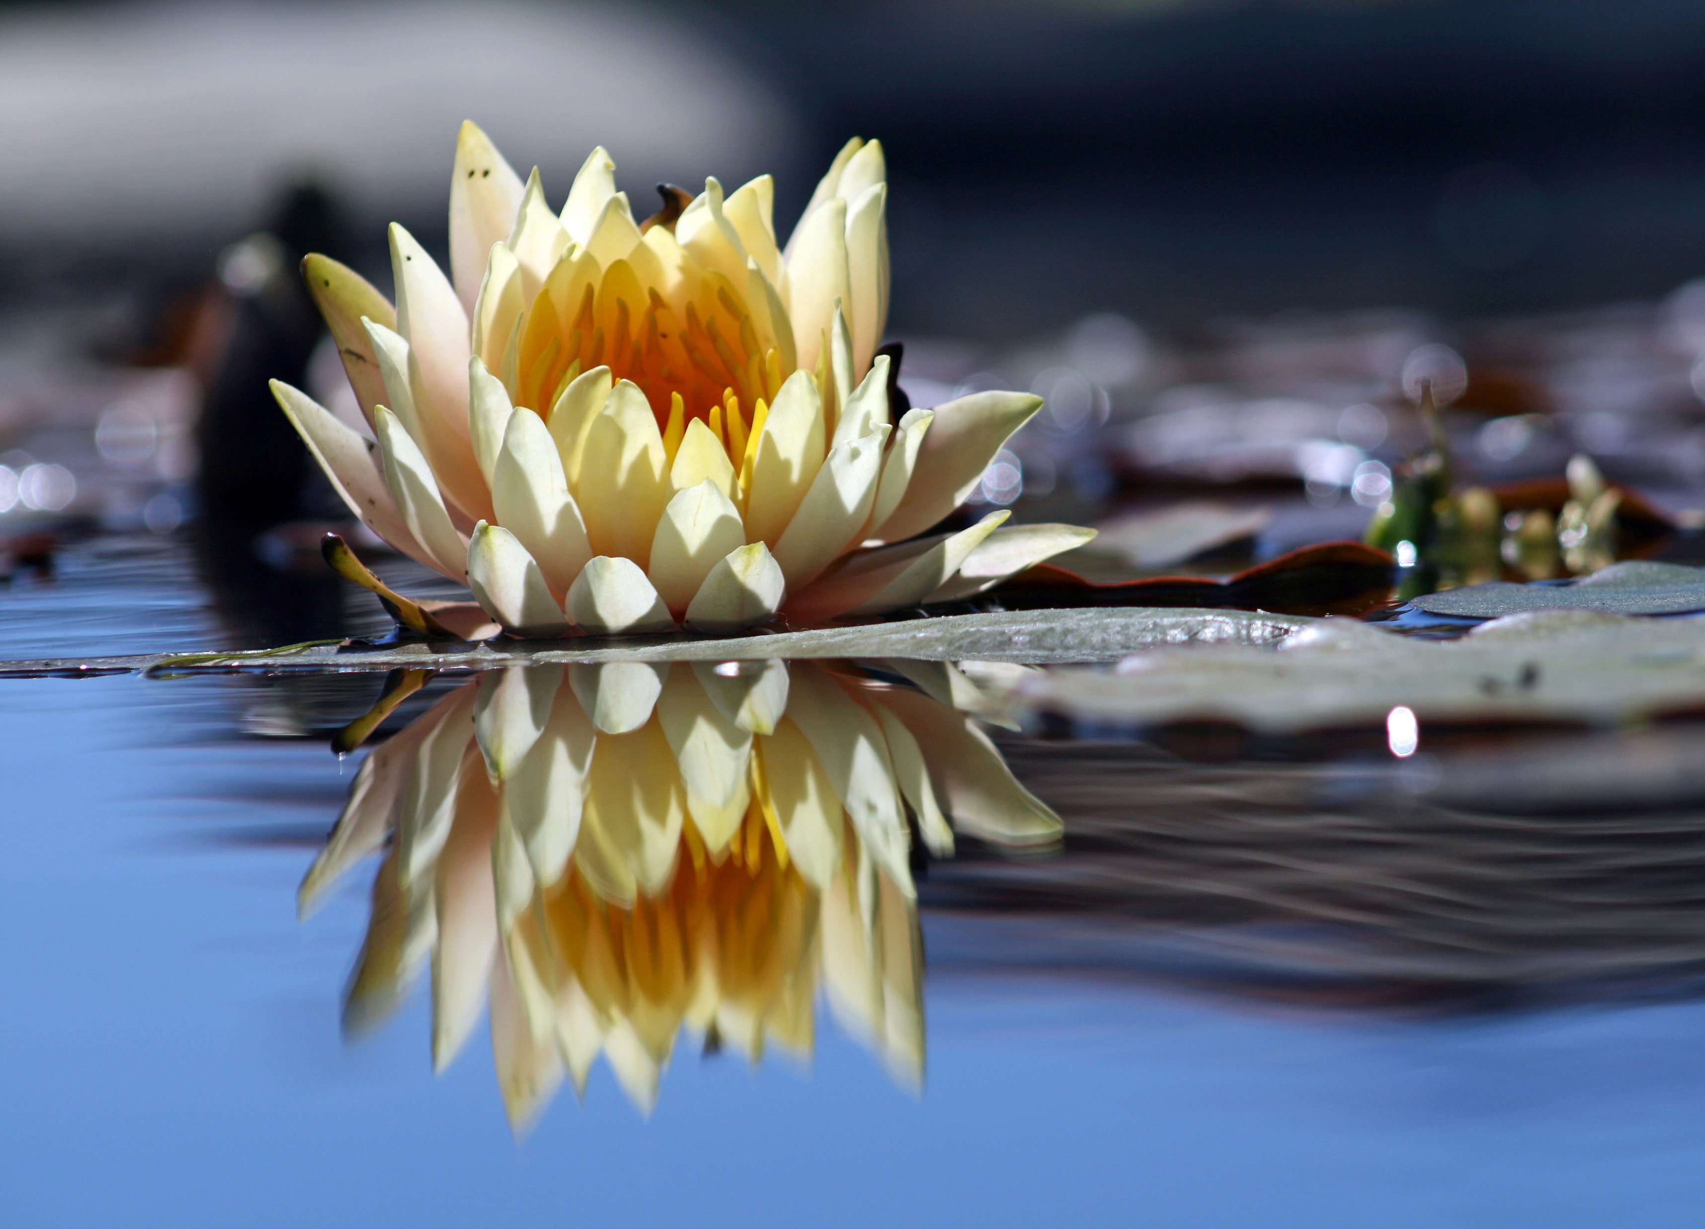

Slide 3
