Slide 1
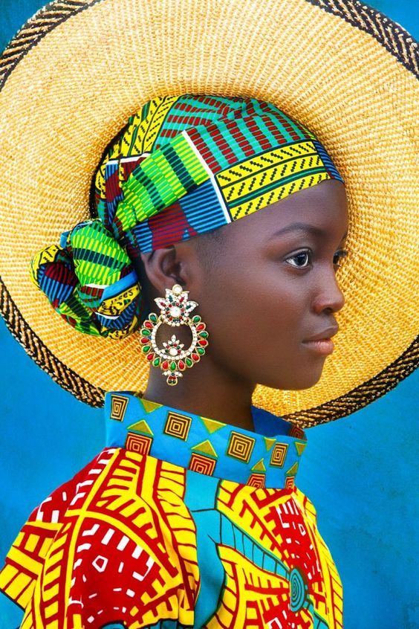
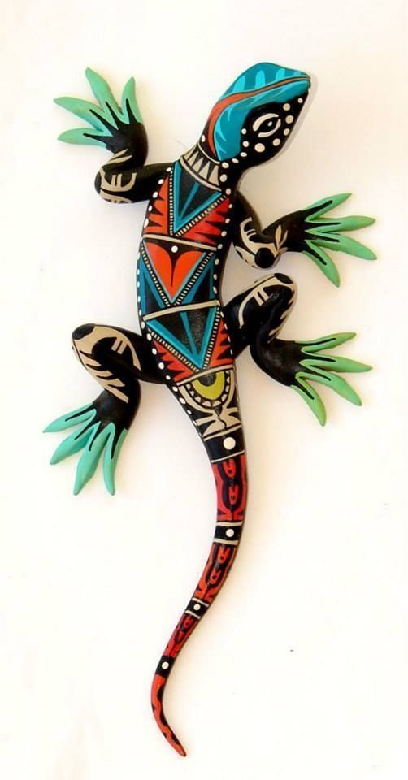
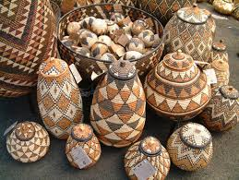
Complete one drawing a week of an image relating to your project theme of African culture.
Please use the images provided.
You can complete these in pencil, pen, pencil crayon, watercolour, acrylic or anything you have access to.

Slide 2
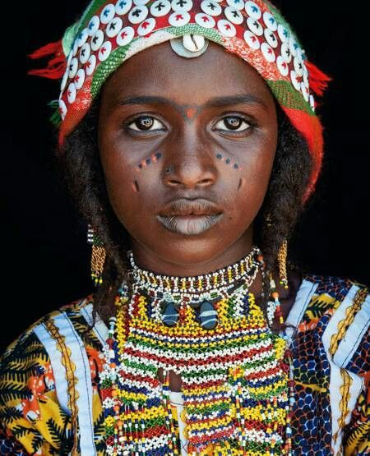
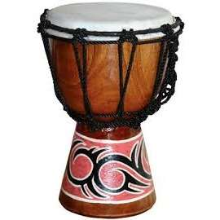
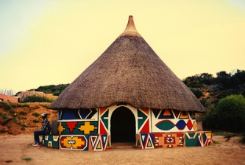

Slide 3
