Slide 1
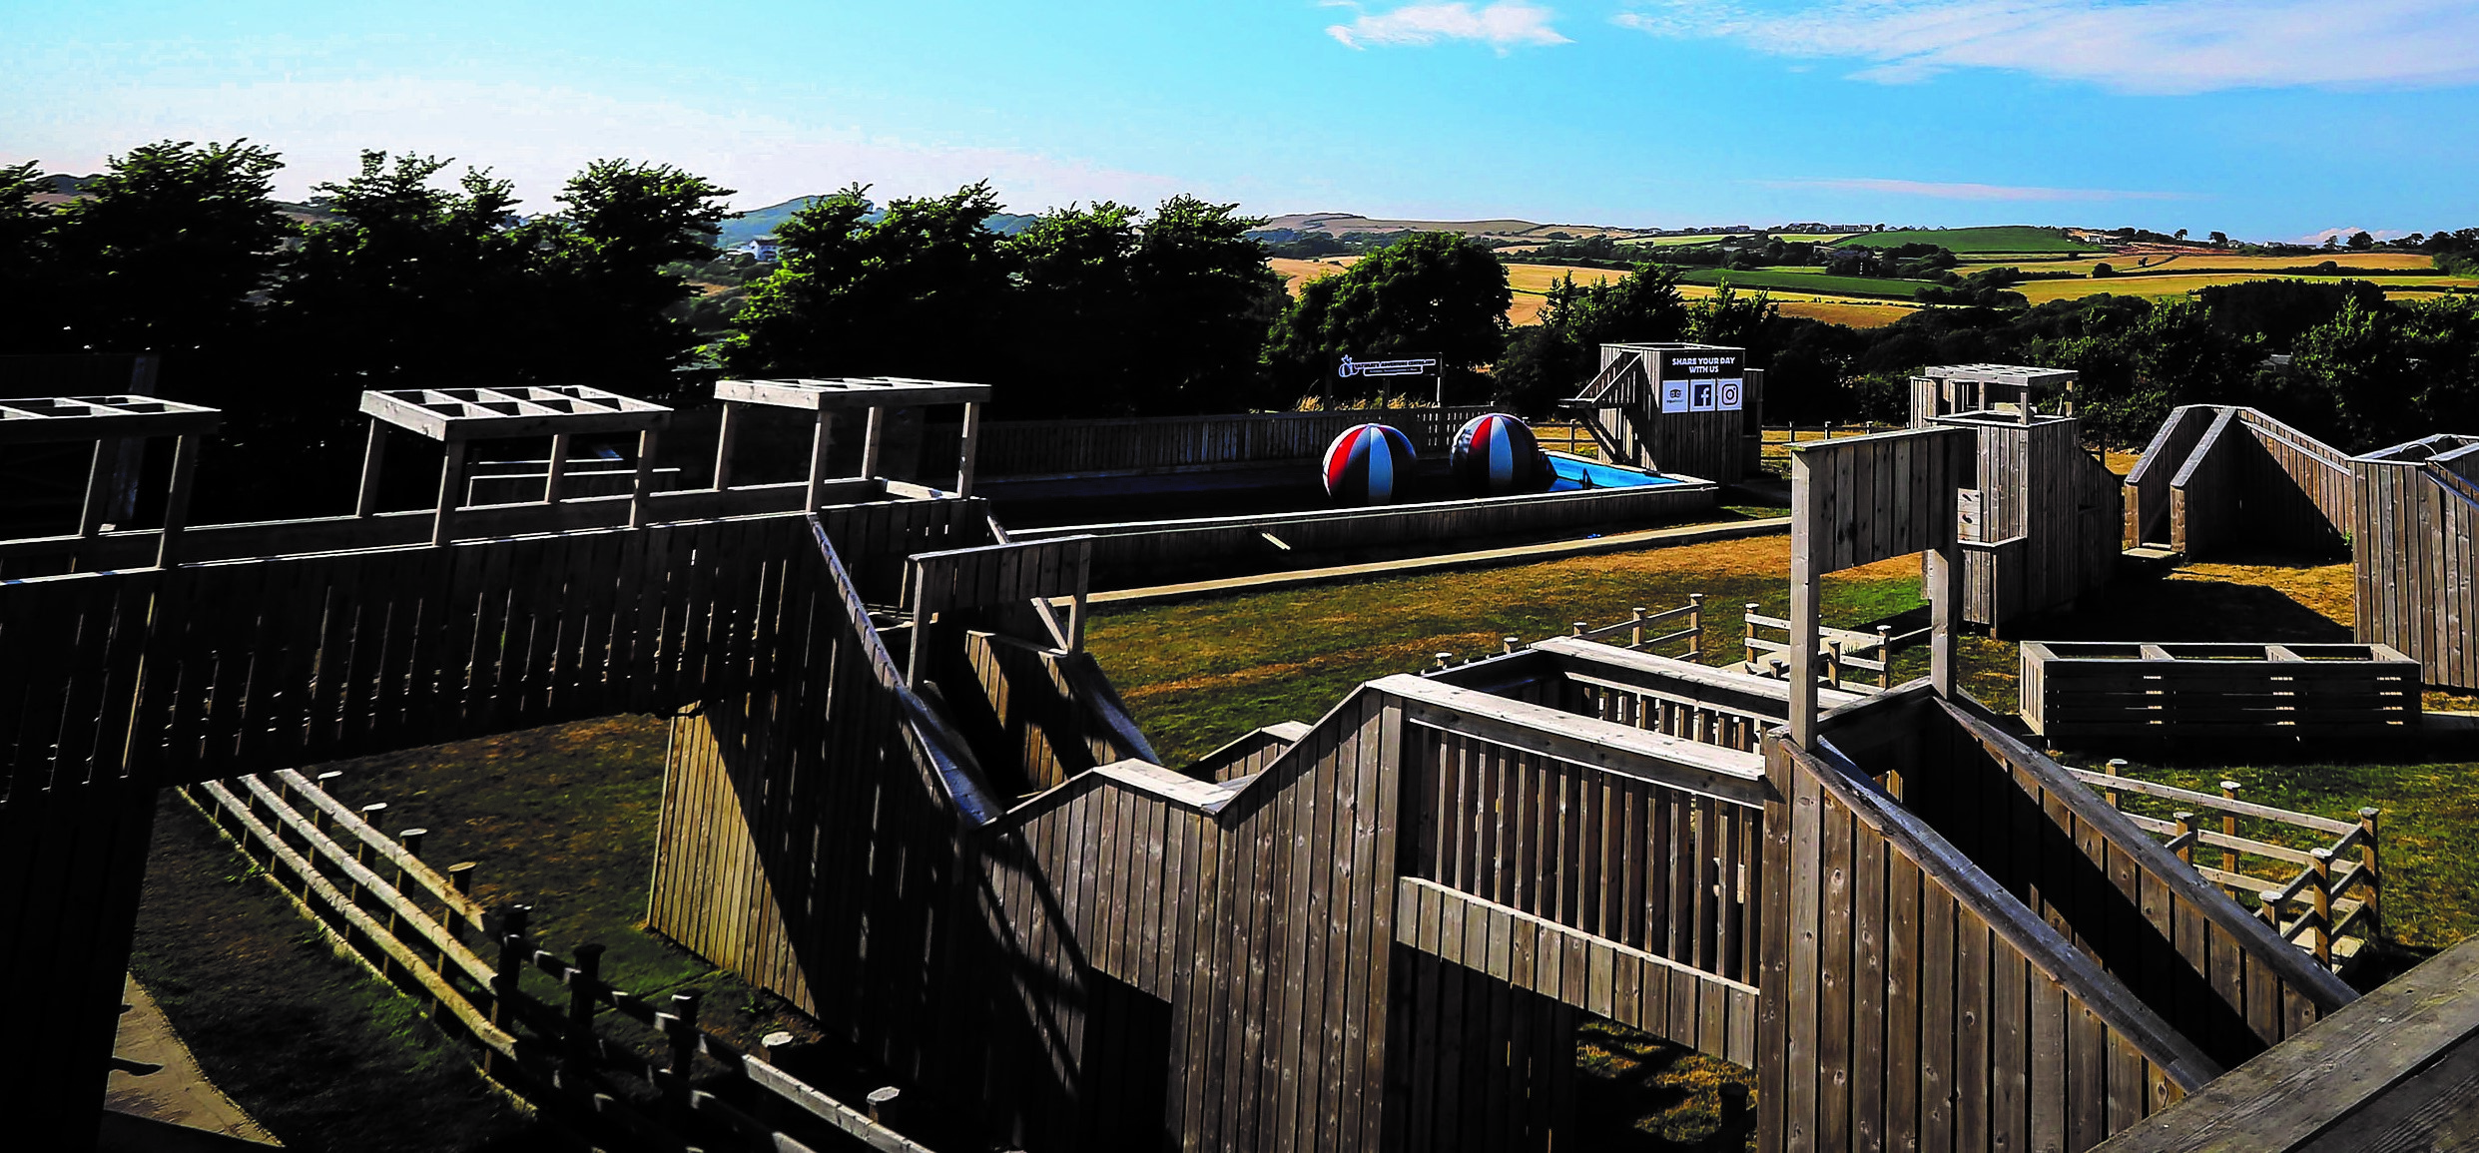
WEST RUNTON
WEST RUNTON
YEAR 7 RESIDENTIAL
RESIDENTIAL TRIP

Slide 2
WHAT TO PACK
PLEASE SEE THE KIT LIST THAT HAS BEEN GIVEN TO YOU!
THINGS TO REMEMBER:
SEPARATE BAGS FOR DIRTY WASHING
SHOES THAT CAN BE WORN INSIDE
NO AEROSOLS
MONEY FOR THE SHOPS
NO MOBILE PHONES ARE ALLOWED

Slide 3
10TH JULY LEAVING DAY
ARRIVE TO SCHOOL IN NON SCHOOL UNIFORM READY TO LEAVE AT 11.00AM
YOU WILL BE ATTENDING UNITS 1 & 2 AS NORMAL
WE AIM TO ARRIVE AT WEST RUNTON BY 2PM
PLEASE BRING A PACKET LUNCH UNLESS YOU HAVE FREE SCHOOL MEALS
YOU CAN BRING SNACKS WITH YOU IF YOU WISH
WATER BOTTLE WILL BE NEEDED FOR THE TRIP, YOU WILL NEED TO REFILL THIS AS THEY DO NOT PROVIDE WATER BOTTLES ONSITE.

Slide 4

MEDICAL
If you want your child to receive Paracetamol and/or Ibuprofen, please fill in the medical form at the back, this needs to be done even if you have filled one in already for school.
If you child must take medication, please fill in this form also.
All medication needs to be in a bag with your child's name on and what medication it is.
Please state the dosage on the bag as well.

Slide 5

ARRIVAL BACK AT KSA
We will be leaving West Runton at about 12.30pm.
We aim to arrive back at school for 3.15pm
If you want your child to walk home, please let me know
If we are going to be late everything will be communicated by social media.

Slide 6

BEHAVIOUR
All students must be on their best behaviour and agree to follow all staff instructions whilst with us.
If a student's behaviour is unacceptable, we will first ring home to let you have a conversation with them, if this still doesn’t work, then we will have no alternative but to ask parents to come and pick their child up.

Slide 7
Questions
I will be going through this again with students this week. If you have any questions, please do not hesitate to email me on c.read@kenstimpson.org.uk

