Slide 1
How to Approach Unseen Poetry
We are: learning how to analyse a poem independently
So that: you can read, enjoy and understand a poem without support

Slide 2
Useful Vocabulary! Write down the words in your book you DO NOT know…
Alliteration Onomatopoeia Rhythm Rhyme Mood Tone
Enjambment Caesura Assonance Simile Metaphor Contrast
Juxtaposition Stanza Symbolism Imagery Connotation
Sarcasm Irony Couplet Ambiguity Attitude
Structure Form Speaker Oxymoron Repetition Sibilance
DISCUSSION: LETS HELP EACH OTHER TO UNDERSTAND THESE WORDS – WRITE A DEFINITION FOR THE DIFFICULT WORDS IN YOUR BOOK AS WE DISCUSS EACH ONE

Slide 3
STAGE 1…
Look at the title of the poem. What clues does it give you about the topic, tone or subject of the poem?
You need to be able to decide what connotations words in the title can give you. Try analysing these in lots of depth...
If I could tell you
Come on, come back
The Rising Sun

Slide 4
If I could tell you
First person narrative. The narrator is addressing the poem to somebody directly. What are they struggling to say? What does the word ‘if’ and ‘could’ suggest? A secret? Probably something that won’t be received well…any ideas?
Come on, come back
The Rising Sun

Slide 5
STAGE 2…
Read the poem and break down your analysis into sections
STRUCTURE
Beg/Mid/End
FORM
Journey
Flashbacks
TONE
Sonnet
Narrative
Couplets
resentful
LANGUAGE
Reflective
Free Verse
Anger
RHYME/RHYTHM
IMAGERY
Metaphor
Take Notes!
Simile
Humour
Personification
Nature
Imabic Pentameter
death
Use of questions
unpredictable
weather

Slide 6
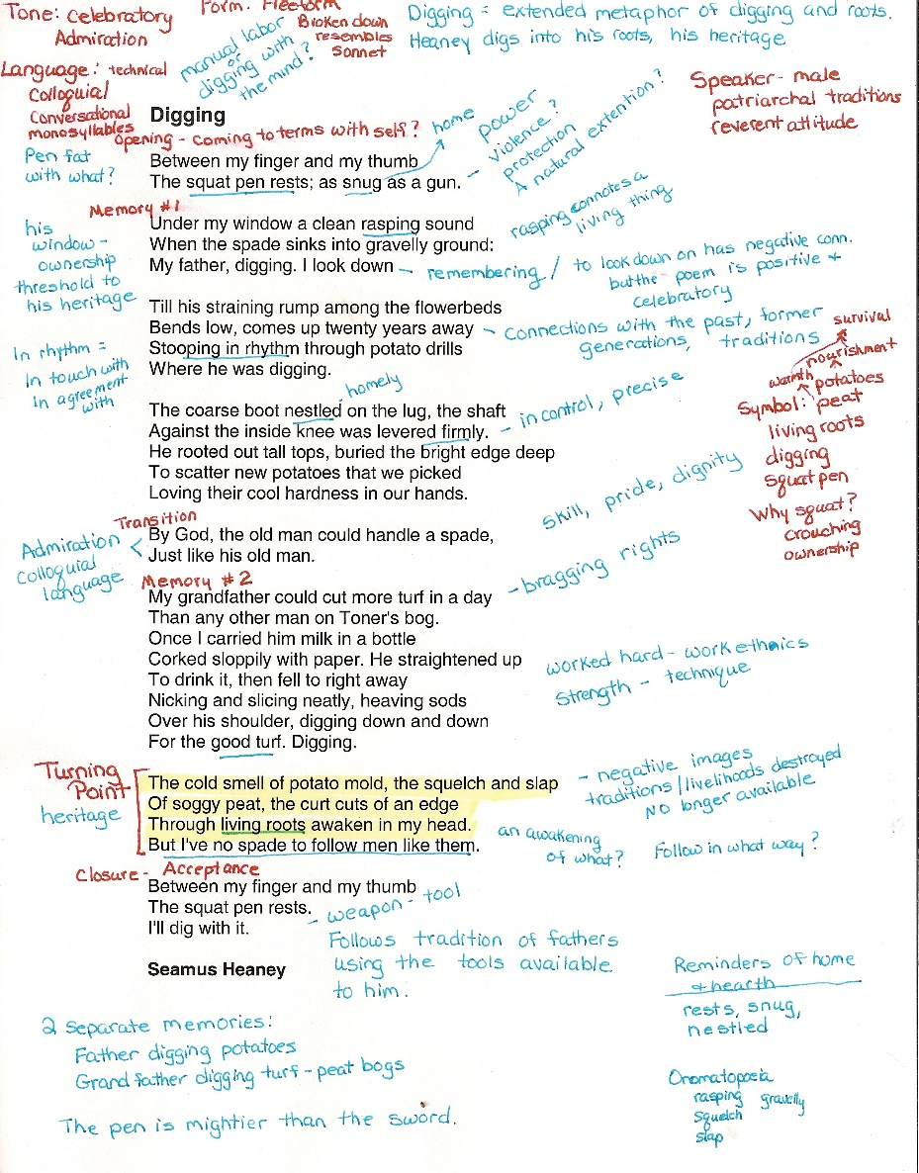
STAGE 3…10 MINUTES
Can you remember what good annotations look like?
NOW IT’S TIME TO ANNOTATE YOUR POEM USING YOUR NOTES. THE ONLY FEEDBACK WE WILL HEAR WILL BE FROM YOU SO MAKE SURE YOU FIND LOTS OF IDEAS (HOWEVER SMALL).
I WILL NOT BE ‘TEACHING’ YOU THIS POEM!

Slide 7
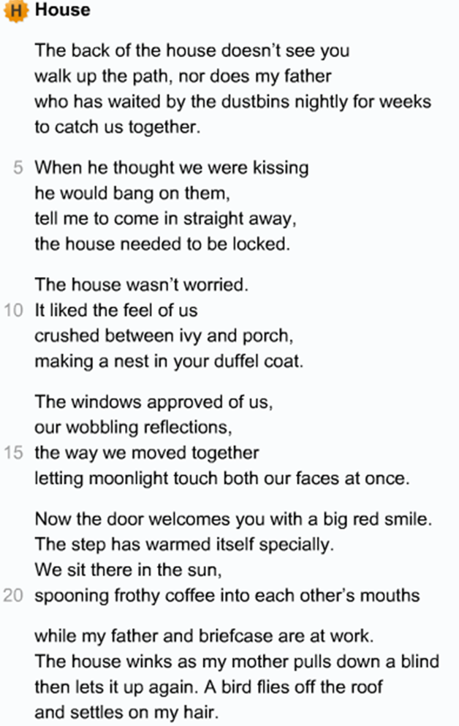
Your Feedback
F
L
I
R
T
S

Slide 8
Considering the Question from the Exam: -
‘What are the poets’ feelings about their house? How are these feelings presented?’
Let’s try and write one structured PETAL paragraph to answer the question.
Write this down
Remembering PETAL paragraphs…
make a Point to respond to the question
use Evidence to support your point
identify the Technique the writer is using
Analyse your chosen evidence by
Linking to the reader and how they will respond to the text.

Slide 9
Writing Poetry
Now it’s your turn! You are going to have a go at writing and illustrating a poem using some of the techniques and ideas we’ve analysed today.
Choose one thing from each column to help you create a poem…
 | SUBJECT | TONE/EMOTION | MAIN TECHNIQUE
1 | Beach | Anger | Personification
2 | River | Sorrow | Simile
3 | Car | Joy | Alliteration
4 | School | Pain | Rhyme
5 | Stadium | Boredom | Onomatopoeia

