Slide 1

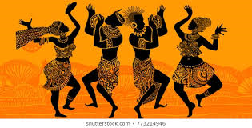
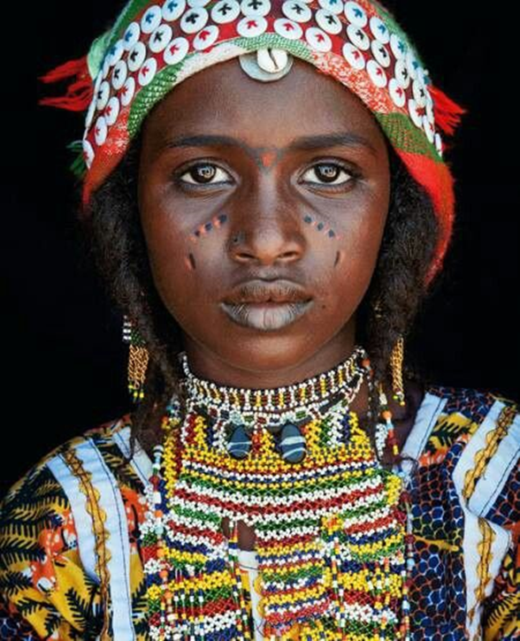
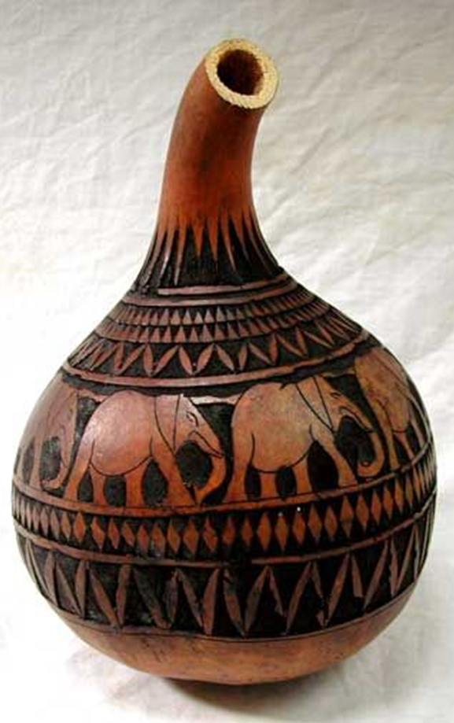



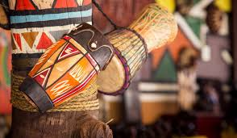
You are to create a mood board using one A4 page of your sketchbook
It should contain primary and secondary images relating to African culture
A title “African Culture”
The page should be full of visual imagery with no big gaps
You then need to use those images to complete a minimum of 5 detailed drawings in both pencil and colour (please try to use as many medias as possible). One page of A4 minimum.
Primary Images – photographs taken or drawings of an object seen by your own eye
Secondary Images – images taken rom magazines or from the internet and drawings produced from these resources.

Slide 2
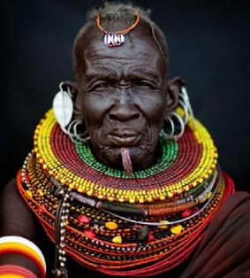
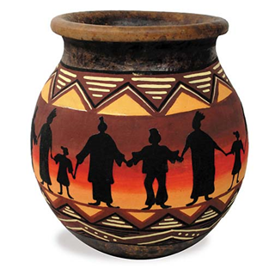
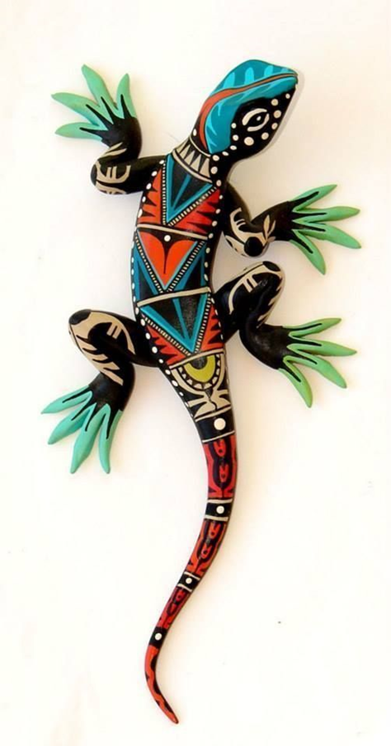
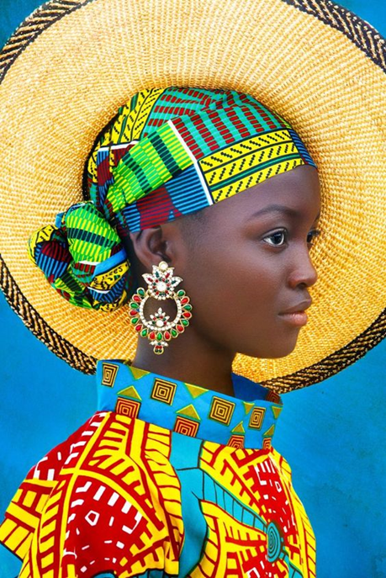
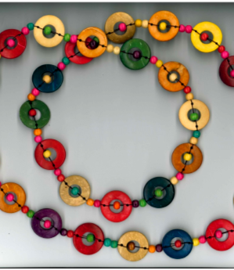
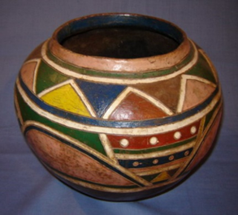
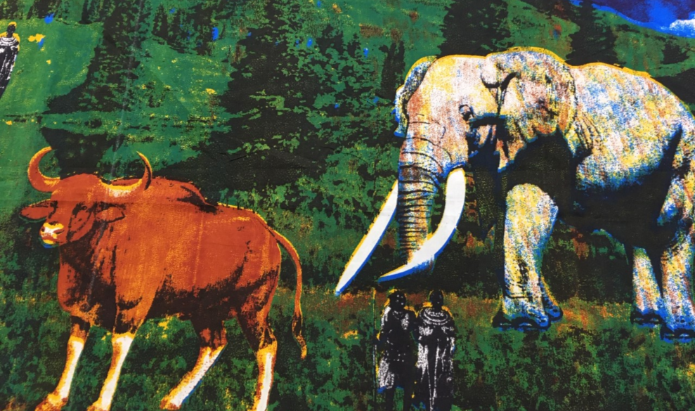
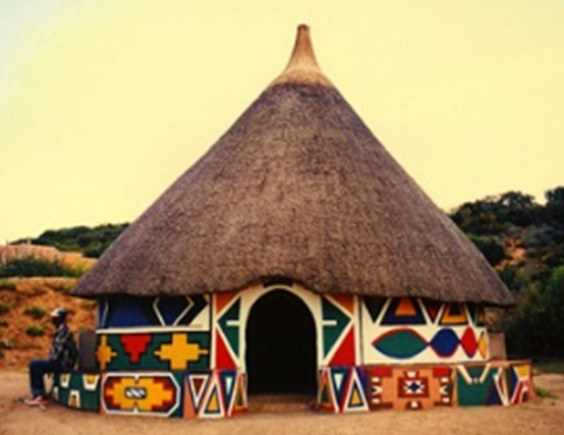

Mood Board

Slide 3
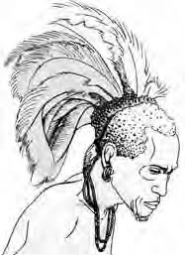
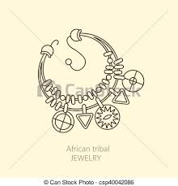
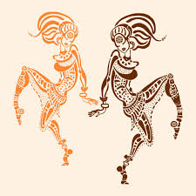
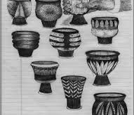
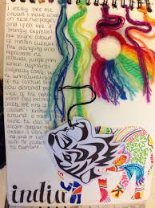
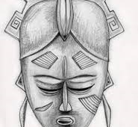
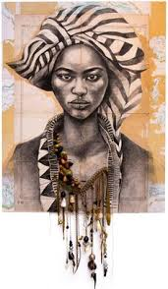
Idea Development
Please annotate your drawings, why did you pick that particular item to draw, what do you like about it and why and how did the drawing/ painting etc go, would you like to develop this image further, if so how might you do this?

Slide 4
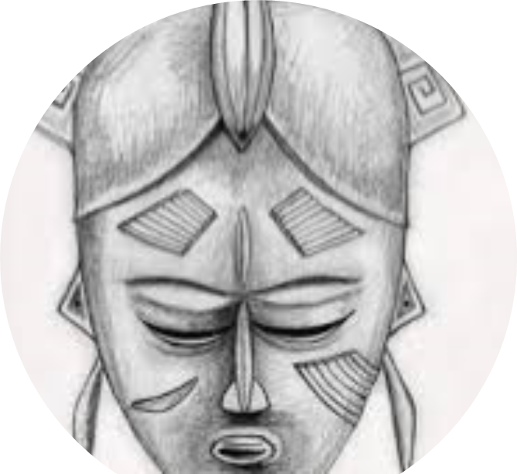
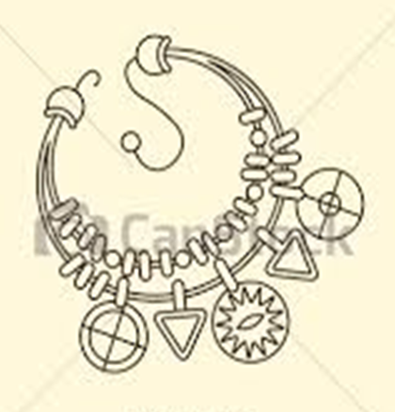
Annotation
1. Please annotate each drawing
Why did you pick that particular item to draw?
What do you like about the drawing?
How did the drawing/ painting etc go, what went well?
5. If you were to develop this image further, how might you do
this? (Adding colour, more detail, pattern/ tone).
Sentence examples
I created this drawing using …(Media Used)…………….
I chose this media because ……(what you feel comfortable using?)….
The most effective part of drawing is …(shape, texture, pattern?)…..
I have used effective ……(colour, tone, line?)…… by ..(selecting the appropriate media?)….
If I could do it again I would …(WWW/EBI)………
LINE TONE TEXTURE COLOUR COMPOSITION PATTERN

Slide 5
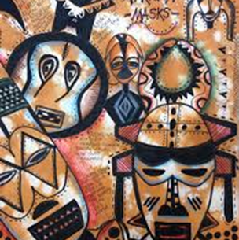
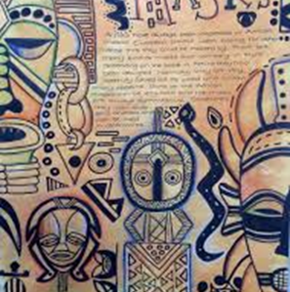
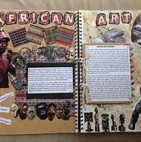
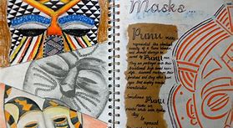
Examples of sketchbook pages, backgrounds and drawn images.
You need to make sure you have included photos, printed images and hand drawn images using both colour and black and white.
2X A4 pages minimum

