Slide 1
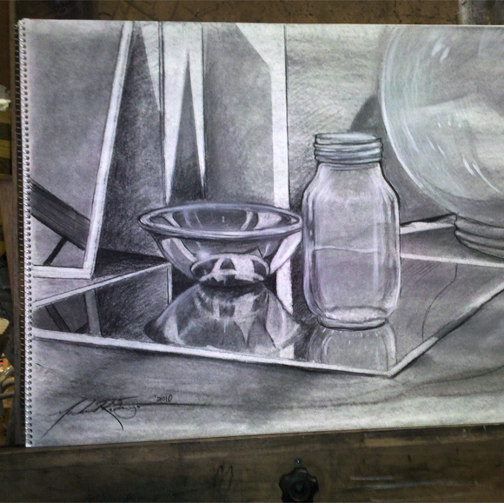
Mirror drawing
For your next task we would like you to complete a drawing of one or more objects stood on a mirror or reflective surface.
We would like you to think carefully about the layout of your objects and what background you might add, if any. For example you could lay out the objects with a background, as with the example given, or you could zoom in more so you are just focussing on the objects and their reflection. Once you have drawn the outline shapes accurately we would then like you to add tone where appropriate. Remember that there will be a great range of light and dark areas so don’t make any of your shading up, keep observing what is in front of you at all times.
If you have any problems with this work please email your teacher. Have fun!

