Slide 1


The PiXL Club The PiXL Club The PiXL Club The PiXL Club The PiXL Club The PiXL Club The PiXL Club The PiXL Club The PiXL Club The PiXL Club The PiXL Club The PiXL Club The PiXL Club The PiXL Club The PiXL Club The PiXL Club The PiXL Club The PiXL Club The PiXL Club The PiXL Club The PiXL Club The PiXL Club The PiXL Club The PiXL Club The PiXL Club The PiXL Club The PiXL Club The PiXL Club The PiXL Club The PiXL Club The PiXL Club The PiXL Club The PiXL Club The PiXL Club The PiXL Club The PiXL Club The PiXL Club The PiXL Club The PiXL Club The PiXL Club The PiXL Club The PiXL Club The PiXL Club The PiXL Club The PiXL Club XL Club The PiXL Club The PiXL Club The PiXL Club The PiXL Club The PiXL Club The PiXL Club The PiXL Club The PiXL Club The PiXL Club The PiXL Club The PiXL Club The PiXL Club The PiXL Club The PiXL Club The PiXL Club The PiXL Club The PiXL Club The PiXL Club The PiXL Club The PiXL Club The PiXL Club The PiXL Club The PiXL Club The PiXL Club The PiXL Club The PiXL Club The PiXL Club The PiXL Club The PiXL Club The PiXL Club The PiXL Club The PiXL Club The PiXL Club The PiXL Club The PiXL Club The PiXL Club The PiXL Club The PiXL Club The PiXL Club The PiXL Club The PiXL Club The PiXL Club The PiXL Club The PiXL Club The PiXL Club The PiXL Club The PiXL Club The PiXL Club The PiXL Club The PiXL Club The PiXL Club The PiXL Club The PiXL Club The PiXL Club The PiXL Club The PiXL Club The PiXL Club The PiXL Club The PiXL Club The PiXL Club The PiXL Club The PiXL Club The PiXL Club The PiXL Club The PiXL Club The PiXL Club The PiXL Club The PiXL Club The PiXL Club The PiXL Club The PiXL Club The PiXL Club The PiXL Club The PiXL Club The PiXL Club The PiXL Club The PiXL Club The PiXL Club The PiXL Club The PiXL Club The PiXL Club The PiXL Club The PiXL Club The PiXL Club The PiXL Club The PiXL Club The PiXL Club The PiXL Club The PiXL Club The PiXL Club The PiXL Club The PiXL Club The PiXL Club The PiXL Club The PiXL Club The PiXL Club The PiXL Club The PiXL Club The PiXL Club The PiXL Club The PiXL Club The PiXL Club The PiXL Club The PiXL Club The PiXL Club The PiXL Club The PiXL Club The PiXL Club The PiXL Club The PiXL Club The PiXL Club The PiXL Club The PiXL Club The PiXL Club The PiXL Club The PiXL Club The PiXL Club The PiXL Club The PiXL Club The PiXL Club The PiXL Club The PiXL Club The PiXL Club The PiXL Club The PiXL Club The PiXL Club The PiXL Club The PiXL Club The PiXL Club The PiXL Club The PiXL Club The PiXL Club The PiXL Club The PiXL Club The PiXL Club The PiXL Club The PiXL Club The PiXL Club The PiXL Club The PiXL Club The PiXL Club The PiXL Club The PiXL Club The PiXL Club The PiXL Club The PiXL Club The PiXL Club The PiXL Club The PiXL Club The PiXL Club The PiXL Club The PiXL Club The PiXL Club The PiXL Club The PiXL Club The PiXL Club The PiXL Club The PiXL Club The PiXL Club The PiXL Club The PiXL Club The PiXL Club The PiXL Club The PiXL Club The PiXL Club The PiXL Club The PiXL Club The PiXL Club The PiXL Club The PiXL Club The PiXL Club The PiXL Club The PiXL Club The PiXL Club The PiXL Club The PiXL Club The PiXL Club The PiXL Club The PiXL Club The PiXL Club The PiXL Club The PiXL Club The PiXL Club The PiXL Club The PiXL Club The PiXL Club The PiXL Club The PiXL Club The PiXL Club The PiXL Club The PiXL Club The PiXL Club The PiXL Club The PiXL Club The PiXL Club The PiXL Club The PiXL Club The PiXL Club The PiXL Club The PiXL Club The PiXL Club The PiXL Club The PiXL Club The PiXL Club The PiXL Club The PiXL Club The PiXL Club The PiXL Club The PiXL Club The PiXL Club The PiXL Club The PiXL Club The PiXL Club The PiXL Club The PiXL Club The PiXL Club The PiXL Club The PiXL Club The PiXL Club The PiXL Club The PiXL Club The PiXL Club The PiXL Club The PiXL Club The PiXL Club The PiXL Club The PiXL Club The PiXL Club The PiXL Club The PiXL Club The PiXL Club The PiXL Club The PiXL Club The PiXL Club The PiXL Club The PiXL Club The PiXL Club The PiXL Club The PiXL Club The PiXL Club The PiXL Club The PiXL Club The PiXL Club The PiXL Club The PiXL Club The PiXL Club The PiXL Club The PiXL Club The PiXL Club The PiXL Club The PiXL Club The PiXL Club The PiXL Club The PiXL Club The PiXL Club The PiXL Club The PiXL Club The PiXL Club The PiXL Club The PiXL Club The PiXL Club The PiXL Club The PiXL Club The PiXL Club The PiXL Club The PiXL Club The PiXL Club The PiXL Club The PiXL Club The PiXL Club The PiXL Club The PiXL Club The PiXL Club The PiXL Club The PiXL Club The PiXL Club The PiXL Club The PiXL Club The PiXL Club The PiXL Club The PiXL Club The PiXL Club The PiXL Club The PiXL Club The PiXL Club The PiXL Club The PiXL Club The PiXL Club The PiXL Club The PiXL Club The PiXL Club The PiXL Club The PiXL Club The PiXL Club The PiXL Club The PiXL Club The PiXL Club The PiXL Club The PiXL Club The PiXL Club The PiXL Club The PiXL Club The PiXL Club The PiXL Club The PiXL Club The PiXL Club The PiXL Club The PiXL Club The PiXL Club The PiXL Club The PiXL Club The PiXL Club The PiXL Club The PiXL Club The PiXL Club The PiXL Club The PiXL Club The PiXL Club The PiXL Club The PiXL Club The PiXL Club The PiXL Club The PiXL Club The PiXL Club The PiXL Club The PiXL Club The PiXL Club The PiXL Club The PiXL Club The PiXL Club The PiXL Club The PiXL Club The PiXL Club The PiXL Club The PiXL Club The PiXL Club The PiXL Club The PiXL Club The PiXL Club The PiXL Club The PiXL Club The PiXL Club The PiXL Club The PiXL Club The PiXL Club The PiXL Club The PiXL Club The PiXL Club The PiXL Club The PiXL Club The PiXL Club The PiXL Club The PiXL Club The PiXL Club The PiXL Club The PiXL Club The PiXL Club The PiXL Club The PiXL Club The PiXL Club The PiXL Club The PiXL Club The PiXL Club The PiXL Club The PiXL Club The PiXL Club The PiXL Club The PiXL Club The PiXL Club The PiXL Club The PiXL Club The PiXL Club The PiXL Club The PiXL Club The PiXL Club The PiXL Club The PiXL Club The PiXL Club The PiXL Club The PiXL Club The PiXL Club The PiXL Club The PiXL Club The PiXL Club The PiXL Club The PiXL Club The PiXL Club The PiXL Club The PiXL Club The PiXL Club The PiXL Club The PiXL Club The PiXL Club The PiXL Club The PiXL Club The PiXL Club The PiXL Club The PiXL Club The PiXL Club The PiXL Club The PiXL Club The PiXL Club The PiXL Club The PiXL Club The PiXL Club The PiXL Club The PiXL Club The PiXL Club The PiXL Club The PiXL Club The PiXL Club The PiXL Club The PiXL Club The PiXL Club The PiXL Club The PiXL Club The PiXL Club The PiXL Club The PiXL Club The PiXL Club The PiXL Club The PiXL Club The PiXL Club The PiXL Club The PiXL Club The PiXL Club The PiXL Club The PiXL Club The PiXL Club The PiXL Club The PiXL Club The PiXL Club The PiXL Club The PiXL Club The PiXL Club The PiXL Club The PiXL Club The PiXL Club The PiXL Club The PiXL Club The PiXL Club The PiXL Club The PiXL Club The PiXL Club The PiXL Club The PiXL Club The PiXL Club The PiXL Club The PiXL Club The PiXL Club The PiXL Club The PiXL Club The PiXL Club The PiXL Club The PiXL Club The PiXL Club The PiXL Club The PiXL Club The PiXL Club The PiXL Club The PiXL Club The PiXL Club The PiXL Club The PiXL Club The PiXL Club The PiXL Club The PiXL Club The PiXL Club The PiXL Club The PiXL Club The PiXL Club The PiXL Club The PiXL Club The PiXL Club The PiXL Club The PiXL Club The PiXL Club The PiXL Club The PiXL Club The PiXL Club The PiXL Club The PiXL Club The PiXL Club The PiXL Club The PiXL Club The PiXL Club The PiXL Club The PiXL Club The PiXL Club The PiXL Club The PiXL Club The PiXL Club The PiXL Club The PiXL Club The PiXL Club The PiXL Club The PiXL Club The PiXL Club The PiXL Club The PiXL Club The PiXL Club The PiXL Club The PiXL Club The PiXL Club The PiXL Club The PiXL Club The PiXL Club The PiXL Club The PiXL Club The PiXL Club The PiXL Club The PiXL Club The PiXL Club The PiXL Club The PiXL Club The PiXL Club The PiXL Club The PiXL Club The PiXL Club The PiXL Club The PiXL Club The PiXL Club The PiXL Club The PiXL Club The PiXL Club The PiXL Club The PiXL Club The PiXL Club The PiXL Club The PiXL Club The PiXL Club The PiXL Club The PiXL Club The PiXL Club The PiXL Club The PiXL Club The PiXL Club The PiXL Club The PiXL Club The PiXL Club The PiXL Club The PiXL Club The PiXL Club The PiXL Club The PiXL Club The PiXL Club The PiXL Club The PiXL Club The PiXL Club The PiXL Club The PiXL Club The PiXL Club The PiXL Club The PiXL Club The PiXL Club The PiXL Club The PiXL Club The PiXL Club The PiXL Club The PiXL Club The PiXL Club The PiXL Club The PiXL Club The PiXL Club The PiXL Club The PiXL Club The PiXL Club The PiXL Club The PiXL Club The PiXL Club The PiXL Club The PiXL Club The PiXL Club The PiXL Club The PiXL Club The PiXL Club The PiXL Club The PiXL Club The PiXL Club The PiXL Club The PiXL Club The PiXL Club The PiXL Club The PiXL Club The PiXL Club The PiXL Club The PiXL Club The PiXL Club The PiXL Club The PiXL Club The PiXL Club The PiXL Club The PiXL Club The PiXL Club The PiXL Club The PiXL Club The PiXL Club The PiXL Club The PiXL Club The PiXL Club The PiXL Club The PiXL Club The PiXL Club The PiXL Club The PiXL Club The PiXL Club The PiXL Club The PiXL Club The PiXL Club The PiXL Club The PiXL Club The PiXL Club The PiXL Club The PiXL Club The PiXL Club The PiXL Club The PiXL Club The PiXL Club The PiXL Club The PiXL Club The PiXL Club The PiXL Club The PiXL Club The PiXL Club The PiXL Club The PiXL Club The PiXL Club The PiXL Club The PiXL Club The PiXL Club The PiXL Club The PiXL Club The PiXL Club The PiXL Club The PiXL Club The PiXL Club The PiXL Club The PiXL Club The PiXL Club The PiXL Club The PiXL Club The PiXL Club The PiXL Club The PiXL Club The PiXL Club The PiXL Club The PiXL Club The PiXL Club The PiXL Club The PiXL Club The PiXL Club The PiXL Club The PiXL Club The PiXL Club The PiXL Club The PiXL Club The PiXL Club The PiXL Club The PiXL Club The PiXL Club The PiXL Club The PiXL Club The PiXL Club The PiXL Club The PiXL Club The PiXL Club The PiXL Club The PiXL Club The PiXL Club The PiXL Club The PiXL Club The PiXL Club The PiXL Club The PiXL Club The PiXL Club The PiXL Club The PiXL Club The PiXL Club The PiXL Club The PiXL Club The PiXL Club The PiXL Club The PiXL Club The PiXL Club The PiXL Club The PiXL Club The PiXL Club The PiXL Club The PiXL Club The PiXL Club The PiXL Club The PiXL Club The PiXL Club The PiXL Club The PiXL Club The PiXL Club The PiXL Club The PiXL Club The PiXL Club The PiXL Club
PiXL KnowIT!
GCSE Physics
Edexcel Energy – Forces doing work
© Copyright The PiXL Club Ltd, 2017
This resource is strictly for the use of member schools for as long as they remain members of The PiXL Club. It may not be copied, sold nor transferred to a third party or used by the school after membership ceases. Until such time it may be freely used within the member school.
All opinions and contributions are those of the authors. The contents of this resource are not connected with nor endorsed by any other company, organisation or institution.
www.pixl.org.uk The PiXL Club Ltd, Company number 07321607

Slide 2
Overview
Edexcel Topic 7
  Energy – Forces doing work
  Part 1
  Work done
  GPE and KE
  Part 2
  Power
  Efficiency

Slide 3
LearnIT!
KnowIT!
Part 1
Work done
GPE and KE

Slide 4
Work Done and Energy Transfer
Work Done
When a force causes an object to move through a distance, WORK IS DONE on the object. So a force does work on an object when the force causes a displacement of the object.
Work done can be calculated using the equation:
work done (J) = force (N) x distance moved in the direction of the force (m)
E= F x d
Note: Energy transferred (joule, J) is equal to work done (joule, J)

Slide 5
Work Done and Energy Transfer
Work Done Calculations
A box is pushed 3 m across the floor with a force of 120 N.
Work out the work done in moving the box.
Solution
Equation: work done = force x distance travelled
Substitution: work done = 120 x 3
Work done = 360 J
Click to reveal answer

Slide 6
Work Done and Energy Transfer
Work Done Calculations
A man with a mass of 70 kg gets onto a moving escalator.
The escalator moves 15 m horizontally and 8 m vertically.
Calculate the work done by the motor against gravity.
Take g = 10 N/kg.
Solution
Gravity acts downwards, so the distance moved against gravity is 8 m.
Since W = mg; the weight of the man is 700 N.
Using: work done = force x distance travelled
work done = 700 x 8
work done = 5600 J
Click to reveal answer

Slide 7
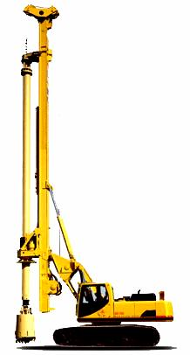
Gravitational potential energy
When an object is raised above ground level it gains gravitational potential energy (GPE). This stored energy can be released if the object is allowed to fall.
A pile driver is a machine that lifts a heavy weight then drops it on a post to drive it into the ground.
Recall and use the equation to calculate the change in
gravitational PE when an object is raised above the ground:
change in G.P.E (J) = mass (kg) × gravitational field strength (N/kg) × change in height (m)
ΔGPE = m× g ×Δh
The pile driver hammer has a mass of 120 kg and it is raised to a height of 4 m above the ground. How much G.P.E will it have?
ΔGPE = m× g ×Δh
ΔGPE = 120 x 10 x 4
The G.P.E gained is: ΔGPE = 4800 J
From topic 3
Click to reveal answer

Slide 8
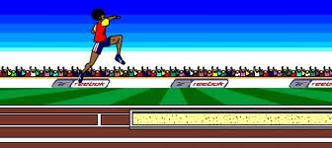
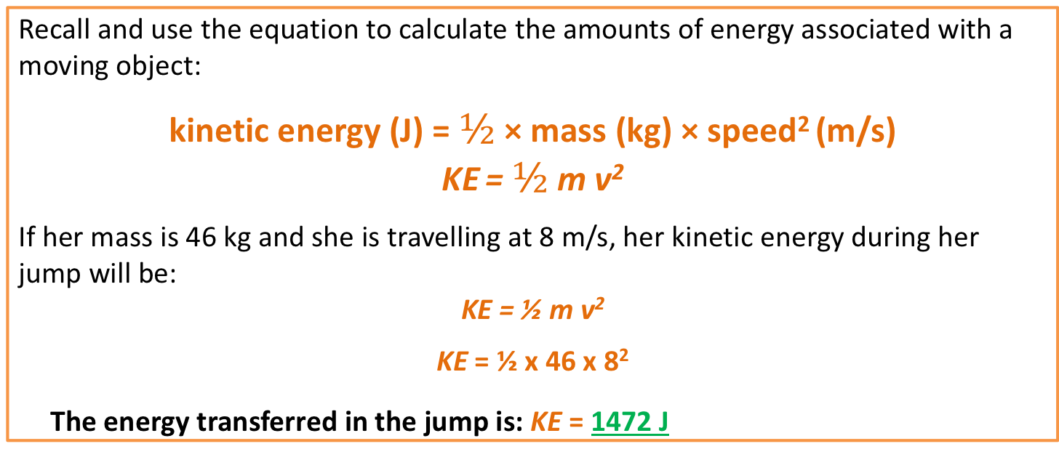
Kinetic Energy
Moving objects have kinetic energy.
The long-jumper is using her kinetic energy to
carry her body as far as possible. The more
kinetic energy she has, the longer her jump will
be. Her kinetic energy depends on her mass
(which she can not change) and her velocity (she can run faster!).
Recall and use the equation to calculate the amounts of energy associated with a moving object:
kinetic energy (J) = $½$ × mass (kg) × speed² (m/s)
KE = $½$ m v²
If her mass is 46 kg and she is travelling at 8 m/s, her kinetic energy during her jump will be:
KE = ½ m v²
KE = ½ x 46 x 8²
The energy transferred in the jump is: KE = 1472 J
From topic 3
Click to reveal answer

Slide 9
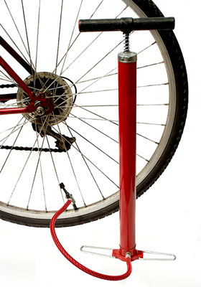
Work Done and Energy Transfer
Work Done Against Frictional Forces
When work is done against frictional forces on an object there is a temperature increase of the object.
A bicycle pump gets hot in use as work is done in compressing the gas, causing the pump to get hotter.

Slide 10
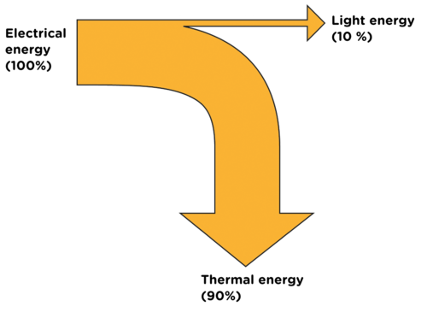
  Energy transfers in a system
Energy can be stored, transferred or dissipated - but can not be created or destroyed.
In a closed energy system there can be transfer of energy but not mass. There is no change to the total energy in the system.
No mass change
In a closed energy system all the energy can be accounted for even when energy stores change.
Closed
Energy
system
E in
E out
The diagram shows the energy transfer for a light
bulb. All the electrical energy store can be accounted
for as light energy and thermal energy.
The thermal energy is not useful in this case and can be
considered to be dissipated or “waste” energy.
From topic 3

Slide 11

  Energy transfers in a system
Unwanted energy transfers result in energy stores that are not useful.
The F1 car below shows that eventually all the chemical energy (fuel) put in the car ends up as unwanted thermal energy which is dissipated to the surroundings. Unwanted energy is often described as being ‘wasted’
Kinetic energy is dissipated by the tyres, brakes and air resistance to become unwanted thermal energy stores.
Sound energy is absorbed by materials and becomes thermal energy.
Thermal energy is produced by the engine as fuel is burnt.
Oil is used in the engine, gearbox and other moving parts as a lubricant to reduce friction and reduce unwanted thermal energy in these parts.
Kinetic
Thermal
Chemical
Sound
Thermal
Thermal
From topic 3

Slide 12
QuestionIT!
Part 1
Work done
GPE and KE

Slide 13
Part 1 - QuestionIT
A piano is pushed across a wooden floor with a force of 2500 N. The piano moves a distance of 3.5 m. Calculate the work done moving the piano.
Work done is usually measured in joules. An alternative unit for work done is (circle the correct answer).
kg/m³ Nm W N/m2 N/kg
Why does a bicycle pump get hotter when used to pump up a tyre?

Slide 14
Part 1 - QuestionIT
A box with a weight of 120 N is lifted up 1.8 m onto a shelf. Calculate the work done in lifting the box.
When a book is lifted 3 m the work done on the book is 1.2 J. Calculate the weight of the book.

Slide 15
  Part 1– QuestionIT
6. Javier Sotomayor is the current men's record holder with a jump of
2.45 m His mass is 82 kg.
(g = 10N/kg)
a. What type of stored energy does he have
as he clears the bar?
b. Work out how much stored energy Javier Sotomayor has due to
his position above the ground.
c. As he falls back to the ground, this energy store will be
transferred into a new energy store. Name this new energy store.

Slide 16
  Part 1– QuestionIT
7. When a tennis ball is hit with a racket it gains kinetic energy.
a. What is the formula used to calculate kinetic energy?
b. The tennis ball has a mass of 56 g and hit has a velocity
of 48 m/s. Work out the kinetic energy of the moving ball?

Slide 17
  Part 1 - QuestionIT
8. Describe how the thermal energy applying the brakes on a bike while riding along a road is dissipated.
a. The diagram shows the main energy transfers for an electric kettle. Complete boxes A to D showing the energy stores involved. Use the size of the arrows to help you.
B
A
C
D
b. State why the total energy supplied to an electric kettle must always equal the total

Slide 18

AnswerIT!
Part 1
Work done
GPE and KE

Slide 19
  Part 1– AnswerIT
A piano is pushed across a wooden floor with a force of 2500 N.
The piano moves a distance of 3.5 m.
Work out the work done moving the piano.
Using E = F x d
Work done = 2500 x 3.5
Work done = 8750 J
2. Work done is usually measured in joules. An alternative unit for
work done is (circle the correct answer).
kg/m³ Nm W N/m2 N/kg
3. Why does a bicycle pump get hot when used to pump up a tyre?
Work is done in compressing the air
Causing the molecules to increase the frequency of their collisions
Causing frictional heating and an increase in the temperature.

Slide 20
  Part 1– AnswerIT
A box with a weight of 120 N is lifted up 1.8 m onto a shelf.
Calculate the work done in lifting the box.
Using
  Work done = force x distance travelled
Work done = 120 x 1.8
Work done = 216 J
When a book is lifted 3 m the work done on the book is 12.6 J.
Calculate the weight of the book.
Using
  Work done = force x distance travelled
Rearranging gives
Force = work done / distance
Substitution gives
Force = 12.6 / 3
Answer
Force = 4.2 N

Slide 21
  Part 1– AnswerIT
6. Javier Sotomayor is the current men's record holder with a jump of
2.45 m His mass is 82 kg.
(g = 10N/kg)
a. What type of stored energy does he have
as he clears the bar?
gravitational potential energy
b. Work out how much stored energy Javier Sotomayor has due to
his position above the ground.
ΔGPE = m× g ×Δh = 82 x 10 x 2.45 = 2009 J
c. As he falls back to the ground, this energy store will be
transferred into a new energy store. Name this new energy store.
kinetic energy

Slide 22
  Part 1– AnswerIT
7. When a tennis ball is hit with a racket it gains kinetic energy.
a. What is the formula used to calculate kinetic energy?
KE = ½ m v²
b. The tennis ball has a mass of 56 g and hit has a velocity
of 48 m/s. Work out the kinetic energy of the moving ball?
Convert 56 g into kg = 0.056 kg
KE = ½ x 0.056 x 48²
KE = 64.52 J

Slide 23
  Part 1 - AnswerIT
8. Describe how the thermal energy applying the brakes on a bike while riding along a road is dissipated.
The friction between the brake block and bike wheel transfer thermal energy to the air particles surrounding them
a. The diagram shows the main energy transfers for an electric kettle. Complete boxes A to D showing the energy stores involved. Use the size of the arrows to help you.
B
A - Electrical energy
B - Sound energy
C - Thermal energy to heat the water
D - Thermal energy to heat the surroundings
A
C
D
b. State why the total energy supplied to an electric kettle must always equal the total energy transferred by the electric kettle.
Energy can not be created or destroyed so:
total energy in = total energy out

Slide 24
LearnIT!
KnowIT!
Part 2
Power
Efficiency

Slide 25
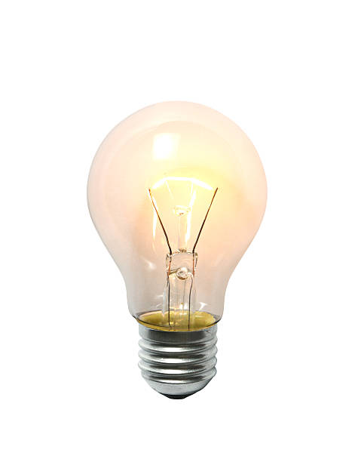
Power
Power - the rate at which energy is transferred
the rate at which work is done (rate means “how quickly”)
Power is measured in joules per second 1 J/s = 1 Watt
An object which transfers energy does so at a certain rate.
The metal filament in this light bulb transfers the
electrical energy store into heat and light.
This bulb transfers 2400 joules of energy in 60 seconds.
Power can be calculated using the following equation:
power (W) = work done (J)
P = E
time taken (s)
From topic 3
P= 2400 / 60 = 40 J/s
So this is a 40 Watt light bulb.
t
Click to reveal answer

Slide 26
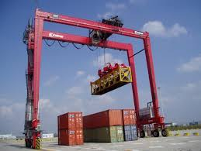
Power
Power - the rate at which energy is transferred
the rate at which work is done (rate means “how quickly”)
Mechanical power
Power = work done / time
The crane lifts the 2000 kg container through a height of 5.4m in 30s.
The power of the crane is:
Power = work done / time But: Work done = force x distance
= 20 000 N x 5.4 m = 108 000 J
Power = 108 000 J / 30 s
The Power of the crane is 3600 J/s or 3600 Watts
From topic 3

Slide 27
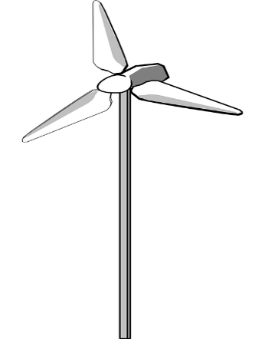
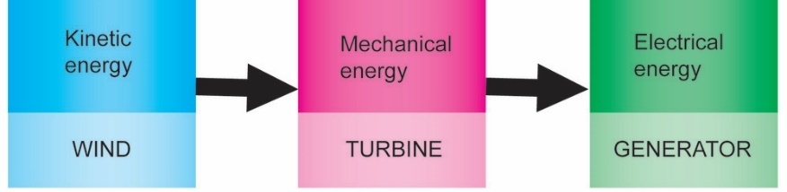
  Efficiency
The amount of useful energy you get from an energy transfer, compared to the energy put in, is called the EFFICIENCY
This calculation will result in a decimal value which can be multiplied by 100 to give a percentage efficiency.
Efficiency = (useful energy transferred by the device)
(total energy supplied to the device)
A wind turbine energy transfer
The wind turbine produces 120 MW of electrical energy for every 500 MW of kinetic energy provided by the wind.
Efficiency = (useful energy transferred by the device)
(total energy supplied to the device)
= 120 = 0.24 efficient
500
or 0.24 x 100 = 24 % efficient
Click to reveal answer
Click to reveal answer

Slide 28
QuestionIT!
Part 2
Power
Efficiency

Slide 29
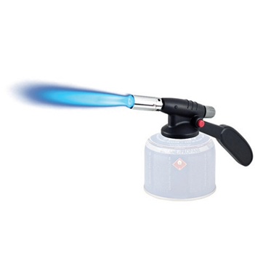
  Part 2 – QuestionIT
1. Give two alternative units of power?
2. A blowtorch burns butane gas to heat metal pipes.
a. Describe the energy transfers which occur as it is used.
………….. energy is transferred into
.…………. energy usefully and
………….. energy is wasted.
b. Explain how some of the transferred energy
is wasted.
c. The blowtorch transfers 2 kJ of energy in 4 mins. Work out the
power of the blowtorch?

Slide 30
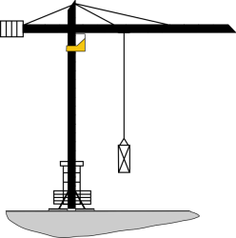
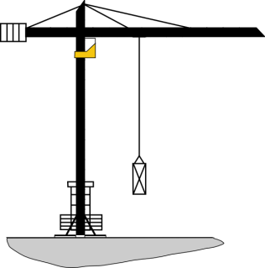
  Part 2 – QuestionIT
3. Two cranes are lifting the same load of 120 kg to a height of 15 m.
Crane A
Crane B
Crane A takes 30 s to lift the load. Crane B lifts the same load in 9 s.
Calculate the difference in power of the two cranes.

Slide 31
  Part 2 - QuestionIT
4. The diagram represents the energy store transfers when a motor is lifting a weight.
How much electrical energy is transferred to a thermal energy store?
What is the total amount of dissipated energy?
c. Calculate the efficiency the of the useful energy transfer

Slide 32
AnswerIT!
Part 2
Power
Efficiency

Slide 33
  Part 2 – AnswerIT
1. Give two alternative units of power?
Joules/second or Watts
2. A blowtorch burns butane gas to heat metal pipes.
a. Describe the energy transfers which occur as it is used.
Chemical energy is transferred into
thermal energy usefully and
light energy is wasted.
b. Explain how some of the transferred energy
is wasted.
As thermal energy to the environment
c. The blowtorch transfers 2 kJ of energy in 4 mins. Work out the
power of the blowtorch?
Power = work done / time taken = 2000 / 240
Power of the blowtorch = 8.33Watts

Slide 34
  Part 2 – AnswerIT
3. Two cranes are lifting the same load of 120 kg to a height of 15 m.
Crane A
Crane B
Crane A takes 30 s to lift the load. Crane B lifts the same load in 9 s.
Calculate the difference in power of the two cranes.
Crane A power = 1200 x 15 / 30 = 600 W
Crane B power = 1200 x 15 / 9 = 2000W
Difference in power = 2000 – 600 = 1400 Watts

Slide 35
  Part 2 - AnswerIT
4. The diagram represents the energy store transfers when a motor is lifting a weight.
How much electrical energy is transferred to a thermal energy store?
340 – (100 + 80) = 160 J
What is the total amount of dissipated energy?
160 + 80 = 240 J
c. Calculate the efficiency the of the useful energy transfer
Efficiency = (useful energy transferred by the device) = 100 = 0.294
(total energy supplied to the device) 340

