Slide 1


The PiXL Club The PiXL Club The PiXL Club The PiXL Club The PiXL Club The PiXL Club The PiXL Club The PiXL Club The PiXL Club The PiXL Club The PiXL Club The PiXL Club The PiXL Club The PiXL Club The PiXL Club The PiXL Club The PiXL Club The PiXL Club The PiXL Club The PiXL Club The PiXL Club The PiXL Club The PiXL Club The PiXL Club The PiXL Club The PiXL Club The PiXL Club The PiXL Club The PiXL Club The PiXL Club The PiXL Club The PiXL Club The PiXL Club The PiXL Club The PiXL Club The PiXL Club The PiXL Club The PiXL Club The PiXL Club The PiXL Club The PiXL Club The PiXL Club The PiXL Club The PiXL Club The PiXL Club XL Club The PiXL Club The PiXL Club The PiXL Club The PiXL Club The PiXL Club The PiXL Club The PiXL Club The PiXL Club The PiXL Club The PiXL Club The PiXL Club The PiXL Club The PiXL Club The PiXL Club The PiXL Club The PiXL Club The PiXL Club The PiXL Club The PiXL Club The PiXL Club The PiXL Club The PiXL Club The PiXL Club The PiXL Club The PiXL Club The PiXL Club The PiXL Club The PiXL Club The PiXL Club The PiXL Club The PiXL Club The PiXL Club The PiXL Club The PiXL Club The PiXL Club The PiXL Club The PiXL Club The PiXL Club The PiXL Club The PiXL Club The PiXL Club The PiXL Club The PiXL Club The PiXL Club The PiXL Club The PiXL Club The PiXL Club The PiXL Club The PiXL Club The PiXL Club The PiXL Club The PiXL Club The PiXL Club The PiXL Club The PiXL Club The PiXL Club The PiXL Club The PiXL Club The PiXL Club The PiXL Club The PiXL Club The PiXL Club The PiXL Club The PiXL Club The PiXL Club The PiXL Club The PiXL Club The PiXL Club The PiXL Club The PiXL Club The PiXL Club The PiXL Club The PiXL Club The PiXL Club The PiXL Club The PiXL Club The PiXL Club The PiXL Club The PiXL Club The PiXL Club The PiXL Club The PiXL Club The PiXL Club The PiXL Club The PiXL Club The PiXL Club The PiXL Club The PiXL Club The PiXL Club The PiXL Club The PiXL Club The PiXL Club The PiXL Club The PiXL Club The PiXL Club The PiXL Club The PiXL Club The PiXL Club The PiXL Club The PiXL Club The PiXL Club The PiXL Club The PiXL Club The PiXL Club The PiXL Club The PiXL Club The PiXL Club The PiXL Club The PiXL Club The PiXL Club The PiXL Club The PiXL Club The PiXL Club The PiXL Club The PiXL Club The PiXL Club The PiXL Club The PiXL Club The PiXL Club The PiXL Club The PiXL Club The PiXL Club The PiXL Club The PiXL Club The PiXL Club The PiXL Club The PiXL Club The PiXL Club The PiXL Club The PiXL Club The PiXL Club The PiXL Club The PiXL Club The PiXL Club The PiXL Club The PiXL Club The PiXL Club The PiXL Club The PiXL Club The PiXL Club The PiXL Club The PiXL Club The PiXL Club The PiXL Club The PiXL Club The PiXL Club The PiXL Club The PiXL Club The PiXL Club The PiXL Club The PiXL Club The PiXL Club The PiXL Club The PiXL Club The PiXL Club The PiXL Club The PiXL Club The PiXL Club The PiXL Club The PiXL Club The PiXL Club The PiXL Club The PiXL Club The PiXL Club The PiXL Club The PiXL Club The PiXL Club The PiXL Club The PiXL Club The PiXL Club The PiXL Club The PiXL Club The PiXL Club The PiXL Club The PiXL Club The PiXL Club The PiXL Club The PiXL Club The PiXL Club The PiXL Club The PiXL Club The PiXL Club The PiXL Club The PiXL Club The PiXL Club The PiXL Club The PiXL Club The PiXL Club The PiXL Club The PiXL Club The PiXL Club The PiXL Club The PiXL Club The PiXL Club The PiXL Club The PiXL Club The PiXL Club The PiXL Club The PiXL Club The PiXL Club The PiXL Club The PiXL Club The PiXL Club The PiXL Club The PiXL Club The PiXL Club The PiXL Club The PiXL Club The PiXL Club The PiXL Club The PiXL Club The PiXL Club The PiXL Club The PiXL Club The PiXL Club The PiXL Club The PiXL Club The PiXL Club The PiXL Club The PiXL Club The PiXL Club The PiXL Club The PiXL Club The PiXL Club The PiXL Club The PiXL Club The PiXL Club The PiXL Club The PiXL Club The PiXL Club The PiXL Club The PiXL Club The PiXL Club The PiXL Club The PiXL Club The PiXL Club The PiXL Club The PiXL Club The PiXL Club The PiXL Club The PiXL Club The PiXL Club The PiXL Club The PiXL Club The PiXL Club The PiXL Club The PiXL Club The PiXL Club The PiXL Club The PiXL Club The PiXL Club The PiXL Club The PiXL Club The PiXL Club The PiXL Club The PiXL Club The PiXL Club The PiXL Club The PiXL Club The PiXL Club The PiXL Club The PiXL Club The PiXL Club The PiXL Club The PiXL Club The PiXL Club The PiXL Club The PiXL Club The PiXL Club The PiXL Club The PiXL Club The PiXL Club The PiXL Club The PiXL Club The PiXL Club The PiXL Club The PiXL Club The PiXL Club The PiXL Club The PiXL Club The PiXL Club The PiXL Club The PiXL Club The PiXL Club The PiXL Club The PiXL Club The PiXL Club The PiXL Club The PiXL Club The PiXL Club The PiXL Club The PiXL Club The PiXL Club The PiXL Club The PiXL Club The PiXL Club The PiXL Club The PiXL Club The PiXL Club The PiXL Club The PiXL Club The PiXL Club The PiXL Club The PiXL Club The PiXL Club The PiXL Club The PiXL Club The PiXL Club The PiXL Club The PiXL Club The PiXL Club The PiXL Club The PiXL Club The PiXL Club The PiXL Club The PiXL Club The PiXL Club The PiXL Club The PiXL Club The PiXL Club The PiXL Club The PiXL Club The PiXL Club The PiXL Club The PiXL Club The PiXL Club The PiXL Club The PiXL Club The PiXL Club The PiXL Club The PiXL Club The PiXL Club The PiXL Club The PiXL Club The PiXL Club The PiXL Club The PiXL Club The PiXL Club The PiXL Club The PiXL Club The PiXL Club The PiXL Club The PiXL Club The PiXL Club The PiXL Club The PiXL Club The PiXL Club The PiXL Club The PiXL Club The PiXL Club The PiXL Club The PiXL Club The PiXL Club The PiXL Club The PiXL Club The PiXL Club The PiXL Club The PiXL Club The PiXL Club The PiXL Club The PiXL Club The PiXL Club The PiXL Club The PiXL Club The PiXL Club The PiXL Club The PiXL Club The PiXL Club The PiXL Club The PiXL Club The PiXL Club The PiXL Club The PiXL Club The PiXL Club The PiXL Club The PiXL Club The PiXL Club The PiXL Club The PiXL Club The PiXL Club The PiXL Club The PiXL Club The PiXL Club The PiXL Club The PiXL Club The PiXL Club The PiXL Club The PiXL Club The PiXL Club The PiXL Club The PiXL Club The PiXL Club The PiXL Club The PiXL Club The PiXL Club The PiXL Club The PiXL Club The PiXL Club The PiXL Club The PiXL Club The PiXL Club The PiXL Club The PiXL Club The PiXL Club The PiXL Club The PiXL Club The PiXL Club The PiXL Club The PiXL Club The PiXL Club The PiXL Club The PiXL Club The PiXL Club The PiXL Club The PiXL Club The PiXL Club The PiXL Club The PiXL Club The PiXL Club The PiXL Club The PiXL Club The PiXL Club The PiXL Club The PiXL Club The PiXL Club The PiXL Club The PiXL Club The PiXL Club The PiXL Club The PiXL Club The PiXL Club The PiXL Club The PiXL Club The PiXL Club The PiXL Club The PiXL Club The PiXL Club The PiXL Club The PiXL Club The PiXL Club The PiXL Club The PiXL Club The PiXL Club The PiXL Club The PiXL Club The PiXL Club The PiXL Club The PiXL Club The PiXL Club The PiXL Club The PiXL Club The PiXL Club The PiXL Club The PiXL Club The PiXL Club The PiXL Club The PiXL Club The PiXL Club The PiXL Club The PiXL Club The PiXL Club The PiXL Club The PiXL Club The PiXL Club The PiXL Club The PiXL Club The PiXL Club The PiXL Club The PiXL Club The PiXL Club The PiXL Club The PiXL Club The PiXL Club The PiXL Club The PiXL Club The PiXL Club The PiXL Club The PiXL Club The PiXL Club The PiXL Club The PiXL Club The PiXL Club The PiXL Club The PiXL Club The PiXL Club The PiXL Club The PiXL Club The PiXL Club The PiXL Club The PiXL Club The PiXL Club The PiXL Club The PiXL Club The PiXL Club The PiXL Club The PiXL Club The PiXL Club The PiXL Club The PiXL Club The PiXL Club The PiXL Club The PiXL Club The PiXL Club The PiXL Club The PiXL Club The PiXL Club The PiXL Club The PiXL Club The PiXL Club The PiXL Club The PiXL Club The PiXL Club The PiXL Club The PiXL Club The PiXL Club The PiXL Club The PiXL Club The PiXL Club The PiXL Club The PiXL Club The PiXL Club The PiXL Club The PiXL Club The PiXL Club The PiXL Club The PiXL Club The PiXL Club The PiXL Club The PiXL Club The PiXL Club The PiXL Club The PiXL Club The PiXL Club The PiXL Club The PiXL Club The PiXL Club The PiXL Club The PiXL Club The PiXL Club The PiXL Club The PiXL Club The PiXL Club The PiXL Club The PiXL Club The PiXL Club The PiXL Club The PiXL Club The PiXL Club The PiXL Club The PiXL Club The PiXL Club The PiXL Club The PiXL Club The PiXL Club The PiXL Club The PiXL Club The PiXL Club The PiXL Club The PiXL Club The PiXL Club The PiXL Club The PiXL Club The PiXL Club The PiXL Club The PiXL Club The PiXL Club The PiXL Club The PiXL Club The PiXL Club The PiXL Club The PiXL Club The PiXL Club The PiXL Club The PiXL Club The PiXL Club The PiXL Club The PiXL Club The PiXL Club The PiXL Club The PiXL Club The PiXL Club The PiXL Club The PiXL Club The PiXL Club The PiXL Club The PiXL Club The PiXL Club The PiXL Club The PiXL Club The PiXL Club The PiXL Club The PiXL Club The PiXL Club The PiXL Club The PiXL Club The PiXL Club The PiXL Club The PiXL Club The PiXL Club The PiXL Club The PiXL Club The PiXL Club The PiXL Club The PiXL Club The PiXL Club The PiXL Club The PiXL Club The PiXL Club The PiXL Club The PiXL Club The PiXL Club The PiXL Club The PiXL Club The PiXL Club The PiXL Club The PiXL Club The PiXL Club The PiXL Club The PiXL Club The PiXL Club The PiXL Club The PiXL Club The PiXL Club The PiXL Club The PiXL Club The PiXL Club The PiXL Club The PiXL Club The PiXL Club The PiXL Club The PiXL Club The PiXL Club The PiXL Club The PiXL Club The PiXL Club The PiXL Club The PiXL Club The PiXL Club The PiXL Club The PiXL Club The PiXL Club The PiXL Club The PiXL Club The PiXL Club The PiXL Club The PiXL Club The PiXL Club The PiXL Club The PiXL Club The PiXL Club The PiXL Club The PiXL Club The PiXL Club The PiXL Club The PiXL Club The PiXL Club The PiXL Club The PiXL Club The PiXL Club The PiXL Club The PiXL Club The PiXL Club The PiXL Club The PiXL Club The PiXL Club The PiXL Club The PiXL Club The PiXL Club The PiXL Club The PiXL Club The PiXL Club The PiXL Club The PiXL Club The PiXL Club The PiXL Club The PiXL Club The PiXL Club The PiXL Club The PiXL Club The PiXL Club The PiXL Club The PiXL Club The PiXL Club The PiXL Club The PiXL Club The PiXL Club The PiXL Club The PiXL Club The PiXL Club The PiXL Club The PiXL Club The PiXL Club The PiXL Club The PiXL Club The PiXL Club The PiXL Club The PiXL Club The PiXL Club The PiXL Club The PiXL Club
PiXL KnowIT!
GCSE Biology
Edexcel Topic – Animal coordination, control and Homeostasis
© Copyright The PiXL Club Ltd, 2017
This resource is strictly for the use of member schools for as long as they remain members of The PiXL Club. It may not be copied, sold nor transferred to a third party or used by the school after membership ceases. Until such time it may be freely used within the member school.
All opinions and contributions are those of the authors. The contents of this resource are not connected with nor endorsed by any other company, organisation or institution.
www.pixl.org.uk The PiXL Club Ltd, Company number 07321607

Slide 2
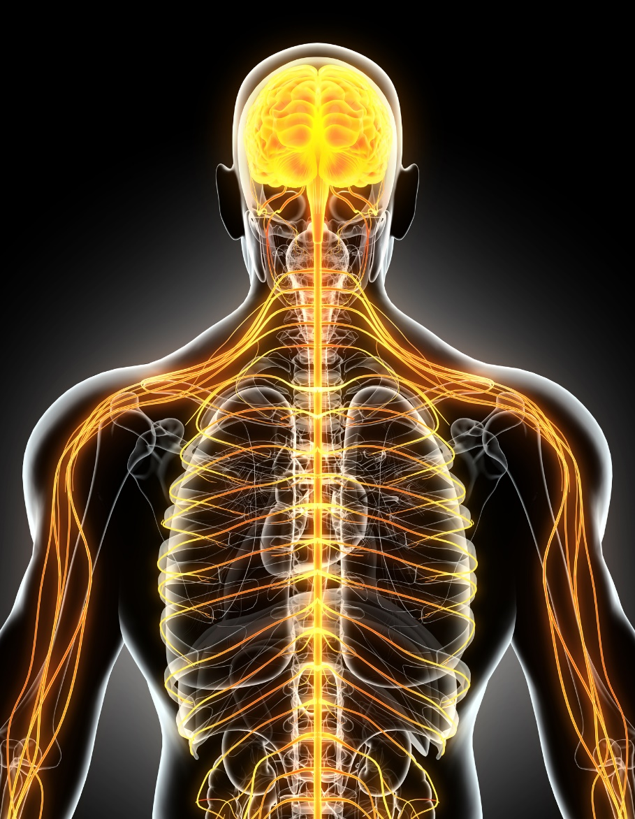
Overview: Animal coordination, control and homeostasis
Hormonal coordination in humans
  Human endocrine system
  Role of adrenalin in fight or flight response (HT)
  Control of metabolic rate (HT only)
  Menstrual cycle
  Hormones in human reproduction (HT only)
  Contraception
  The use of hormones in ART (HT only)
  Homeostasis
  Homeostasis in humans
  Thermoregulation (biology only)
  Control of blood glucose
  Osmoregulation and control of water and nitrogen balance (biology only)
  Kidney dialysis and organ donation

Slide 3
LearnIT!
KnowIT!
Hormonal control in
humans
Part 1

Slide 4
  Animal coordination, control and homeostasis Part 1 - Human endocrine system
The endocrine system is composed of glands which secrete chemicals called hormones directly into the bloodstream.
The blood carries the hormone to a target organ where it produces an effect.
Compared to the nervous system the effects of the endocrine system are slower but act for longer.

Slide 5
  Animal coordination, control and homeostasis Part 1 - Human endocrine system
The pituitary gland in the brain is often called a ‘master gland’ as it it produces and secretes many hormones into the blood.
The hormones are released in response to changes in body conditions.
These hormones released act on other glands to stimulate other hormones to be released to bring about effects that regulate the body.

Slide 6
  Animal coordination, control and homeostasis
  Part 1 – Human endocrine system (Higher tier)
Hormones released by the pituitary gland
Hormone | Target | Effect
Anti-diuretic hormone (ADH) | Kidney | Controls water levels in the blood
Thyroid-stimulating hormone (TSH) | Thyroid | Stimulates the thyroid gland to secrete thyroxine
Luteinising hormone (LH) | Ovaries | Stimulates egg release and progesterone production in the ovaries
Follicle-stimulating hormone (FSH) | Ovaries | Stimulates egg ripening and oestrogen production (in ovaries)
Prolactin (PRL) | Breasts | Stimulates the breasts to produce milk
Growth hormone (GH) | All cells in the body | Stimulates growth and repair

Slide 7
  Animal coordination, control and homeostasis Part 1 - Human endocrine system (Higher tier)
The adrenal glands produce and secrete the hormone adrenaline to prepare the body for fight or flight.
Adrenaline does this by:
Binding to receptors on the cardiac (heart) muscle to increase the rate and force of contraction. Heart rate and blood pressure go up.
If heart rate increases then blood flow increases so muscle cells receive more glucose and oxygen for increased respiration.
Adrenaline stimulates the liver to break down stored glycogen to increase the level of blood glucose for cells to use for respiration.

Slide 8
  Animal coordination, control and homeostasis Part 1 - Human endocrine system
Thyroid:
The thyroid gland produces and secretes the hormone thyroxine.
Thyroxine regulates the metabolic rate; this is the rate at which energy is released in the body.
Thyroxine also regulates breathing, heart rate, and body temperature.

Slide 9
  Animal coordination, control and homeostasis Part 1 - Human endocrine system (Higher tier)
TRH stands for thyrotropin releasing hormone.
Low levels of thyroxine detected in the blood
The hypothalamus in the brain releases TRH into the blood
TRH acts upon the pituitary gland
Pituitary gland releases TSH into the blood
TSH acts upon the thyroid gland
Thyroxine is released
Normal levels of thyroxine inhibit the release of TRH and production of TSH. This is called negative feedback.
TSH stands for thyroid stimulating hormone.
Thyroxine controls metabolic rate. Negative feedback keeps the amount of thyroxine in the blood roughly the same. It acts like a thermostat in a room controlling temperature.

Slide 10
QuestionIT!
Hormonal coordination in humans
Part 1

Slide 11
  Hormonal coordination in humans Part 1
  - Question IT
What is the endocrine system composed of?
What is a hormone?
How are hormones carried around the body?
Which acts faster, the nervous system or the endocrine system?
Where is the pituitary gland?
What is the role of the pituitary gland?
Name the hormones that the pancreas releases.
Where is thyroxine produced?
What is the role of thyroxine?
Higher tier
10. Name the hormones released by the pituitary gland.
11. Where is adrenaline produced?
12. What does adrenaline prepare the body to do?
13. What effect does adrenaline have on the heart?

Slide 12

AnswerIT!
Homeostasis

Slide 13
  Hormonal coordination in humans Part 1 AnswerIT
What is the endocrine system composed of? Glands
What is a hormone? A chemical that is released from a gland in response to a change
How are hormones carried around the body? In the bloodstream
Which acts faster, the nervous system or the endocrine system? The nervous system
Where is the pituitary gland? In the brain
What is the role of the pituitary gland? It secretes many hormones in response to changes in body conditions
Name the hormones that the pancreas releases. Insulin and glucagon
Where is thyroxine produced? Thyroid gland in neck
What is the role of thyroxine? It regulates the metabolic rate, this is the rate at which energy is released in the body.

Slide 14
  Hormonal coordination in humans Part 3
  - Answer IT
Higher tier
10. Name the hormones released by the pituitary gland. Anti diuretic, thyroid, luteinising, follicle stimulating, prolactin and growth hormone
11. Where is adrenaline produced? Adrenal glands
12. What does adrenaline prepare the body to do? To prepare the body for rapid activity.
13. What effect does adrenaline have on the heart? Increases frequency of contraction and force of contraction.

Slide 15
LearnIT!
KnowIT!
Hormonal coordination
in humans
Part 2
Hormones in human reproduction
Contraception
The use of hormones to treat infertility (HT only)

Slide 16

  Animal coordination, control and homeostasis Part 2 – Menstrual cycle
FEMALE: The ovaries produce and secrete the hormones oestrogen and progesterone.
Oestrogen is released by the ovaries and causes the lining of the uterus to thicken and a high level causes the release of another hormone from the pituitary gland which causes the egg to be released.
Progesterone maintains the lining of the uterus during the menstrual cycle.

Slide 17
  Animal coordination, control and homeostasis Part 2 – Menstrual cycle
The menstrual cycle lasts 28 days: It is the reproductive cycle in women and is brought about by hormones. Oestrogen is the main female reproductive hormone. At puberty, eggs begin to mature and one is released approximately every 28 days. This is called ovulation and it occurs half way through the cycle.
Hormone | Produced in... | Causes...
FSH Follicle stimulating hormone | Pituitary Gland | Stimulates egg ripening and oestrogen production (in ovaries)
Oestrogen | Ovaries | Lining of the womb to develop. Stimulates pituitary gland to make LH
LH Luteinising hormone | Pituitary Gland | Stimulates egg release and progesterone production in the ovaries
Progesterone | Ovaries | Maintains the lining of the womb

Slide 18
  Animal coordination, control and homeostasis Part 2 – Menstrual cycle
This shows the monthly menstrual cycle for a
non-pregnant woman.
An egg is released on day 14
If the woman became pregnant-the level of progesterone would stay high.
1
1. LH
2. FSH
3. Oestrogen
4. Progesterone
4
3
2
Menstruation
Lining of the uterus builds up
Lining of the uterus is maintained
Lining breaks down

Slide 19
  Animal coordination, control and homeostasis Part 2 – Menstrual cycle (Higher tier)
The PITUITARY GLAND
High levels of OESTROGEN stimulate the production of LH (positive feedback)
High levels of OESTROGEN inhibit the production of FSH (negative feedback)
RELEASES FSH
FSH STIMULATES egg ripening and OESTROGEN production (in ovaries)
RELEASES LH
LH STIMULATES egg release and STIMULATES PROGESTERONE production in the ovaries
RELEASES PROGESTERONE
High levels of PROGESTERONE inhibit the production of LH (negative feedback)
PROGESTERONE maintains the lining of the uterus in preparation for fertilised egg
The interactions of FSH, oestrogen, LH and progesterone control the menstrual cycle.

Slide 20
  Animal coordination, control and homeostasis Part 2 – Contraception
Controlling fertility – Contraception Fertility can be controlled by a variety of hormonal and non-hormonal methods of contraception.
These include:
The pill - oral contraceptives that contain oestrogen to inhibit FSH production so that no eggs develop and mature. After taking for a while egg development and release will stop completely.
The mini pill and injections contain progesterone. High levels stimulate the cervix to produce a thick mucus which stops sperm entering the uterus.
Implant or skin patches of slow release progesterone inhibit the maturation and release of eggs for a number of months or years.
Spermicidal agents which kill or disable sperm.

Slide 21
  Animal coordination, control and homeostasis Part 2 – Contraception
Controlling fertility – Contraception Fertility can be controlled by a variety of hormonal and non-hormonal methods of contraception.
Barrier methods such as condoms
and diaphragms prevent the
sperm reaching an egg
The ’coil’ or other intrauterine devices which prevent the implantation of an embryo
Abstaining from intercourse when an egg may be in the oviduct
Sterilisation or vasectomy - surgical methods of male and female sterilisation.

Slide 22
  Animal coordination, control and homeostasis Part 2 – Contraception
Evaluation of hormonal and barrier methods of contraception.
Hormonal methods | Barrier methods
Advantages: More effective at preventing pregnancy. | Advantages: Can provide protection against sexually transmitted diseases.
No need to think about contraception before a couple have intercourse. | Easily available and do not need a doctor to prescribe them. Useful for people who may not be able to take contraceptives because of side effects.
Disadvantages: Some women suffer side effects from taking hormones e.g. head aches or mood changes. | Disadvantages: Less reliable method of contraception.
Hormone contraceptives do not protect the couple from sexually transmitted diseases. | Need to think ahead before intercourse in order to purchase condoms etc.

Slide 23
  Animal coordination, control and homeostasis Part 2 – Fertility treatment (ART) Higher tier
Some women find it difficult to get pregnant so they need to undergo Assisted Reproductive Technology (ART) fertility treatment.
If a woman has naturally low levels of FSH and LH she can undergo clomifene therapy.
Clomifene is a drug which stimulates the release of FSH and LH by the body. These can be in tablet form or injection form.
FSH stimulates the maturation of the eggs
LH stimulates the release of the egg
She may then become pregnant in the normal way.

Slide 24
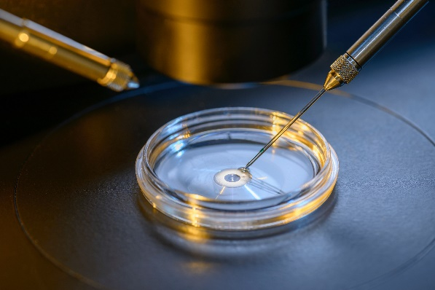
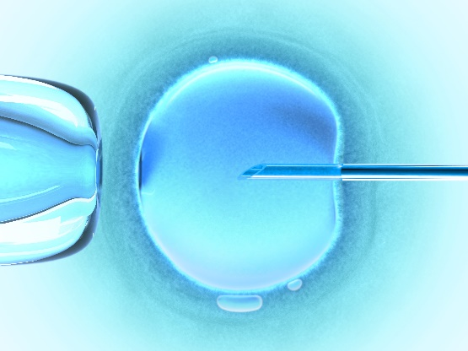
  Animal coordination, control and homeostasis Part 2 – Fertility (ART) Higher tier
If she still cannot get pregnant after using the fertility drugs then IVF treatment may work.
In Vitro Fertilisation (IVF) treatment.
IVF involves giving a mother FSH and LH to stimulate the maturation of several eggs.
The eggs are collected from the mother and fertilised by sperm from the father in the laboratory.
The fertilised eggs develop into embryos.
At the stage when they are tiny balls of cells, one or two embryos are inserted into the mother’s uterus (womb).

Slide 25
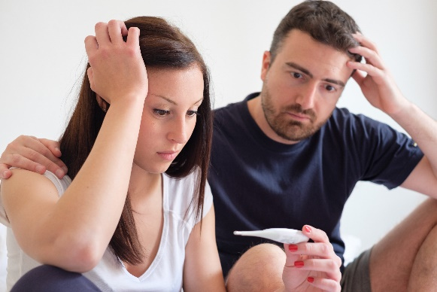
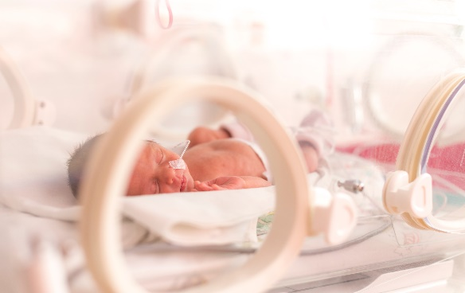
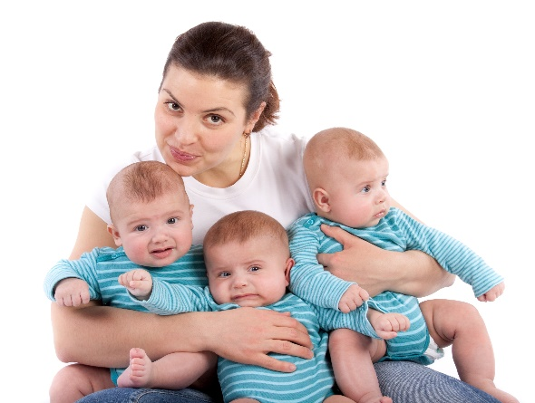
  Animal coordination, control and homeostasis Part 2 – Fertility (ART) Higher tier
Although fertility treatment gives a woman the chance to have a baby of her own:
It is very emotionally and physically stressful; the success rates are not very high.
Increases the risk of complications in pregnancy and childbirth, and may lead to premature or underweight babies.
It can lead to multiple births which are a risk to both the babies and the mother.

Slide 26
QuestionIT!
Hormonal coordination
in humans
Part 2
Hormones in human reproduction
Contraception
The use of hormones to treat infertility (HT only)

Slide 27
  Hormonal coordination in humans Part 2
  - Question IT
1. What is the name of the two main female reproductive hormones?
2. Where are these two female hormones made?
3. What is the menstrual cycle and how long is it?
4. What are the roles of the two main female hormones in the menstrual cycle?
5. At what stage of the menstrual cycle is an egg released and what is this event called?
6. Where is the egg released from?
7. Where does the egg travel to?
8. What happens to the egg if it becomes fertilised?
9. What happens to the egg if it does not become fertilised?
10. What happens on day 1 of the menstrual cycle?
11. What happens to the lining of the uterus if a woman becomes pregnant?

Slide 28
  Hormonal coordination in humans Part 3
  - Question IT
12. What does the term contraception mean?
13. How does the contraceptive pill work?
14. How do contraceptive implants and injections work?
15. What is a spermicidal agent?
16. Name 2 barrier methods of contraception and say how they work.
17. What is the coil and how does it work?
Higher tier
18. Where is FSH released and what is its role in the menstrual cycle?
19. Where is LH released and what is its role in the menstrual cycle?
20. What do high levels of oestrogen stimulate the release of?
21. What do high levels of oestrogen inhibit the release of?
22. What do high levels of progesterone inhibit the release of?

Slide 29
  Hormonal coordination in humans Part 2
  - Question IT
23. What does ART stand for?
24. What is clomifene therapy and how does it work?
25. What is IVF?
26. Describe the IVF process.
27. Describe some issues with IVF treatment.

Slide 30
AnswerIT!
Hormonal coordination
in humans
Part 2
Hormones in human reproduction
Contraception
The use of hormones to treat infertility (HT only)

Slide 31
  Hormonal coordination in humans Part 2
  - Question IT
1. What is the name of the two main female reproductive hormones? Oestrogen and progesterone
2. Where are these two female hormones made? Oestrogen – ovaries
Progesterone- empty follicle after egg has been released from it
3. What is the menstrual cycle and how long is it? It is the reproductive cycle in women, it is brought about by hormones. It lasts around 28 days.
4. What are the roles of the two main female hormones in the menstrual cycle? Oestrogen makes the lining of the uterus repair itself after menstruation and stimulates the pituitary gland to make LH.
Progesterone maintains the lining of the uterus.
5. At what stage of the menstrual cycle is an egg released and what is this event called? ? About half way through, usually day 14. Ovulation
6. Where is the egg released from? Ovary
7. Where does the egg travel to? Uterus
8. What happens to the egg if it becomes fertilised? Fertilised egg becomes embedded in the thick uterus lining.

Slide 32
  Hormonal coordination in humans Part 2
  - Answer IT
9. What happens to the egg if it does not become fertilised? Egg is lost from the body when the lining breaks down.
10. What happens on day 1 of the menstrual cycle? Menstruation/period
11. What happens to the lining of the uterus if a woman becomes pregnant? The lining is maintained (kept)
12. What does the term contraception mean? To prevent pregnancy
13. How does the contraceptive pill work? Contains oestrogen to inhibit FSH production so that no eggs mature.
14. How do contraceptive implants and injections work? They slowly release progesterone to inhibit the maturation and release of eggs for a number of months or years.
15. What is a spermicidal agent? A chemical that kills sperm.

Slide 33
  Hormonal coordination in humans Part 2
  - Question IT
16. Name 2 barrier methods of contraception and say how they work. The condom; fits over the penis. The diaphragm; covers the cervix in the female. They both and prevent sperm reaching an egg.
17. What is the coil and how does it work? It is a device that is placed in the uterus. It stops a fertilised egg implanting in the lining.
Higher tier
18. Where is FSH released and what is its role in the menstrual cycle? The pituitary gland; it stimulates egg ripening and oestrogen production (in ovaries).
19. Where is LH released and what is its role in the menstrual cycle? The pituitary gland; stimulates egg release and progesterone production in the ovaries.
20. What do high levels of oestrogen stimulate the release of? LH
21. What do high levels of oestrogen inhibit the release of? FSH
22. What do high levels of progesterone inhibit the release of? LH

Slide 34
  Hormonal coordination in humans Part 2
  - Answer IT
23. What does ART stand for? Assisted Reproductive Technology
24. What is clomifene therapy and how does it work? Taking a drug that contains FSH and LH. FSH stimulates the maturation of the eggs and
LH stimulates the release of the egg.
25. What is IVF? In vitro fertilisation where an egg is fertilised outside the body in a laboratory
26. Describe the IVF process. FSH and LH are given to stimulate the maturation of several eggs. The eggs are collected from the mother and fertilised by sperm from the father in the laboratory. The fertilised eggs develop into embryos. At the stage when they are tiny balls of cells, one or two embryos are inserted into the mother’s uterus (womb).
27. Describe some issues with IVF treatment. It is emotionally and physically stressful with low success rates. Increases the risk of complications. May lead to premature or underweight babies and multiple births.

Slide 35
LearnIT!
KnowIT!
Homeostasis
Part 3
Homeostasis in
humans
Thermoregulation
(biology)

Slide 36
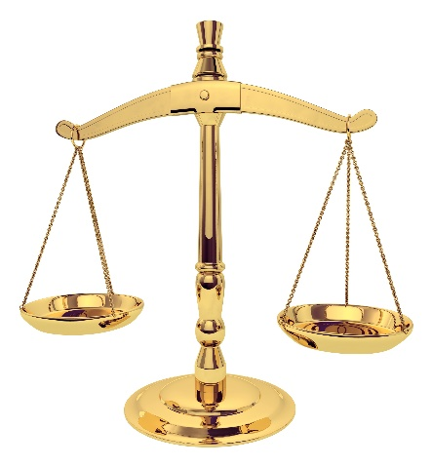
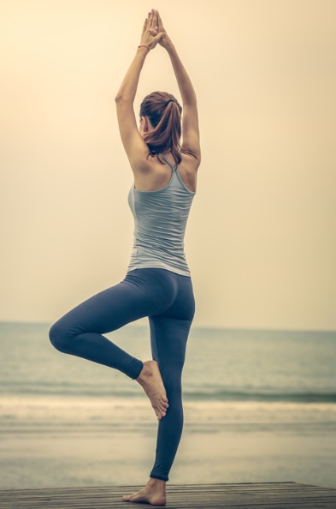
  Animal coordination, control and homeostasis Part 3-Homeostasis
There are many process in the body that keep important substances and the body temperature regulated within narrow limits.
This is called homeostasis
homeo = similar stasis = standing still
Homeostasis is the regulation (balance) of the internal conditions of a cell or organism to maintain optimum conditions for enzyme function and all cell functions in response to internal and external changes.
In the human body, homeostasis controls:
blood glucose concentration
body temperature
water levels.
Activity - Homeostasis
Notes:
http://www.bbc.co.uk/education/clips/zs2r87h

Slide 37
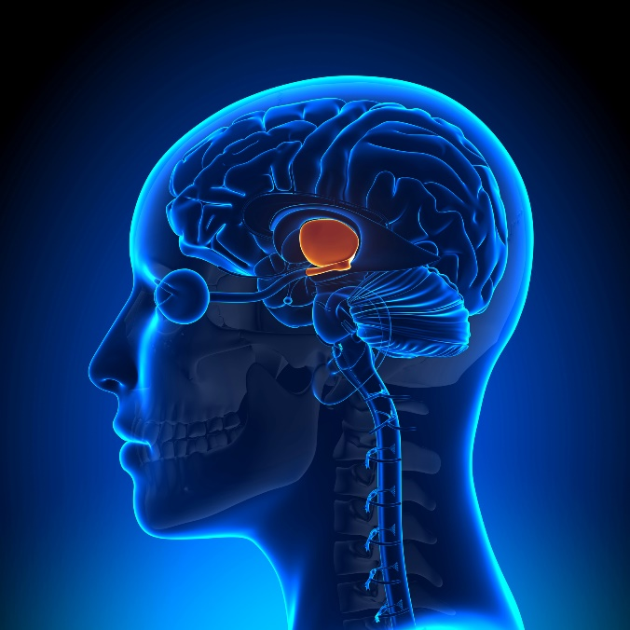
  Animal coordination, control and homeostasis Part 3 – Thermoregulation (biology only)
Human body temperature is 37ºC, this is the optimum temperature for enzymes to work effectively.
Body temperature is monitored and controlled by the thermoregulatory centre (hypothalamus) in the brain.
The thermoregulatory centre contains receptors sensitive to the temperature of the blood. The skin contains temperature receptors and sends nervous impulses to the thermoregulatory centre.
Thermoregulatory centre
Hair
Free nerve endings for pain and temperature
Surface of the skin

Slide 38
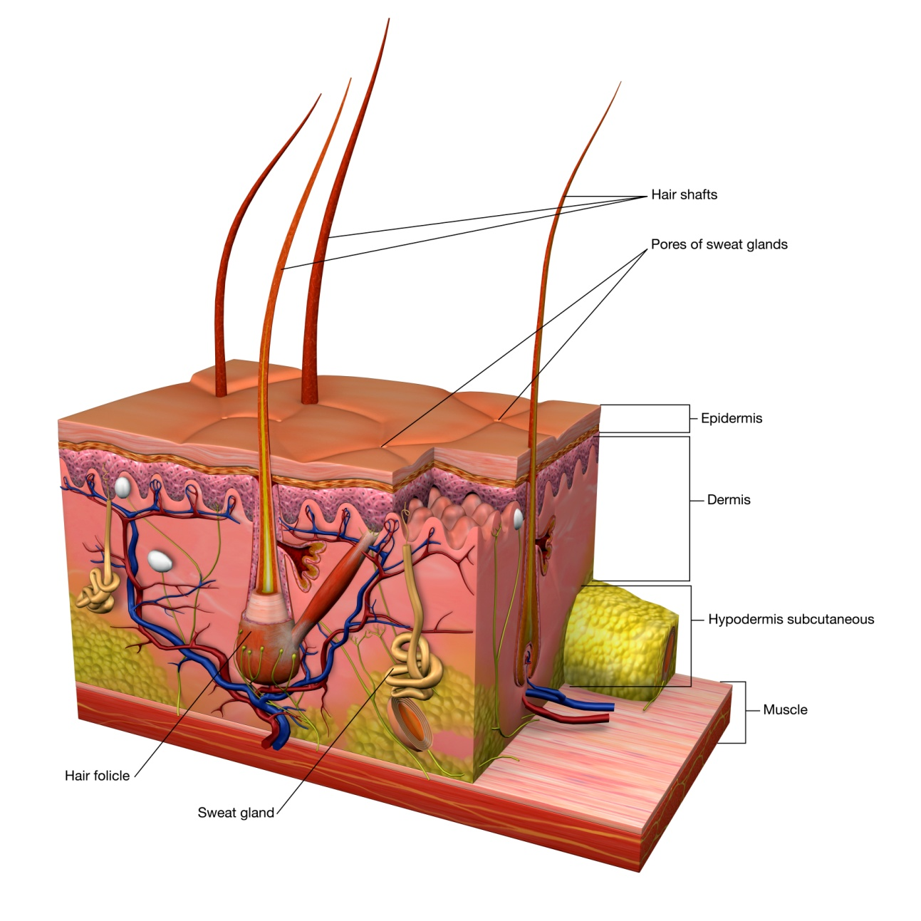
  Animal coordination, control and homeostasis Part 3-Thermoregulation
The skin is made up from three layers:
Epidermis
Dermis
Fatty Layer
When humans get cold the skeletal muscles contract rapidly and this causes shivering.
The muscle contractions require energy from respiration and some of this is released as heat.
The hair erector muscles in the dermis also contract and this raises the hairs which trap a layer of air close to the skin which warms and acts as an insulator.
Epidermis
Dermis
Fat
Hair follicle
Sweat gland

Slide 39
  Animal coordination, control and homeostasis Part 3-Thermoregulation(biology only)
Vasoconstriction
Vasodilation
If the body temperature is too low, blood vessels constrict (vasoconstriction), sweating stops and skeletal muscles contract (shiver).
If the body temperature is too high, blood vessels dilate (vasodilation) and sweat is produced onto the epidermis from the sweat glands in the dermis. Both cause a transfer of energy from the skin to the environment.
Video - Temperature regulation

Slide 40
QuestionIT!
Homeostasis
Part 3
Homeostasis in humans
Control of body temperature (biology only)

Slide 41
  Homeostasis – QuestionIT
Define homeostasis.
Why does homeostasis need to maintain optimal conditions?
3. List three conditions that the body needs to maintain.
4. State the optimum human body temperature.
5. What part of the brain monitors and controls temperature?
BIOLOGY ONLY:
6. Describe what happens in vasoconstriction and vasodilation.

Slide 42
AnswerIT!
Homeostasis
Part 3
Homeostasis in humans
Control of body temperature (biology only)

Slide 43
  Homeostasis – AnswerIT
1. Define homeostasis.
The regulation of the internal conditions of a cell or organism to maintain optimum conditions.
2. Why does homeostasis need to maintain optimal conditions?
For enzyme action and all cell functions.
3. List three conditions that the body needs to maintain.
Blood glucose concentration, body temperature and water levels.
4. State the optimum human body temperature. 37ºC
5. What part of the brain monitors and controls temperature? Thermoregulatory centre

Slide 44
  The human nervous system Part 2 - AnswerIT
BIOLOGY ONLY:
6. Describe what happens in vasoconstriction and vasodilation.
If the body temperature is too low, blood vessels constrict (vasoconstriction), sweating stops and skeletal muscles contract (shiver).
If the body temperature is too high, blood vessels dilate (vasodilation) and sweat is produced from the sweat glands. Both these mechanisms cause a transfer of energy from the skin to the environment.

Slide 45
LearnIT!
KnowIT!
Homeostasis
continued
Part 4
Control of blood glucose
Diabetes
Lifestyle

Slide 46
  Animal coordination, control and homeostasis Part 4 - Control of blood glucose
Blood glucose concentration is monitored and controlled by the pancreas.
Blood glucose concentration TOO HIGH
The PANCREAS releases the hormone insulin
Insulin stimulates the movement of GLUCOSE from the blood into cells
LIVER and MUSCLE cells convert excess GLUCOSE into GLYCOGEN for storage
Video - Regulating blood glucose

Slide 47
  Animal coordination, control and homeostasis Part 4- Control of blood glucose (HT)
The control of blood glucose concentration is an example of NEGATIVE FEEDBACK. This ensures that, in any control system, changes are reversed and returned back to the set level.
The PANCREAS releases INSULIN
Blood glucose concentration TOO HIGH
LIVER and MUSCLE cells convert excess GLUCOSE into GLYCOGEN
Normal blood GLUCOSE levels
Blood glucose concentration TOO LOW
LIVER and MUSCLE cells convert GLYCOGEN into GLUCOSE
The PANCREAS releases GLUCAGON

Slide 48
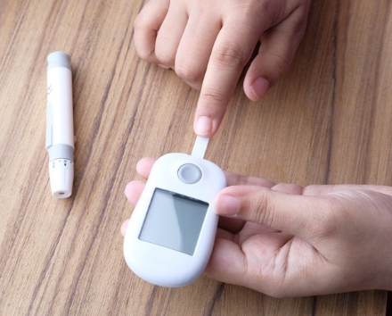
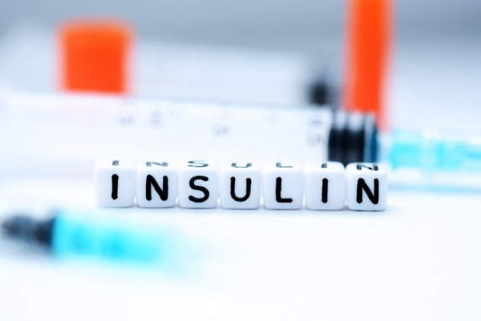
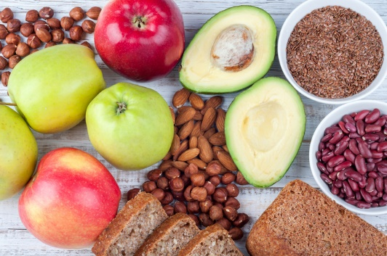
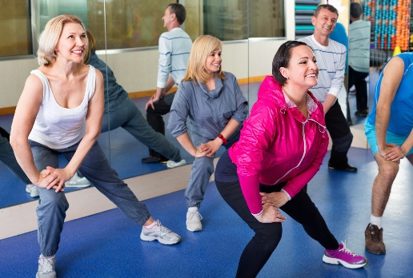
  Animal coordination, control and homeostasis Part 4 - Diabetes
Diabetes is a condition that causes a person's blood sugar level to become too high.
Type 1 diabetes
A disorder in which the pancreas fails to produce enough insulin.
The lack of insulin causes uncontrolled high blood glucose levels.
Type 1 is normally treated with insulin injections.
Type 2 diabetes
A disorder where the body cells no longer respond to insulin produced by the pancreas.
Obesity is a risk factor for Type 2 diabetes.
Type 2 is normally treated by controlling the carbohydrate in the diet and by exercise.

Slide 49
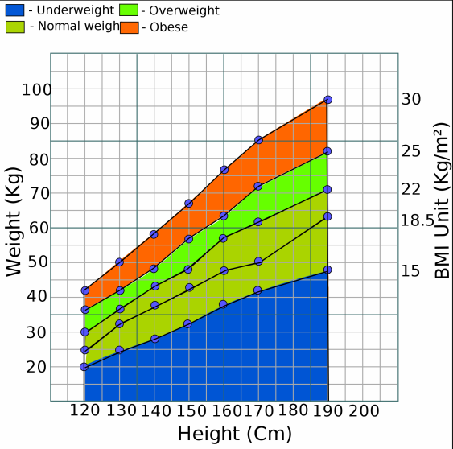

  Animal coordination, control and homeostasis Part 4 - Diabetes
Excess weight (obesity) can make a person have a greater risk of developing type 2 diabetes.
A tool called the Body Mass Indicator (BMI) can be used to calculate whether a persons weight lies within a healthy range.
BMI calculator
Notes:
https://www.nhs.uk/Livewell/loseweight/Pages/BodyMassIndex.aspx

Slide 50
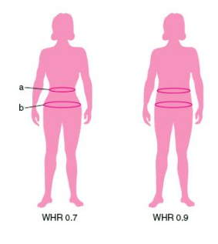
  Animal coordination, control and homeostasis Part 4 - Lifestyle
The use of BMI has limitations because it simply shows if a person is carrying too much weight. It does not calculate if this is excess fat, muscle or bone.
Very muscular adults and athletes may be classed as overweight or obese even though their body fat is low.
The waist to hip ratio should be considered alongside the BMI figure.
Male (waist : hip ratio) | Female (waist : hip ratio) | Health risk based on Waist : hip ratio
0. 95 or below | 0.80 or below | Low risk
0.96 to 1.0 | 0.81 to 0.85 | Moderate risk
1.1 or more | 0.86 or more | High risk
Notes:
https://upload.wikimedia.org/wikipedia/commons/thumb/1/13/Body_mass_index_simplified.svg/2000px-Body_mass_index_simplified.svg.png
https://www.nhs.uk/Tools/Pages/Healthyweightcalculator.aspx

Slide 51
QuestionIT!
Homeostasis continued
Part 4
Control of blood glucose
Diabetes
Lifestyle

Slide 52
  Hormonal coordination in humans
  Part 4 - Question IT
1. What happens to the glucose in the blood when insulin is released?
2. Which type of diabetes is caused when the body cells no longer respond to insulin?
3. State how Type 1 diabetes is treated.
4. State how Type 2 diabetes is treated.
5. Where is insulin produced?
6. What do the initials BMI stand for?
7. What is BMI used for?
8. What two measurements are required in order to calculate BMI?
9. What other measurements can be used to give an indication of whether a person is in a healthy weight range?

Slide 53
  Hormonal coordination in humans
  Part 4 - Question IT
Higher Tier
10. Describe the role of glucagon in the regulation of blood glucose?

Slide 54
AnswerIT!
Homeostasis continued
Part 4
Control of blood glucose
Diabetes
Lifestyle

Slide 55
  Hormonal coordination in humans
  Part 4 - Question IT
1. What happens to the glucose in the blood when insulin is released? The glucose is removed from the blood and then converted to glycogen and stored in the liver and muscles
2. Which type of diabetes is caused when the body cells no longer respond to insulin? Type 2
3. State how Type 1 diabetes is treated. With insulin injections
4. State how Type 2 diabetes is treated. By controlling the carbohydrate in the diet and by exercise.
5. Where is insulin produced? Pancreas
6. What do the initials BMI stand for? Body Mass Index
7. What is BMI used for? To calculate whether a person is in a healthy weight range for their height.
8. What two measurements are required in order to calculate BMI? Height and mass
9. What other measurements can be used to give an indication of whether a person is in a healthy weight range? Waist to hip ratio

Slide 56
  Hormonal coordination in humans Part 1 AnswerIT
Higher Tier
10. Describe the role of glucagon in the regulation of glucose?
Glucagon is released when the blood glucose concentration is low and it stimulates the liver and muscles to convert stored glycogen into glucose.

Slide 57
LearnIT!
KnowIT!
Homeostasis continued
Part 5
Osmoregulation (biology)
Structure of the urinary system (biology)
Maintaining water and nitrogen balance in the body (biology)
Kidney failure and treatment (biology)

Slide 58

  Animal coordination, control and homeostasis
  Part 5 - Osmoregulation
There is no control over water, ion or urea loss by the lungs or skin.
Water leaves the body via the lungs when you breathe out (exhalation).
Water, ions and urea are lost from the skin in sweat.
Excess water, ions and urea are removed via the kidneys in the urine.
Ions – include sodium, potassium, calcium , nitrogen.
Urea – A waste product produced when proteins are broken down.
Osmoregulation is the regulation of water content in the body. This is important for homeostasis.

Slide 59
  Animal coordination, control and homeostasis
  Part 5 – Osmoregulation (Biology)
The cytoplasm of body cells is mainly made from water. If cells lose or gain too much water by osmosis they do not function efficiently.
Hypertonic – more concentrated solution than in the cells e.g. concentrated sugar solution
Isotonic – same concentration as the solution in the cell.
Hypotonic – more dilute than the solution in the cells. e.g. water or dilute sugar solution
When a red blood cell is placed in hypotonic solutions e.g. water, water enters the cell by osmosis and as the volume increases this puts pressure on the cell membrane and it bursts. This is called lysis.
When a red blood cell is placed in hypertonic solutions e.g. concentrated sugar solution, water leaves the cell by osmosis and the cells shrink and the membrane wrinkles. This is called crenation.
Lysis and crenation do not happen in the body if the kidneys function properly as the kidneys keep the blood concentration isotonic.

Slide 60
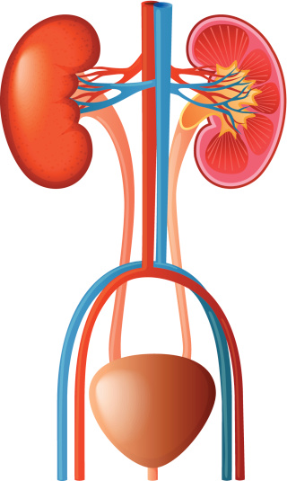
  Animal coordination, control and homeostasis
  Part 5 – Structure of the urinary system(Biology)
blood flowing into the kidney from the renal artery
internal structure of the kidney
kidney
blood flowing from the kidney into the renal vein
ureter
bladder
urethra

Slide 61
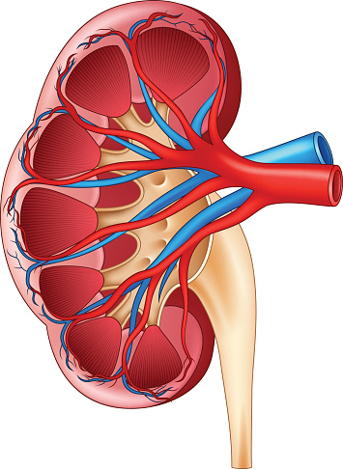
  Animal coordination, control and homeostasis
  Part 5 – Structure of the urinary system (Biology)
The kidneys filter the blood and form urine that is stored in the bladder. They are located in the lower back. Each kidney has an outer layer called the cortex and an inner layer called the medulla. There are millions of structures called kidney tubules (nephrons) and this is where the blood is filtered.
There are 3 steps to this process:
cortex
1. Filtration of glucose, urea, ions (salts) and water from the blood.
2. Selective reabsorption of ALL glucose, some ions (salts) and some water into the blood.
3. Excretion of ALL urea, excess ions (salts) and excess water into the urine.
medulla
ureter

Slide 62
  Animal coordination, control and homeostasis
  Part 5 – Maintaining nitrogen balance in the body (Biology)
When you have a diet high in proteins, the excess proteins are digested (broken down) into amino acids that are absorbed into the blood. The excess amino acids are then deaminated (removal of an amino group from the amino acids) in the liver to form ammonia. Ammonia is a very toxic substance and so it is immediately converted to urea for safe excretion from the body in the urine.
Diet high in proteins
Digestive system
proteins → amino acids
Liver
amino acids → ammonia
(deaminated)
ammonia → urea
💀
Kidneys
Urea is filtered from the blood and excreted from the body in urine

Slide 63
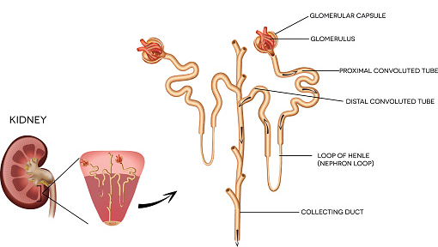
  Animal coordination, control and homeostasis
  Part 5 – Maintaining water balance in the body (Biology Higher Tier)
The pituitary gland in the brain monitors the water levels in the blood. It releases a hormone called anti-diuretic hormone (ADH).
Kidney tubules (nephrons) have some of the structures in both the cortex and the medulla.
kidney tubule
ADH causes the kidney tubules to become more permeable to water. Increased levels of ADH cause the kidneys to re-absorb more water.

Slide 64
  Animal coordination, control and homeostasis
  Part 5 – Maintaining water balance in the body (Biology Higher Tier)
The PITUITARY GLAND STOPS releasing ADH into the blood
Increased water content of the blood (more dilute)
Kidney tubules LESS permeable and reabsorb LESS water. LESS CONCENTRATED urine is produced
Normal blood WATER levels
Decreased water content of the blood (more concentrated)
Kidney tubules MORE permeable and reabsorb MORE water. MORE CONCENTRATED urine is produced
The PITUITARY GLAND RELEASES ADH into the blood
This is an example of a process controlled by NEGATIVE FEEDBACK

Slide 65
  Animal coordination, control and homeostasis
  Part 5 – Kidney failure (Biology)
Kidney failure is a medical condition where the kidneys no longer work. The kidneys are important in homeostasis and if kidneys fail toxins can build up in the blood and the concentration of ions (salts) gets out of balance.
The current treatments for kidney failure are kidney dialysis and kidney transplants

Slide 66
  Animal coordination, control and homeostasis
  Part 5 – Kidney failure (Biology)
KIDNEY DIALYSIS: Treatment by dialysis restores the concentrations of dissolved substances in the blood to normal levels and has to be carried out at regular intervals.
In a dialysis machine:
Blood high in urea flows between partially permeable membranes in the opposite direction to the dialysis fluid (maintains the concentration gradient)
The dialysis fluid contains the same concentration of useful substances as the blood - this ensures that glucose and ions (salts) are not lost.
Urea passes out from the blood into the dialysis fluid.

Slide 67
  Animal coordination, control and homeostasis
  Part 5 – Kidney failure (Biology)
KIDNEY TRANSPLANT: A diseased kidney is replaced by a healthy donor kidney. This can be from a live donor or from someone who has died.
Organ rejection is a problem as the antigens on the surface of the donor kidney are recognised by the immune system as foreign and can be attacked by the patient’s antibodies.
To reduce the chances of this happening two precautions are taken:
Immune-suppressant drugs are given
A donor kidney with a similar ‘tissue type’ is used

Slide 68
  Animal coordination, control and homeostasis
  Part 5 – Kidney failure (Biology)
Treatment | Advantages | Disadvantages
Kidney Dialysis | Available to all kidney patients (no shortage) No need for immune-suppressant drugs | Patient must limit their salt and protein intake between dialysis sessions Expensive for the NHS Regular dialysis sessions (up to 8hrs) – impacts on the patient’s lifestyle Risk of infection
Kidney Transplant | Patients can lead a more normal life without having to watch what they eat and drink Cheaper for the NHS overall | Must take immune-suppressant drugs which increase the risk of infection Shortage of organ donors Transplanted kidney only lasts 8-9 years on average Any operation carries risks

Slide 69
QuestionIT!
Homeostasis continued
Part 5
Osmoregulation (biology)
Structure of the urinary system (biology)
Maintaining water and nitrogen balance in the body (biology only)
Kidney failure and treatment

Slide 70
  Hormonal coordination in humans Part 5
  - Biology only - Question IT
State the ways in which water is lost from the body.
Sweat contains mostly water. What else can be found in sweat?
What is removed via the kidneys in the urine?
What is a hypertonic solution?
What is an isotonic solution?
What is a hypotonic solution?
What happens to animal cells when they are put in water?
What happens to animal cells when they are put in a concentrated sugar solution?
HT: What happens to excess proteins in the diet?
HT: What does deaminated mean?
HT: What is ammonia converted to in the liver?

Slide 71
  Hormonal coordination in humans Part 5
  - Biology only - Question IT
12. Label A – G on the diagram below.
A.
G.
B.
C.
F.
E.
D.

Slide 72
  Hormonal coordination in humans Part 5
  - Question IT
13. Name the structures in the kidneys where the blood is filtered.
14. What are the 3 steps in the blood filtering process?
15. Describe what happens in each of the 3 steps of the blood filtering process.
16. HT: Where in the body are the water levels in the blood monitored?
17. HT: Name the hormone that controls the water levels in the blood.
18. HT: What effect does increased levels of this hormone have on the kidneys?
19. HT: Describe what happens in the body when the water content of the blood is too low?
20. HT: Describe what happens in the body when the water content of the blood is too high?

Slide 73
  Hormonal coordination in humans Part 5
  - Question IT
21. How does kidney dialysis treat kidney failure?
22. Describe how the dialysis machine works.
23. How does a kidney transplant treat kidney failure?
24. State the advantages and disadvantages of kidney dialysis and kidney transplants.

Slide 74
AnswerIT!
Homeostasis continued
Part 5
Osmoregulation (biology)
Structure of the urinary system (biology)
Maintaining water and nitrogen balance in the body (biology only)
Kidney failure and treatment

Slide 75
  Hormonal coordination in humans Part 5 AnswerIT
State the ways in which water is lost from the body. Lungs, urine, skin (sweat)
Sweat contains mostly water. What else can be found in sweat? Ions and urea
What is removed via the kidneys in the urine? Excess water, ions and urea
What is a hypertonic solution? More concentrated solution than in the cells e.g. concentrated sugar solution
What is an isotonic solution? Same concentration as the solution in the cell
What is a hypotonic solution? More dilute than the solution in the cells. e.g. water or dilute sugar solution
What happens to animal cells when they are put in water? Water enters the cell by osmosis and as the volume increases this puts pressure on the cell membrane and it bursts. This is called lysis.

Slide 76
  Hormonal coordination in humans Part 5 AnswerIT
8. What happens to animal cells when they are put in a concentrated sugar solution? Water leaves the cell by osmosis and the cells shrink and the membrane wrinkles. This is called crenation.
9. HT: What happens to excess proteins in the diet? They are transported to the liver and converted into urea.
10. HT: What does deaminated mean? An amino group is removed from an amino acid.
11. HT: What is ammonia converted to in the liver? Urea

Slide 77
  Hormonal coordination in humans Part 5 AnswerIT
12. Label A – G on the diagram below.
A. blood flowing into the kidney from the renal artery
G. internal structure of the kidney
B. kidney
C. blood flowing from the kidney into the renal vein
F. ureter
E. bladder
D. urethra

Slide 78
  Hormonal coordination in humans Part 5 AnswerIT
13. Name the structures in the kidneys where the blood is filtered. Kidney tubules (nephrons)
14. What are the 3 steps in the blood filtering process? Filtration, selective reabsorption and excretion
15. Describe what happens in each of the 3 steps of the blood filtering process. Filtration of glucose, urea, ions (salts) and water from the blood. Selective reabsorption of ALL glucose, some ions (salts) and some water into the blood. Excretion of ALL urea, excess ions (salts) and excess water into the urine.
16: HT: Where in the body are the water levels in the blood monitored? The pituitary gland in the brain
17. HT: Name the hormone that controls the water levels in the blood. Anti-diuretic hormone (ADH).
18. HT: What effect does increased levels of this hormone have on the kidneys? The kidney tubules to become more permeable to water. Increased levels of ADH cause the kidneys to re-absorb more water.

Slide 79
  Hormonal coordination in humans Part 5 AnswerIT
19. HT: Describe what happens in the body when the water content of the blood is too low? The PITUITARY GLAND releases ADH into the blood, kidney tubules MORE permeable and reabsorb MORE water. MORE CONCENTRATED urine is produced and the blood water levels return to normal
20. HT: Describe what happens in the body when the water content of the blood is too high? The PITUITARY GLAND stops releasing ADH into the blood, kidney tubules LESS permeable and reabsorb LESS water. LESS concentrated urine is produced and the blood water levels return to normal.
21. How does kidney dialysis treat kidney failure? Filters the blood to restore the concentrations of dissolved substances in the blood to normal levels.
22. Describe how the dialysis machine works. Blood high in urea flows between partially permeable membranes in the opposite direction to the dialysis fluid (maintains the concentration gradient). The dialysis fluid contains the same concentration of useful substances as the blood - this ensures that glucose and ions (salts) are not lost. Urea passes out from the blood into the dialysis fluid.

Slide 80
  Hormonal coordination in humans Part 5 AnswerIT
23. How does a kidney transplant treat kidney failure? A diseased kidney is replaced by a healthy donor kidney; this can be from a live donor or from someone who has died.
24. State the advantages and disadvantages of kidney dialysis and kidney transplants. Kidney Dialysis – Advantages: Available to all kidney patients (no shortage), no need for immune-suppressant drugs Disadvantages: Patient must limit their salt and protein intake between dialysis sessions, expensive for the NHS, regular dialysis sessions (up to 8hrs) – impacts on the patient’s lifestyle, risk of infection Kidney Transplant – Advantages: Patients can lead a more normal life without having to watch what they eat and drink, cheaper for the NHS overall.
Disadvantages: Must take immune-suppressant drugs which increase the risk of infection, shortage of organ donors, kidney only lasts 8-9 years on average, any operation carries risks.

