Slide 1
The PiXL Club The PiXL Club The PiXL Club The PiXL Club The PiXL Club The PiXL Club The PiXL Club The PiXL Club The PiXL Club The PiXL Club The PiXL Club The PiXL Club The PiXL Club The PiXL Club The PiXL Club The PiXL Club The PiXL Club The PiXL Club The PiXL Club The PiXL Club The PiXL Club The PiXL Club The PiXL Club The PiXL Club The PiXL Club The PiXL Club The PiXL Club The PiXL Club The PiXL Club The PiXL Club The PiXL Club The PiXL Club The PiXL Club The PiXL Club The PiXL Club The PiXL Club The PiXL Club The PiXL Club The PiXL Club The PiXL Club The PiXL Club The PiXL Club The PiXL Club The PiXL Club The PiXL Club XL Club The PiXL Club The PiXL Club The PiXL Club The PiXL Club The PiXL Club The PiXL Club The PiXL Club The PiXL Club The PiXL Club The PiXL Club The PiXL Club The PiXL Club The PiXL Club The PiXL Club The PiXL Club The PiXL Club The PiXL Club The PiXL Club The PiXL Club The PiXL Club The PiXL Club The PiXL Club The PiXL Club The PiXL Club The PiXL Club The PiXL Club The PiXL Club The PiXL Club The PiXL Club The PiXL Club The PiXL Club The PiXL Club The PiXL Club The PiXL Club The PiXL Club The PiXL Club The PiXL Club The PiXL Club The PiXL Club The PiXL Club The PiXL Club The PiXL Club The PiXL Club The PiXL Club The PiXL Club The PiXL Club The PiXL Club The PiXL Club The PiXL Club The PiXL Club The PiXL Club The PiXL Club The PiXL Club The PiXL Club The PiXL Club The PiXL Club The PiXL Club The PiXL Club The PiXL Club The PiXL Club The PiXL Club The PiXL Club The PiXL Club The PiXL Club The PiXL Club The PiXL Club The PiXL Club The PiXL Club The PiXL Club The PiXL Club The PiXL Club The PiXL Club The PiXL Club The PiXL Club The PiXL Club The PiXL Club The PiXL Club The PiXL Club The PiXL Club The PiXL Club The PiXL Club The PiXL Club The PiXL Club The PiXL Club The PiXL Club The PiXL Club The PiXL Club The PiXL Club The PiXL Club The PiXL Club The PiXL Club The PiXL Club The PiXL Club The PiXL Club The PiXL Club The PiXL Club The PiXL Club The PiXL Club The PiXL Club The PiXL Club The PiXL Club The PiXL Club The PiXL Club The PiXL Club The PiXL Club The PiXL Club The PiXL Club The PiXL Club The PiXL Club The PiXL Club The PiXL Club The PiXL Club The PiXL Club The PiXL Club The PiXL Club The PiXL Club The PiXL Club The PiXL Club The PiXL Club The PiXL Club The PiXL Club The PiXL Club The PiXL Club The PiXL Club The PiXL Club The PiXL Club The PiXL Club The PiXL Club The PiXL Club The PiXL Club The PiXL Club The PiXL Club The PiXL Club The PiXL Club The PiXL Club The PiXL Club The PiXL Club The PiXL Club The PiXL Club The PiXL Club The PiXL Club The PiXL Club The PiXL Club The PiXL Club The PiXL Club The PiXL Club The PiXL Club The PiXL Club The PiXL Club The PiXL Club The PiXL Club The PiXL Club The PiXL Club The PiXL Club The PiXL Club The PiXL Club The PiXL Club The PiXL Club The PiXL Club The PiXL Club The PiXL Club The PiXL Club The PiXL Club The PiXL Club The PiXL Club The PiXL Club The PiXL Club The PiXL Club The PiXL Club The PiXL Club The PiXL Club The PiXL Club The PiXL Club The PiXL Club The PiXL Club The PiXL Club The PiXL Club The PiXL Club The PiXL Club The PiXL Club The PiXL Club The PiXL Club The PiXL Club The PiXL Club The PiXL Club The PiXL Club The PiXL Club The PiXL Club The PiXL Club The PiXL Club The PiXL Club The PiXL Club The PiXL Club The PiXL Club The PiXL Club The PiXL Club The PiXL Club The PiXL Club The PiXL Club The PiXL Club The PiXL Club The PiXL Club The PiXL Club The PiXL Club The PiXL Club The PiXL Club The PiXL Club The PiXL Club The PiXL Club The PiXL Club The PiXL Club The PiXL Club The PiXL Club The PiXL Club The PiXL Club The PiXL Club The PiXL Club The PiXL Club The PiXL Club The PiXL Club The PiXL Club The PiXL Club The PiXL Club The PiXL Club The PiXL Club The PiXL Club The PiXL Club The PiXL Club The PiXL Club The PiXL Club The PiXL Club The PiXL Club The PiXL Club The PiXL Club The PiXL Club The PiXL Club The PiXL Club The PiXL Club The PiXL Club The PiXL Club The PiXL Club The PiXL Club The PiXL Club The PiXL Club The PiXL Club The PiXL Club The PiXL Club The PiXL Club The PiXL Club The PiXL Club The PiXL Club The PiXL Club The PiXL Club The PiXL Club The PiXL Club The PiXL Club The PiXL Club The PiXL Club The PiXL Club The PiXL Club The PiXL Club The PiXL Club The PiXL Club The PiXL Club The PiXL Club The PiXL Club The PiXL Club The PiXL Club The PiXL Club The PiXL Club The PiXL Club The PiXL Club The PiXL Club The PiXL Club The PiXL Club The PiXL Club The PiXL Club The PiXL Club The PiXL Club The PiXL Club The PiXL Club The PiXL Club The PiXL Club The PiXL Club The PiXL Club The PiXL Club The PiXL Club The PiXL Club The PiXL Club The PiXL Club The PiXL Club The PiXL Club The PiXL Club The PiXL Club The PiXL Club The PiXL Club The PiXL Club The PiXL Club The PiXL Club The PiXL Club The PiXL Club The PiXL Club The PiXL Club The PiXL Club The PiXL Club The PiXL Club The PiXL Club The PiXL Club The PiXL Club The PiXL Club The PiXL Club The PiXL Club The PiXL Club The PiXL Club The PiXL Club The PiXL Club The PiXL Club The PiXL Club The PiXL Club The PiXL Club The PiXL Club The PiXL Club The PiXL Club The PiXL Club The PiXL Club The PiXL Club The PiXL Club The PiXL Club The PiXL Club The PiXL Club The PiXL Club The PiXL Club The PiXL Club The PiXL Club The PiXL Club The PiXL Club The PiXL Club The PiXL Club The PiXL Club The PiXL Club The PiXL Club The PiXL Club The PiXL Club The PiXL Club The PiXL Club The PiXL Club The PiXL Club The PiXL Club The PiXL Club The PiXL Club The PiXL Club The PiXL Club The PiXL Club The PiXL Club The PiXL Club The PiXL Club The PiXL Club The PiXL Club The PiXL Club The PiXL Club The PiXL Club The PiXL Club The PiXL Club The PiXL Club The PiXL Club The PiXL Club The PiXL Club The PiXL Club The PiXL Club The PiXL Club The PiXL Club The PiXL Club The PiXL Club The PiXL Club The PiXL Club The PiXL Club The PiXL Club The PiXL Club The PiXL Club The PiXL Club The PiXL Club The PiXL Club The PiXL Club The PiXL Club The PiXL Club The PiXL Club The PiXL Club The PiXL Club The PiXL Club The PiXL Club The PiXL Club The PiXL Club The PiXL Club The PiXL Club The PiXL Club The PiXL Club The PiXL Club The PiXL Club The PiXL Club The PiXL Club The PiXL Club The PiXL Club The PiXL Club The PiXL Club The PiXL Club The PiXL Club The PiXL Club The PiXL Club The PiXL Club The PiXL Club The PiXL Club The PiXL Club The PiXL Club The PiXL Club The PiXL Club The PiXL Club The PiXL Club The PiXL Club The PiXL Club The PiXL Club The PiXL Club The PiXL Club The PiXL Club The PiXL Club The PiXL Club The PiXL Club The PiXL Club The PiXL Club The PiXL Club The PiXL Club The PiXL Club The PiXL Club The PiXL Club The PiXL Club The PiXL Club The PiXL Club The PiXL Club The PiXL Club The PiXL Club The PiXL Club The PiXL Club The PiXL Club The PiXL Club The PiXL Club The PiXL Club The PiXL Club The PiXL Club The PiXL Club The PiXL Club The PiXL Club The PiXL Club The PiXL Club The PiXL Club The PiXL Club The PiXL Club The PiXL Club The PiXL Club The PiXL Club The PiXL Club The PiXL Club The PiXL Club The PiXL Club The PiXL Club The PiXL Club The PiXL Club The PiXL Club The PiXL Club The PiXL Club The PiXL Club The PiXL Club The PiXL Club The PiXL Club The PiXL Club The PiXL Club The PiXL Club The PiXL Club The PiXL Club The PiXL Club The PiXL Club The PiXL Club The PiXL Club The PiXL Club The PiXL Club The PiXL Club The PiXL Club The PiXL Club The PiXL Club The PiXL Club The PiXL Club The PiXL Club The PiXL Club The PiXL Club The PiXL Club The PiXL Club The PiXL Club The PiXL Club The PiXL Club The PiXL Club The PiXL Club The PiXL Club The PiXL Club The PiXL Club The PiXL Club The PiXL Club The PiXL Club The PiXL Club The PiXL Club The PiXL Club The PiXL Club The PiXL Club The PiXL Club The PiXL Club The PiXL Club The PiXL Club The PiXL Club The PiXL Club The PiXL Club The PiXL Club The PiXL Club The PiXL Club The PiXL Club The PiXL Club The PiXL Club The PiXL Club The PiXL Club The PiXL Club The PiXL Club The PiXL Club The PiXL Club The PiXL Club The PiXL Club The PiXL Club The PiXL Club The PiXL Club The PiXL Club The PiXL Club The PiXL Club The PiXL Club The PiXL Club The PiXL Club The PiXL Club The PiXL Club The PiXL Club The PiXL Club The PiXL Club The PiXL Club The PiXL Club The PiXL Club The PiXL Club The PiXL Club The PiXL Club The PiXL Club The PiXL Club The PiXL Club The PiXL Club The PiXL Club The PiXL Club The PiXL Club The PiXL Club The PiXL Club The PiXL Club The PiXL Club The PiXL Club The PiXL Club The PiXL Club The PiXL Club The PiXL Club The PiXL Club The PiXL Club The PiXL Club The PiXL Club The PiXL Club The PiXL Club The PiXL Club The PiXL Club The PiXL Club The PiXL Club The PiXL Club The PiXL Club The PiXL Club The PiXL Club The PiXL Club The PiXL Club The PiXL Club The PiXL Club The PiXL Club The PiXL Club The PiXL Club The PiXL Club The PiXL Club The PiXL Club The PiXL Club The PiXL Club The PiXL Club The PiXL Club The PiXL Club The PiXL Club The PiXL Club The PiXL Club The PiXL Club The PiXL Club The PiXL Club The PiXL Club The PiXL Club The PiXL Club The PiXL Club The PiXL Club The PiXL Club The PiXL Club The PiXL Club The PiXL Club The PiXL Club The PiXL Club The PiXL Club The PiXL Club The PiXL Club The PiXL Club The PiXL Club The PiXL Club The PiXL Club The PiXL Club The PiXL Club The PiXL Club The PiXL Club The PiXL Club The PiXL Club The PiXL Club The PiXL Club The PiXL Club The PiXL Club The PiXL Club The PiXL Club The PiXL Club The PiXL Club The PiXL Club The PiXL Club The PiXL Club The PiXL Club The PiXL Club The PiXL Club The PiXL Club The PiXL Club The PiXL Club The PiXL Club The PiXL Club The PiXL Club The PiXL Club The PiXL Club The PiXL Club The PiXL Club The PiXL Club The PiXL Club The PiXL Club The PiXL Club The PiXL Club The PiXL Club The PiXL Club The PiXL Club The PiXL Club The PiXL Club The PiXL Club The PiXL Club The PiXL Club The PiXL Club The PiXL Club The PiXL Club The PiXL Club The PiXL Club The PiXL Club The PiXL Club The PiXL Club The PiXL Club The PiXL Club The PiXL Club The PiXL Club The PiXL Club The PiXL Club The PiXL Club The PiXL Club The PiXL Club The PiXL Club The PiXL Club The PiXL Club The PiXL Club The PiXL Club The PiXL Club The PiXL Club The PiXL Club The PiXL Club The PiXL Club The PiXL Club The PiXL Club The PiXL Club The PiXL Club The PiXL Club The PiXL Club The PiXL Club The PiXL Club The PiXL Club The PiXL Club
PiXL KnowIT!
GCSE Chemistry
Edexcel Topic – Key Concepts in Chemistry
© Copyright The PiXL Club Ltd, 2017
This resource is strictly for the use of member schools for as long as they remain members of The PiXL Club. It may not be copied, sold nor transferred to a third party or used by the school after membership ceases. Until such time it may be freely used within the member school.
All opinions and contributions are those of the authors. The contents of this resource are not connected with nor endorsed by any other company, organisation or institution.
www.pixl.org.uk The PiXL Club Ltd, Company number 07321607

Slide 2
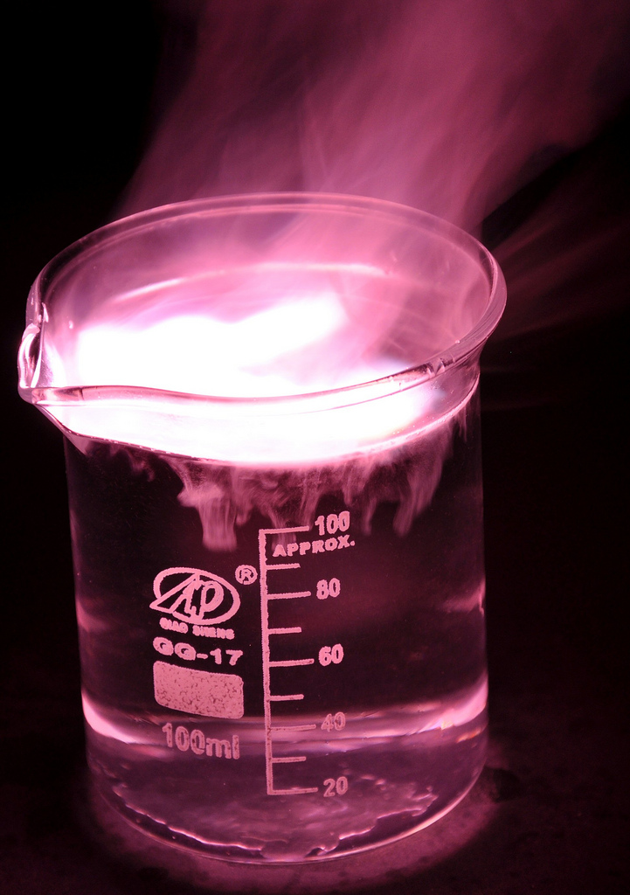
Overview Key concepts in chemistry
Atomic structure
Atomic model
Structure of atom, including subatomic particles
Isotopes
Relative atomic mass
Periodic table
Mendeleev and the periodic table
Atomic number and position in table
Metals and non-metals
Electronic configurations
Bonding
Ionic bonding
Covalent bonding
Notes:
https://c2.staticflickr.com/4/3178/4076380768_03994aed44_b.jpg

Slide 3
Overview Key concepts in chemistry
Types of substance
Properties of ionic substances
Properties of covalent substances
Carbon allotropes
Polymers
Properties of metals
Limitations of models
Calculations involving masses
Relative formula mass
Empirical and molecular formulae
Law of conservation of mass
Masses of reactants and products from balanced equations
Calculate concentration of solutions
Moles
Stoichiometry
Notes:
https://c2.staticflickr.com/4/3178/4076380768_03994aed44_b.jpg

Slide 4
LearnIT!
KnowIT!
Atomic structure
PART 1
Model of the atom
Structure of the atom

Slide 5
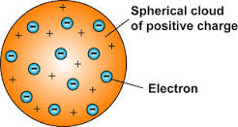
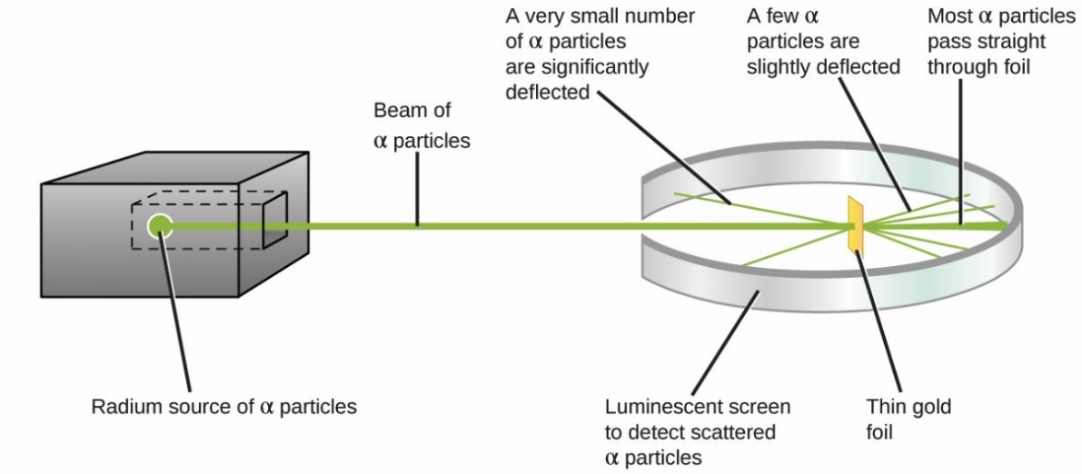
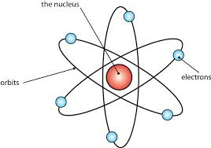
Model of the atom
Early 1800s
Before the discovery of electrons, John Dalton’s experiments led to the idea that atoms were tiny spheres that could not be divided.
End of 1800s
The electron was discovered by JJ Thomson. Scientists believed
that atoms were spheres of positive charge with negative
charges spread throughout - the ‘plum-pudding’ model.
1908-1913
Ernst Rutherford designed an experiment carried out by Geiger and Marsden. They fired alpha particles at a piece of very thin gold foil (only a few atoms thick) which scattered, leading to the conclusion that the
mass of an atom was concentrated in a nucleus,
which was charged.
It proposed that electrons orbited
around the nucleus.

Slide 6
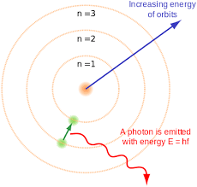
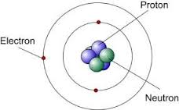
Model of the atom
1914
Niels Bohr noticed that the light given out when atoms were heated only had specific amounts of energy and he adapted the nuclear model by suggesting that electrons orbit the nucleus at specific distances in certain fixed energy levels (or shells). The energy must be given out when excited electrons fall from a high to low energy level.
Later experiments led to the idea that the positive charge of the nucleus could be subdivided into a whole number of smaller particles, each particle having the same amount of positive charge. The name proton was given to these particles.
1932
James Chadwick bombarded beryllium atoms with alpha particles. An unknown radiation was produced. Chadwick interpreted this radiation as being composed of particles with a neutral electrical charge and the approximate mass of a proton. This particle became known as the neutron.

Slide 7
Model of the atom
1800s
John Dalton – tiny spheres that could not be divided.
1890s
JJ Thomson – electron discovered. Plum pudding model - spheres of positive charge with negative charges spread evenly though.
1908 -1913
E. Rutherford, Geiger and Marsden - alpha particle scattering experiment. Nuclear model - mass of atom concentrated in a charged nucleus, with orbiting electrons.
1914
Niels Bohr – electrons orbit nucleus at specific distances in fixed energy levels (shells). Energy given out when electrons change level.
Later…
Positive charge of nucleus could be subdivided into particles of positive charge – protons.
1932
James Chadwick – provided evidence for the existence of neutrons within the nucleus.

Slide 8
Structure of the atom
Subatomic particles
 | Mass | Charge | Location
Proton | 1 | + | nucleus
Neutron | 1 | 0 | nucleus
Electron | Very small | - | shells
An atom has a nucleus containing protons and neutrons, surrounded by electrons in shells.
Most of the mass of an atom is concentrated in the nucleus
An atom contains equal numbers of protons and electrons.
Atoms have no overall electrical charge because the number of positive protons equals the number of negative electrons.
Number of protons = atomic number.
All atoms of an element have the same number of protons in the nucleus. This number is unique to that element.

Slide 9
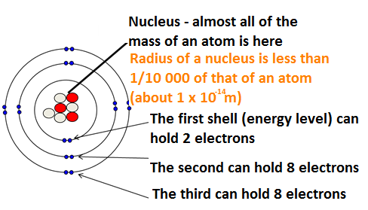
Structure of the atom
Atoms are very small.
Protons and Neutrons are found in the nucleus. Electrons orbit the nucleus in shells.
Mass number = Number of protons and neutrons
7
Protons = 3
Electrons = 3
Neutrons = 4
Li
Atomic number = Number of protons
3
To calculate the number of neutrons = Mass Number – Atomic Number

Slide 10
QuestionIT!
Atomic structure
PART 1
Model of the atom
Structure of the atom

Slide 11
Atomic model PART 1 – QuestionIT
What was the earliest model of the atom?
Which subatomic particle did JJ. Thomson discover?
Which early atomic model does the following diagram show?
Name Rutherford’s experiment.
State two ways in which Rutherford’s experiment changed Thomson’s model of the atom.
How did Bohr adapt the nuclear model?
Explain why Bohr revised Rutherford’s model of the atom.

Slide 12
Atomic model PART 2 – QuestionIT
Name three subatomic particles and their charges.
Complete the sentence ‘All atoms of one type of element have the same number of…’
What does the atomic number tell us about an atom?
What does the mass number tell us about an atom?
Why is the overall charge of an atom zero?
Calculate how many protons, electrons and neutrons there are in a silver atom with atomic number 47 and mass number 108.

Slide 13
AnswerIT!
Atomic structure
PART 1
Model of the atom
Structure of the atom

Slide 14
Atomic model PART 1 – QuestionIT
What was the earliest model of the atom?
Tiny spheres that could not be divided.
Which subatomic particle did JJ. Thomson discover?
The electron
3. Which early atomic model does the following diagram show?
The plum pudding model.
Name Rutherford’s experiment.
Alpha particle scattering.
State two ways in which Rutherford’s experiment changed Thomson’s model of the atom.
He said the positive charge was concentrated into very small
volume at centre of atom (nucleus) and the electrons orbit
nucleus.

Slide 15
Atomic model PART 1 – QuestionIT
Explain why Bohr revised Rutherford’s model of the atom.
Suggesting electrons orbit the nucleus at different distances.
Explain why Bohr revised Rutherford’s model of the atom.
Energy emitted from electron transitions can only have certain
fixed energies, so he refined the ‘orbiting electrons’ in
Rutherford’s nuclear model to ‘orbiting electrons in energy levels
(or shells) at fixed distances from the nucleus’.

Slide 16
Atomic model PART 2 – QuestionIT
Name three subatomic particles and their charges.
Proton – positive; neutron – no charge; electron – negative.
Complete the sentence ‘All atoms of one type of element have the same number of…’
Protons.
What does the atomic number tell us about an atom?
Number of protons.
What does the mass number tell us about an atom?
Number of protons + number of neutrons.

Slide 17
Atomic model PART 2 – QuestionIT
Why is the overall charge of an atom zero?
Number of protons (positive) = number electrons (negative).
Calculate how many protons, electrons and neutrons there are in a silver atom with atomic number 47 and mass number 108
Protons = 47 Electrons = 47 Neutrons = 61

Slide 18
LearnIT!
KnowIT!
Atomic structure
PART 2
Isotopes
Relative atomic mass

Slide 19
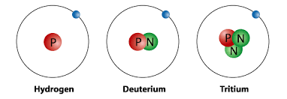
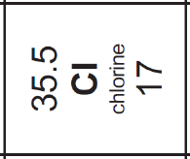
Isotopes
Isotopes are different atoms of the same element containing the same number of protons but different numbers of neutrons in their nuclei.
Isotopes of Hydrogen – all containing 1 proton, but different numbers of neutrons
The existence of isotopes results in relative atomic masses of some elements not being whole numbers e.g. chlorine

Slide 20
Relative atomic mass (HT)
The relative atomic mass of an element is an average value that takes account of the abundance of the isotopes of the element.
The relative atomic mass is calculated using the equation:
(% of isotope 1 × mass of isotope 1) + (% of isotope 2 × mass of isotope 2) 100
If there are more than 2 isotopes they will appear on the top of the equation in the same manner e.g.
(% of isotope 1 x mass) + (% of isotope 2 x mass) + (% of isotope 3 x mass)
100
Chlorine’s relative atomic mass of 35.5 is an average of the masses of the different isotopes of chlorine.
For example, in any sample of Chlorine 25% will be ³⁷Cl and 75% ³⁵Cl.
(25 x 37) + (75 x 35) ÷ 100 = 35.5

Slide 21
QuestionIT!
Atomic structure
PART 2
Isotopes
Relative atomic mass

Slide 22
Atomic structure PART 2 – QuestionIT
What is an isotope?
Why do some elements have relative atomic masses which are not whole numbers?
Calculate the number of neutrons in this isotope of chlorine.
(HT) Boron has two naturally occurring isotopes B-10 (20%) and B-11 (80%). Calculate the relative atomic mass of bromine.
(HT) Magnesium has three naturally occurring isotopes Mg -24 (79%); Mg – 25 (10%) and Mg – 26 (11%). Calculate the relative atomic mass of magnesium.

Slide 23
AnswerIT!
Atomic structure
PART 2
Isotopes
Relative atomic mass

Slide 24
Atomic structure PART 2 – QuestionIT
What is an isotope?
Different atom of the same element, same number of protons, different number of neutrons, in the nucleus
Why do some elements have relative atomic masses which are not whole numbers?
Because of the existence of isotopes
Calculate the number of neutrons in this isotope of chlorine.
37 – 17 = 20

Slide 25
Atomic structure PART 2 – QuestionIT
(HT) Boron has two naturally occurring isotopes B-10 (20%) and B-11 (80%). Calculate the relative atomic mass of bromine.
(20 x 10) + (80 x 11) = 10.8 or 11
100
(HT) Magnesium has three naturally occurring isotopes Mg -24 (79%); Mg – 25 (10%) and Mg – 26 (11%). Calculate the relative atomic mass of magnesium.
(79 x 24) + (10 x 25) + (11 x 26) = 24.32 or 24
100

Slide 26
LearnIT!
KnowIT!
Periodic table
Mendeleev and the periodic table
Atomic number
Metals and non-metals
Electronic configuration

Slide 27
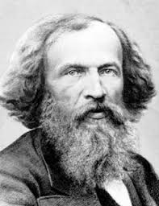
Periodic table
1869
Dmitri Mendeleev published a periodic table of the elements.
He arranged the elements known at the time in order of relative atomic mass. He arranged them so that groups of elements with similar properties were in the same column.
He left gaps for the elements that he thought had not been discovered. Elements with properties predicted by Mendeleev were eventually discovered.
Although Mendeleev thought he had arranged elements in order of increasing relative atomic mass this was not always true because of the relative abundances of isotopes of some pairs of elements in the table.

Slide 28
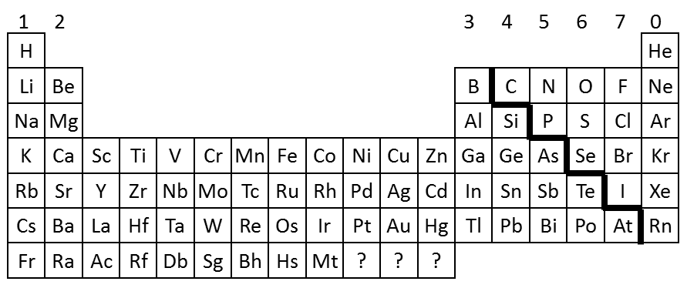
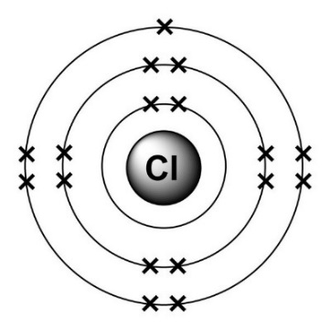
Periodic table
The elements are arranged in order of increasing atomic number. The atomic number indicates the number of protons in an atom of an element.
Elements with similar properties are in columns, known as groups.
Elements in the same group have the same number of electrons in their outer shell.
It is called a periodic table because similar properties occur at regular intervals
The rows in the table are called periods
Group = electrons in outer shell
Period = number of shells
Group = 7
Period = 3

Slide 29
Periodic table
The elements can be divided into metals and non-metals.
1
2
H
3
4
5
6
7
0
He
Elements that do not form positive ions are non-metals
Elements that tend to form positive ions are metals
Li
Be
B
C
N
O
F
Ne
Na
Mg
Al
Si
P
S
Cl
Ar
K
Ca
Sc
Ti
V
Cr
Mn
Fe
Co
Ni
Cu
Zn
Ga
Ge
As
Se
Br
Kr
Rb
Sr
Y
Zr
Nb
Mo
Tc
Ru
Rh
Pd
Ag
Cd
In
Sn
Sb
Te
I
Xe
Cs
Ba
La
Hf
Ta
W
Re
Os
Ir
Pt
Au
Hg
Tl
Pb
Bi
Po
At
Rn
Fr
Ra
Ac
Rf
Db
Sg
Bh
Hs
Mt
?
?
?
Non metals – found towards the right and towards the top of the periodic table
Most elements are metals – found towards the left and towards the bottom of the periodic table
Most metals are shiny solids with high melting points, high density and good conductors of electricity.
Whereas most non-metals have low boiling points and are poor conductors of electricity.

Slide 30
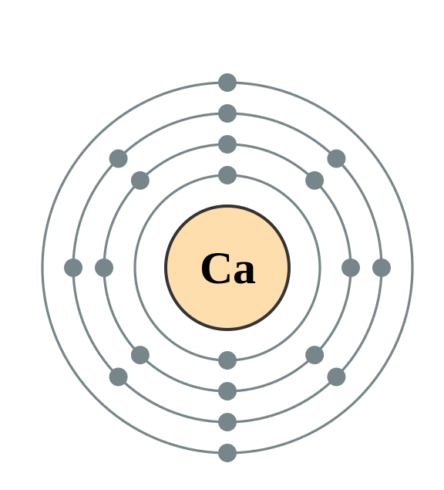
Electronic configuration
The electrons in an atom occupy the lowest available energy levels (innermost available shells). The electronic structure of an atom can be represented by numbers or by a diagram e.g.
Calcium has 2 electrons on its lowest energy level,
8 on the second energy level,
8 on the third energy level
and 2 on the fourth (the highest) energy level.
So the electron configuration for Calcium = 2,8,8,2
The 2 electrons in the outer shell tell us calcium is in Group 2
The 4 electron shells tells us calcium is in Period 4

Slide 31
QuestionIT!
Periodic table
Mendeleev and the periodic table
Atomic number
Metals and non-metals
Electronic configuration

Slide 32
Periodic table – QuestionIT
How are elements arranged in the periodic table?
What are the columns of the periodic table called?
What are the rows of a periodic table called?
What does the column an element is in tell you about the atoms?
What does the row an element is in tell you about the atoms?
Which side of the periodic table are the non-metals found?

Slide 33
Periodic table – QuestionIT
How did Mendeleev arrange the elements in his periodic table?
How did Mendeleev use his periodic table to predict the existence of some elements not then discovered?
Why is the order based on atomic masses not always correct?
What do we call elements that tend to form positive ions?
What is the electron configuration for sodium?
Draw the electron configuration for a chlorine atom.
Write the electron configuration for potassium.

Slide 34
AnswerIT!
Periodic table
Mendeleev and the periodic table
Atomic number
Metals and non-metals
Electronic configuration

Slide 35
Periodic table – QuestionIT
How are elements arranged in the modern periodic table?
Increasing atomic number.
What are the columns of the periodic table called?
Groups.
What are the rows of a periodic table called?
Periods.
What does the column an element is in tell you about the atoms?
Number of electrons in outer shell.
What does the row an element is in tell you about the atoms?
Number of electron shells.

Slide 36
Periodic table – QuestionIT
Which side of the periodic table are the non-metals found?
Right and top.
How did Mendeleev arrange the elements in his periodic table?
Arranging in order of their atomic masses, elements with similar properties in the same column
How did Mendeleev use his periodic table to predict the existence of some elements not then discovered?
Left gaps for elements he thought had not yet been discovered; changed the order based on atomic weights for some elements if they did not fit the pattern.
Why is the order based on atomic masses not always correct?
Existence of isotopes.

Slide 37
Periodic table – QuestionIT
What do we call elements that tend to form positive ions?
Metals.
What is the electron configuration for sodium?
2,8,1
Draw the electron configuration for a chlorine atom.
Write the electron configuration for potassium.
2,8,8,1

Slide 38
LearnIT!
KnowIT!
Bonding part 1
Ionic bonding

Slide 39
Ions
Atoms sometimes lose or gain electrons (e.g. when a metal reacts with a non-metal). When they do this they become a charge atom or an ion.
If an atom loses one or more electrons, it gains a positive charge because it has less electrons than protons.
If an atom gains one or more electrons, it gains a negative charge because it has more electrons than protons.
e.g. If sodium atom loses one electron, it forms a Na⁺ ion.
It has 11 protons, 12 neutrons and 10 electrons.
e.g. If an oxygen atom gains two electrons, it forms a O²⁻ ion.
It has 8 protons, 8 neutrons and 10 electrons.

Slide 40
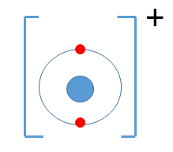
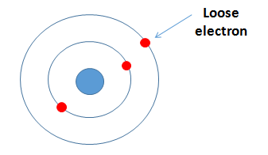
Ionic bonding
Ionic bonds form between metals and non-metals. Ionic bonding involves the transfer of electrons between atoms to produce cations (+) and anions (-).
An ion is an atom or group of atoms with a positive or negative charge.
Metals lose electrons to become positively charged ions
and non-metals gain electrons to become negatively
charged ions.
The elements in Group 1 react with the elements in Group 7.
Groups 1 elements can each lose one electron.
This electron can be given to an atom from Group 7, they both achieve the stable electronic structure of a noble gas.
Notes:
https://examhints.files.wordpress.com/2014/10/ions-list.png

Slide 41
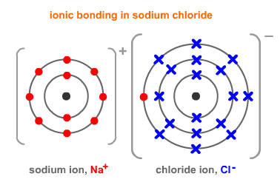
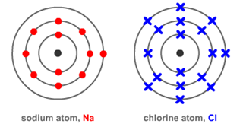
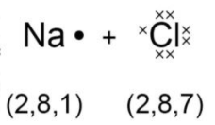
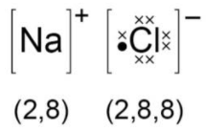
Ionic bonding
The electrostatic attraction between the oppositely charged Na⁺ ions and Cl⁻ ions is called ionic bonding. The electron transfer during the formation of an ionic compound can be represented by a dot and cross diagram:
The charge on the ions produced by metals in group 1 and 2 and by non-metals in group 6 and 7 relates to the group number of the element in the periodic table. For example group 1 form 1+ ions, group 3 form 3+ ions, group 6 form 2- ions and group 7 form 1- ions.
When completing diagrams always include:
The correct number of electrons on outer shells
The charge

Slide 42
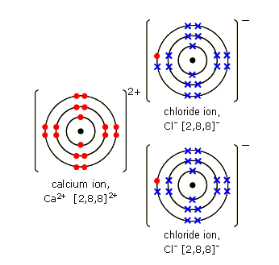
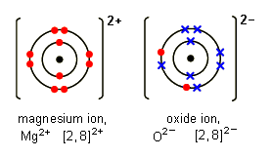
Ionic bonding
Magnesium oxide:
Sometimes the atoms reacting need to gain or lose two electrons to gain a stable noble gas structure. Each magnesium loses two electrons and each oxygen gains two electrons.
Magnesium ions have the formula Mg²⁺, while oxide ions have the formula O²⁻ .
This means that one magnesium atom reacts with one oxygen atom, giving the formula MgO
Calcium Chloride:
Each calcium atom (2, 8, 8, 2) needs to lose two electrons but each chlorine atom (2, 8, 7) needs to gain only one electron.
This means that two chlorine atoms
react with every one calcium atom, giving the formula CaCl₂

Slide 43
Names of compounds
Compounds contain two or more elements chemically combined in fixed proportions and can be represented by formulae using the symbols of atoms from which they formed.
For example:
Na₂S = sodium sulfide
K₂O = potassium oxide
Naming a compound with two elements (usually a metal and a non metal) apply these rules:
The metal name does not change
The non-metal's name ends in ide
When a compound contains a transition metal, the names become a bit more complicated. To distinguish them, Roman numerals indicate the charge on the metal ion
e.g. iron(II) chloride.
Naming a compound with a metal that reacts with ions that consist of two or more non-metal atoms covalently bonded together apply these rules:
The metal name does not change
The non-metal's name ends in ate if oxygen is present
For example: Na₂CO₃ = sodium carbonate
KNO₃ = potassium nitrate

Slide 44
Deduce the formulae of ionic compounds
It is possible to work out the formula of a compound given the formulae of the ions it is made of.
Example 1:
Calcium oxide will contain Ca²⁺ and O²⁻ ions. The correct formula is CaO as there are two positive charges and two negative charges.
An ionic formula will have no overall charge and will consist of ions with the same total number of positive and negative charges.
Example 2:
Magnesium nitrate will contain Mg²⁺ and NO₃⁻ ions. The correct formula is Mg(NO₃)₂ as magnesium has two positive charges two nitrate ions are needed to ensure there is no overall charge.
Common ions include:
Oxides O²⁻
Hydroxides OH⁻
Halides Cl⁻, Br⁻, I⁻
Nitrates NO₃⁻
Carbonates CO₃²⁻
Sulfates SO₄²⁻
Magnesium Mg²⁺
Sodium Na⁺
Calcium Ca²⁺
Example 3:
Sodium sulfate will contain Na⁺ and SO₄²⁻ ions. The correct formula is Na₂SO₄ to ensure there are equal numbers of positive and negative charges.

Slide 45
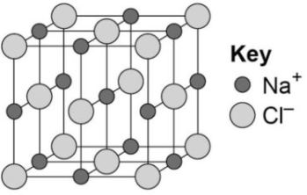
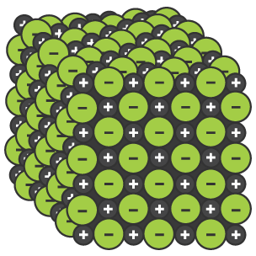
Ionic compounds
An ionic compound is a giant structure of ions.
Ionic compounds are held together by strong electrostatic forces of attraction between oppositely charges ions. These forces act in all directions in the lattice – this is called ionic bonding.
Empirical formula
The models can indicate the chemical formula of a compound by the simplest ratio of atoms or ions in models of their giant structure – this is called the empirical formula.
e.g. there is a 1:1 ratio of sodium to chlorine in sodium chloride, so the formula is NaCl.
The structure of sodium chloride can be represented in the following forms:

Slide 46
QuestionIT!
Bonding part 1
Ionic bonding

Slide 47
Bonding PART 1 – QuestionIT
What is a cation?
What is an anion?
What types of substances bond together with an ionic bond?
What happens to the electrons in ionic bonding?
What electronic structure do the ions produced by metals in Groups 1 and 2 and the non-metals in Groups 6 and 7 have?
What is the link between the charge number on the ions in Groups 1, and 2 and their group?

Slide 48
Bonding PART 1 – QuestionIT
What is an ionic compound?
How are ionic compounds held together?
Draw a diagram to show how potassium and chlorine atoms
join together to form ions.
Explain how you can use the following model to work out the empirical formula of sodium chloride.

Slide 49
Bonding PART 1 – QuestionIT
What does it mean if a compound ends in –ide?
What does it mean if a compound ends in –ate?
Calculate how many protons, electrons and neutrons there are in

Slide 50
AnswerIT!
Bonding part 1
Ionic bonding

Slide 51
Bonding PART 1 – QuestionIT
What is a cation?
Positive ion.
What is an anion?
Negative ion.
What types of substances bond together with an ionic bond?
Metals and non-metals; ions

Slide 52
Bonding PART 1 – QuestionIT
What happens to the electrons in ionic bonding?
Transferred between atoms to form ions.
What electronic structure do the ions produced by metals in Groups 1 and 2 and the non-metals in Groups 6 and 7 have?
Electronic structure of a noble gas.
What is the link between the charge number on the ions in Groups 1 and 2 and their group?
Charge number is same as Group number.
What is an ionic compound?
Giant structure of ions.
How are ionic compounds held together?
Strong electrostatic forces of attraction; between oppositely charged ions.

Slide 53
Bonding PART 1 – QuestionIT
What does it mean if a compound ends in –ide?
Contains 2 elements; usually metal and non-metal.
What does it mean if a compound ends in –ate?
Contains 3 or more elements, 1 of which is always oxygen.
Calculate how many protons, electrons and neutrons there are in
Protons = 19 Electrons = 18 Neutrons = 20

Slide 54
Bonding PART 1 – QuestionIT
Draw a diagram to show how potassium and chlorine atoms
join together to form ions.
Explain how you can use the following model of sodium chloride to work out the empirical formula.
Count the number of each type of atom in the giant structure and work out simplest whole number ratio.

Slide 55
LearnIT!
KnowIT!
Bonding
PART 2
Covalent bonding

Slide 56
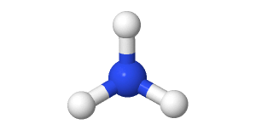
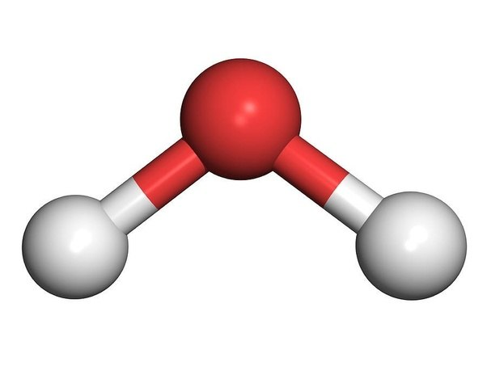
Covalent bonding
When atoms share pairs of electrons, they form covalent bonds. These are formed between non-metals and non-metals.
These are STRONG bonds.
Covalent bonding results in the formation of molecules.
NH₃
H
H₂O
N
O
H
H
H
H

Slide 57
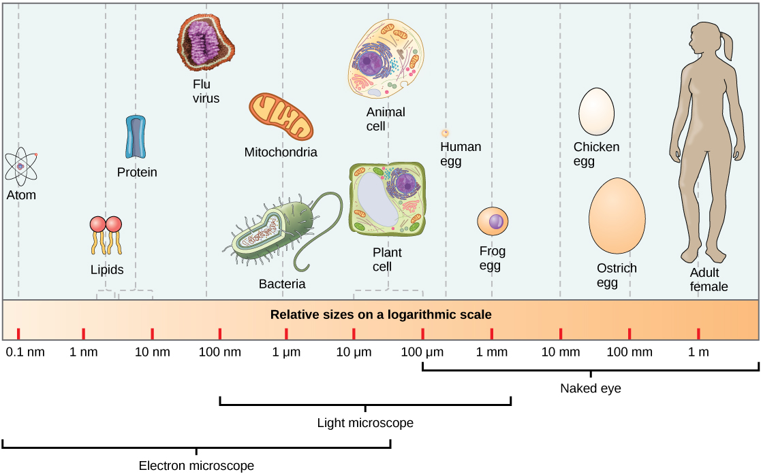
Order of magnitude of atoms and molecules
Atoms are tiny - the radius of a typical atom is one tenth of a billionth of a meter.

Slide 58
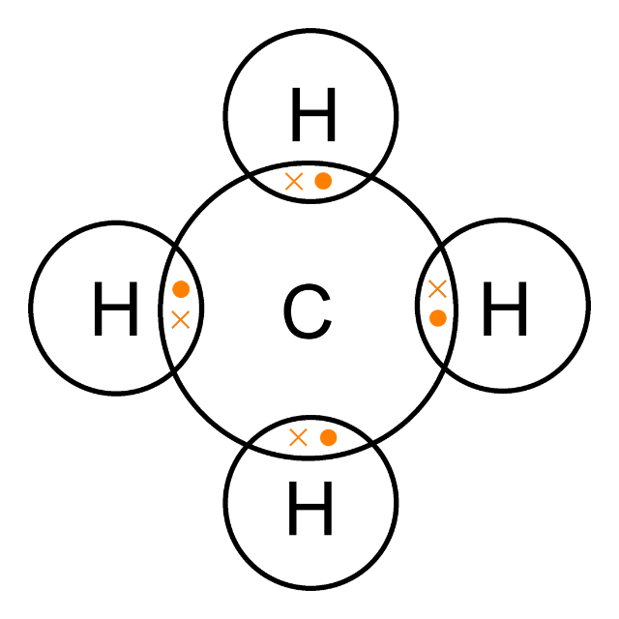
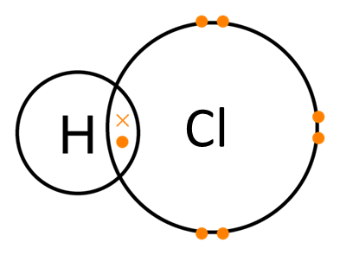
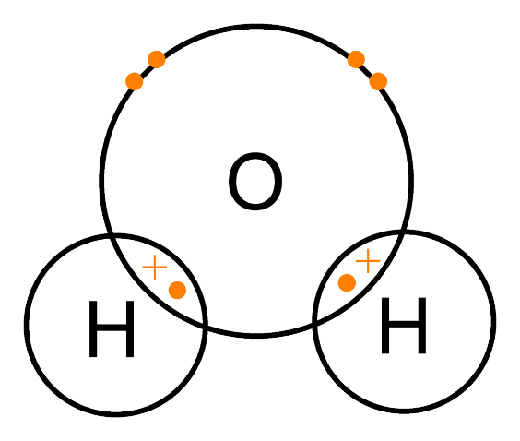
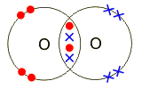
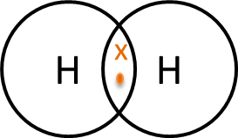
Covalent bonding
Covalently bonded substances may consist of small molecules. The covalent bond in molecules can be represented using dot and cross diagrams.
Normally only the outer shell of electrons is shown. These are the simple molecular, covalent substances mentioned in the specification.
Hydrogen chloride
Water
Methane
Hydrogen
Oxygen
Carbon dioxide

Slide 59
QuestionIT!
Bonding
PART 2
Covalent bonding

Slide 60
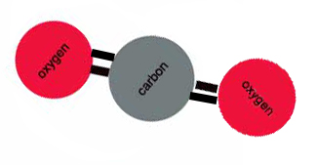
Bonding – Part 2 – QuestionIT
How are strong covalent bonds formed?
What is formed by covalent bonding?
What is the formula of the following model?
What is the typical size of an atom?
Draw a dot and cross diagram for water.
Draw a dot and cross diagram for an oxygen molecule.

Slide 61
AnswerIT!
Bonding
PART 2
Covalent bonding

Slide 62
Bonding – Part 2 – QuestionIT
How are strong covalent bonds formed?
A pair of electrons is shared between two atoms.
What is formed by covalent bonding?
Molecules.
What is the formula of the following model?
CO₂
What is the typical size of an atom?
0.1nm

Slide 63
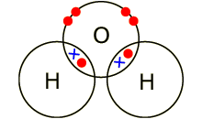
Bonding – Part 2 – QuestionIT
Draw a dot and cross diagram for water.
Draw a dot and cross diagram for an oxygen molecule.

Slide 64
LearnIT!
KnowIT!
Properties of
substances Part 1
Ionic substances
Covalent substances, simple molecular compounds

Slide 65
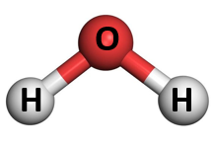
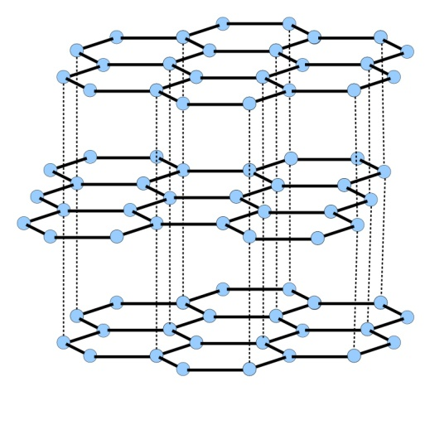
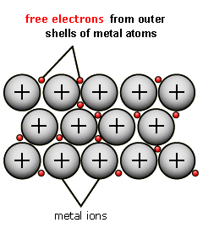
Classification of elements and compounds
Elements and compounds can be classified as:
Ionic
Simple molecular (covalent)
Giant covalent
Metallic
The structure and bonding in these substances results in different physical properties including:
Relative melting and boiling points
Relative solubility in water
The ability to conduct electricity.

Slide 66
Properties of ionic compounds
Structure
Ionic compounds have regular structures called giant ionic lattices.
There is strong electrostatic forces of attraction in all directions between oppositely changed ions.
Properties
High melting and boiling points – large amounts of energy is needed to break the many strong bonds and overcome the electrostatic attraction.
Conduct electricity when molten or dissolved in water – ions are free to move and can carry charge.
Solubility in water – ionic compounds are soluble in water the ions separate.

Slide 67
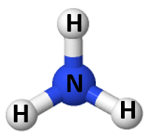
Properties of small molecules
Structure
They have weak forces between the molecules. These weak forces are overcome when they change state not the strong covalent bonds.
Properties
Low melting and boiling points – small amounts of energy is needed to break the intermolecular forces. Most are gases or liquids.
Poor conduction of electricity – Particles do not have an overall electric charge.
Intermolecular forces increase with the size of the molecules. So larger molecules have higher melting and boiling points.

Slide 68
QuestionIT!
Properties of substances Part 1
Ionic substances
Covalent substances, simple molecular compounds

Slide 69
Properties of substances – Part 1 – QuestionIT
Describe the structure of ionic compounds.
Why do ionic compounds have high melting and boiling points?
Why can ionic compounds conduct electricity when melted or dissolved in water?
What state of matter are small molecules normally found in?
Why do small molecules have low melting and boiling points?

Slide 70
Properties of substances – Part 1 – QuestionIT
What happens to the melting and boiling points as small molecules get bigger? Why?
Why don’t small molecules conduct electricity?

Slide 71
AnswerIT!
Properties of substances Part 2
Ionic substances
Covalent substances, simple molecular compounds

Slide 72
Properties of substances – Part 1 – QuestionIT
Describe the structure of ionic compounds.
Regular, giant ionic lattice.
Why do ionic compounds have high melting and boiling points?
Strong electrostatic forces of attraction between ions.
Why can ionic compounds conduct electricity when melted or dissolved in water?
Ions are free to move, carry the charge.
What state of matter are small molecules normally found in?
Gas or liquid.
Why do small molecules have low melting and boiling points?
Weak forces between molecules/ intermolecular forces.

Slide 73
Properties of substances – Part 1 – QuestionIT
What happens to the melting and boiling points as small molecules get bigger? Why?
Increases, intermolecular forces get bigger.
Why don’t small molecules conduct electricity?
Do not have an overall electric charge.

Slide 74
LearnIT!
KnowIT!
Properties of substances Part 2
Diamond
Graphite
Graphene and fullerenes
Polymers

Slide 75
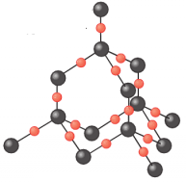
Giant covalent structures
Structure
All atoms within the structure are linked by strong covalent bonds. These bonds must be broken for a solid to melt or boil.
Properties
Very high melting and boiling points – very large amounts of energy is needed to break the covalent bonds.
Do not conduct electricity – Particles do not have an overall electric charge. (Graphite is an exception)
Graphite and diamond are different forms of carbon and are examples of giant covalent structures

Slide 76
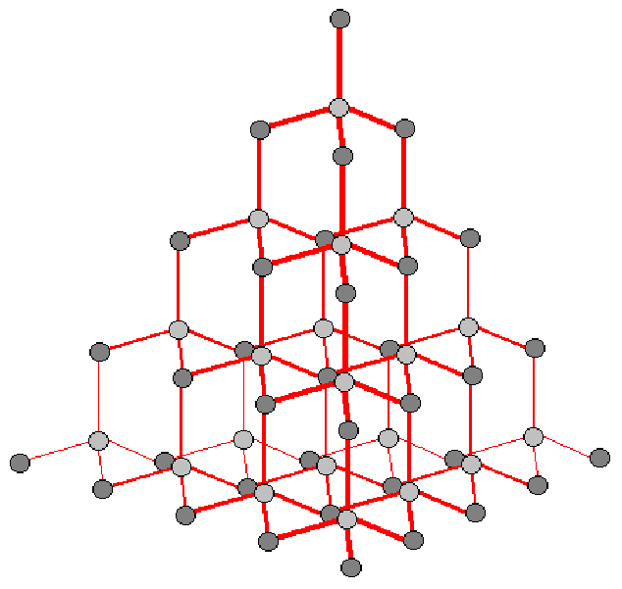
Diamond
Diamond:
In diamond, each carbon atom forms four covalent bonds with other carbon atoms in a giant covalent structure.
Diamond is very hard – it is the hardest natural substance, so it is often used to make jewellery and cutting tools.
Diamond has a very high melting and boiling point – a lot of energy is needed to break the covalent bonds.
Diamond cannot conduct electricity – there are no free electrons or ions to carry a charge.
Diamond is used in cutting tools as it is very hard with a high melting point.

Slide 77
Graphite
Graphite:
In graphite, carbon atom forms three covalent bonds with three other carbon atoms, forming layers of hexagonal rings which have no covalent bonds between the layers.
Graphite is soft and slippery – layers can easily slide over each other because the weak forces of attraction between the layers are easily broken. This is why graphite is used as a lubricant.
Graphite conducts electricity – the only non-metal to do so. One electron from each carbon atom is delocalised.
Graphite is used to make electrodes because it is able to conduct electricity. It is also used a lubricant because it is soft and the layers can slide over each other.

Slide 78
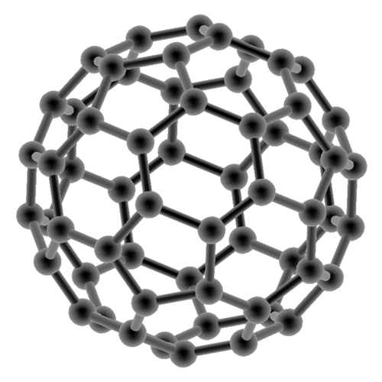
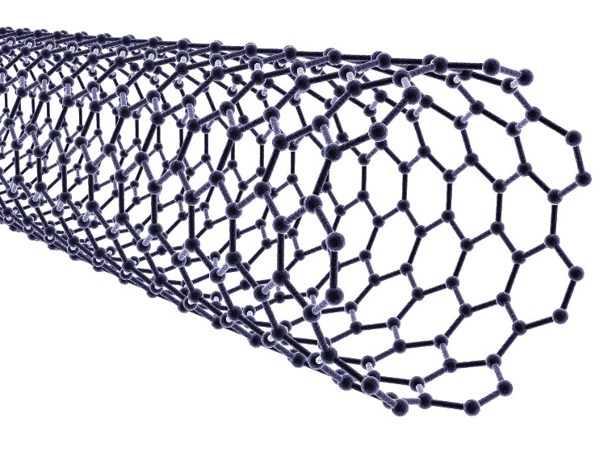
Fullerenes
Fullerenes:
Fullerenes are molecules of carbon with hollow shapes.
The structure is based on hexagonal rings of carbon
atoms, but may have 5 or 7 carbon rings. The first to be
discovered was Buckminsterfullerene (C₆₀)
which is spherical (like a football).
Carbon nanotubes are cylindrical fullerenes with very high length compared to their diameter. This makes them useful for nanotechnology, electronics and materials.

Slide 79
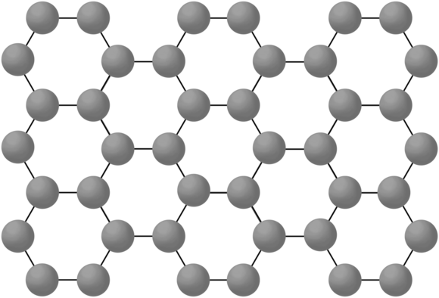
Graphene
Graphene:
This is a single layer of graphite – a layer of inter-locking hexagonal rings of carbon atoms one atom thick.
It is an excellent conductor of thermal energy and electricity (even better than graphite), has a very low density and is incredibly strong.
It has many uses in the electronics industry.

Slide 80
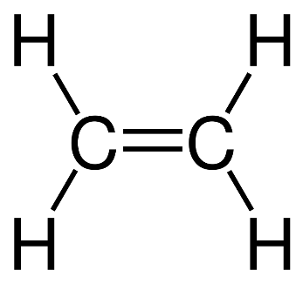
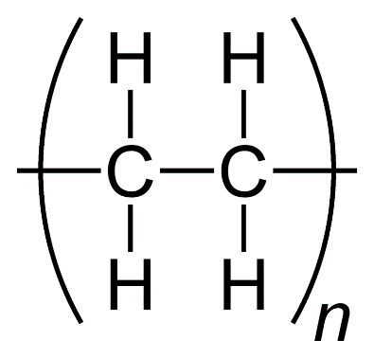
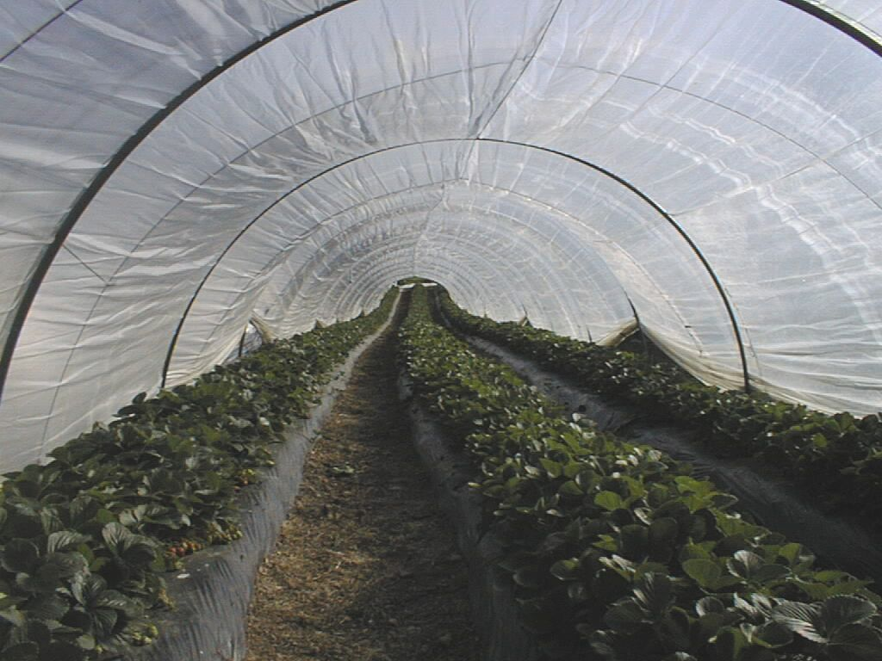
Polymers
Simple polymers consist of large molecules containing chains of carbon atoms e.g. poly(ethene) is a hydrocarbon chain made from ethene monomers.

Slide 81
QuestionIT!
Properties of substances Part 2
Diamond
Graphite
Graphene and fullerenes
Polymers

Slide 82
Properties of substances – Part 2 – QuestionIT
In a diamond, how many covalent bonds does each carbon make?
Diamond does not conduct electricity. Why?
Name 2 other properties of diamond.
In graphite, how many covalent bonds does each carbon make?
Describe the structure of graphite.
Why is graphite soft?

Slide 83
Properties of substances – Part 2 – QuestionIT
Why does graphite conduct electricity?
How is graphite similar to metals?
What is graphene?
What are fullerenes?
What was the first fullerene to be discovered?
What are carbon nanotubes?
What are carbon nanotubes useful for?

Slide 84
AnswerIT!
Properties of substances Part 2
Diamond
Graphite
Graphene and fullerenes
Polymers

Slide 85
Properties of substances – Part 2 – QuestionIT
In a diamond, how many covalent bonds does each carbon make?
4
Diamond does not conduct electricity. Why?
No delocalised electrons.
Name 2 other properties of diamond.
Hard, very high melting point.
In graphite, how many covalent bonds does each carbon make?
3
Describe the structure of graphite.
Layers of hexagonal rings.
Why is graphite soft?
Layers can slide over each other, weak forces between layers, no covalent bonds between layers.

Slide 86
Properties of substances – Part 2 – QuestionIT
Why does graphite conduct electricity?
Each carbon has one delocalised electron.
How is graphite similar to metals?
It contains delocalised electrons.
What is graphene?
Single layer of graphite, 1 atom thick.
What are fullerenes?
Molecules of carbon atoms with hollow shapes.
What was the first fullerene to be discovered?
Buckminsterfullerene.
What are carbon nanotubes?
Cylindrical fullerenes.
What are carbon nanotubes useful for?
Electronics, nanotechnology and materials.

Slide 87
LearnIT!
KnowIT!
Properties of substances Part 3
Properties of metals
Limitations of models

Slide 88
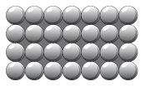
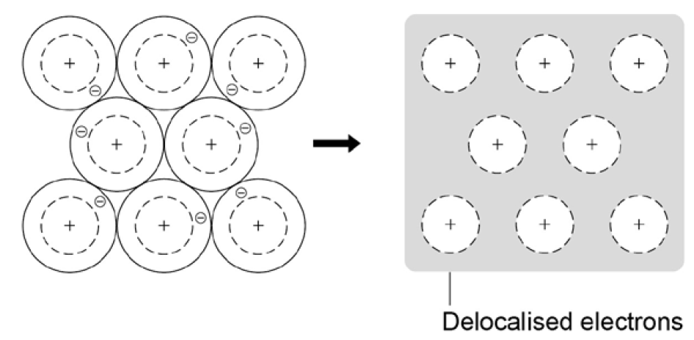
Metallic bonding
The atoms in metals are built up layer upon layer in a regular pattern. They are another example of a giant structure.
The electrons in the outer shell of metal atoms are delocalised and are free to move throughout the structure.
The sharing of delocalised electrons leads to strong metallic bonds.
Metallic bonding can be represented in the following form:

Slide 89
Properties of metals
The giant structure of atoms with strong metallic bonding gives most metals a high melting and boiling point.
Metals are malleable (can be hammered into shape) and ductile (can be drawn out into a wire) because the layers of atoms (or ions) in a giant metallic structure can slide over each other
Delocalised electrons in metals enable electricity and heat to pass through the metal easily.

Slide 90
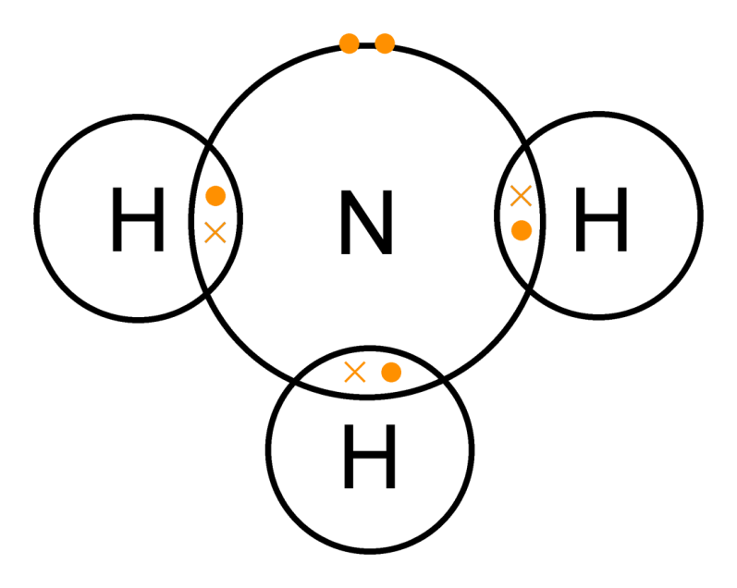
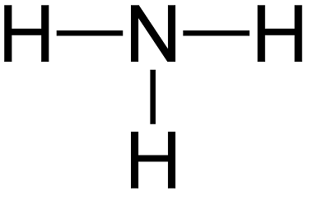
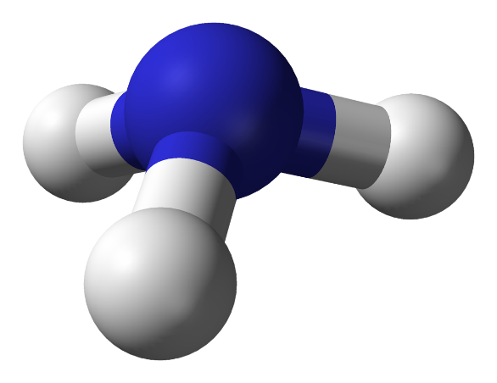
Limitations of models
Dot and cross with outer shells as circles:
+ Show which atom the
electrons in the bonds come
from
- All electrons are identical
2D with bonds:
+ Show which atoms are bonded together
3D ball and stick model:
+ Attempts to show the correct H-N-H bond angle is 107.8°
+ Shows the impact of the lone pair
- It shows the H-N-H bond
incorrectly at 90°
Dot and cross with outer shells electrons:

Slide 91
QuestionIT!
Properties of substances Part 3
Properties of metals
Limitations of models

Slide 92
Properties of substances – Part 3 – QuestionIT
Why do most metals have high melting and boiling points?
How are atoms arranged in pure metals?
Why are metals good conductors of electricity?
What is thermal energy?
Why are metals good conductors of thermal energy?
What are the limitations of using dot and cross diagrams to represent covalent bonds?

Slide 93
Properties of substances – Part 3 – QuestionIT
How are atoms arranged in a metal?
Why are metallic bonds so strong?
Why are the particles that make up a metal described as positively charged?
What are delocalised electrons?

Slide 94
AnswerIT!
Properties of substances Part 3
Properties of metals
Limitations of models

Slide 95
Properties of substances – Part 3 – QuestionIT
Why do most metals have high melting and boiling points?
Strong metallic bonding.
How are atoms arranged in pure metals?
Layers.
Why are metals good conductors of electricity?
Electrical charge carried by delocalised electrons.
What is thermal energy?
Heat energy.
Why are metals good conductors of thermal energy?
Energy is transferred by delocalised electrons.

Slide 96
Properties of substances – Part 3 – QuestionIT
What are the limitations of using dot and cross diagrams to represent covalent bonds?
It shows the electrons differently, when they are the same and it does not show the bond angles or shape of the molecule.
How are atoms arranged in a metal?
Giant structures of atoms, arranged in a regular pattern, delocalised electrons.
Why are metallic bonds so strong?
Sharing of delocalised electrons.

Slide 97
Properties of substances – Part 3 – QuestionIT
Why are the particles that make up a metal described as positively charged?
The metal atoms lose outer shell electrons and therefore there
are more protons (+) than electrons (−).
What are delocalised electrons?
They are free-moving electrons within structure; not associated
with a particular atom.

Slide 98
LearnIT!
KnowIT!
Calculations involving masses
PART 1
Relative formula mass

Slide 99
Chemical measurements - PART 2
Relative formula mass (M_{r}) of a compound is the sum of the relative atomic masses of the atoms in the numbers shown in the formula.
The relative atomic masses can be found in the periodic table
In a balanced chemical equation, the sum of the relative formula masses of the reactants equals the sum of the relative formula masses of the products.
For example: 2Mg + O₂ → 2MgO
(2x24) + (2x16) → 2 x (24+16)
80 → 80
NaCl
(1 x Na + 1 x Cl)
A_{r}: Na (23) Cl (35.5)
M_{r} = 23 + 35.5 = 58.5
H₂O
(2 x H + 1 x O)
A_{r}: H (1) O (16)
M_{r} = (1 x 2) + 16 = 18
H₂SO₄
(2 x H + 1 x S + 4 x O)
A_{r}: H (1) S (32) O (16)
M_{r} = (1x2) + 32 + (16x4) = 98
Al₂(SO₄)₃
(2 x Al + 3 x S + 12 x O)
A_{r}: Al (27) S (32) O (16)
M_{r} = (27x2) + (32x3) + (16x12) = 342

Slide 100
QuestionIT!
Calculations involving masses
PART 1
Relative formula mass

Slide 101
Chemical measurements– QuestionIT
What is the relative formula mass of a compound?
What is the relative formula mass of:
a) MgCl₂
b) C₆H₁₂O₆
What can be said about the sum of the relative formula masses of the reactants and products of a reaction?
Why can you have relative atomic masses which are not whole numbers e.g. chlorine is 35.5?

Slide 102
AnswerIT!
Calculations involving masses
PART 1
Relative formula mass

Slide 103
Chemical measurements– QuestionIT
What is the relative formula mass of a compound?
Sum of the relative atomic masses of the atoms in the numbers shown in the formula.
What is the relative formula mass of:
a) MgCl₂ 95
b) C₆H₁₂O₆ 180
What can be said about the sum of the relative formula masses of the reactants and products of a reaction?
In a balanced chemical equation – the sum of the relative formula masses of the reactants in the quantities shown = sum of the relative formula masses of the products in the quantities shown.

Slide 104
Chemical measurements– QuestionIT
Why can you have relative atomic masses which are not whole numbers e.g. chlorine is 35.5?
Isotopes.

Slide 105
LearnIT!
KnowIT!
Calculations involving masses
PART 2
Empirical and molecular formulae

Slide 106
Calculate the formulae of simple compounds
It is possible to find the formula of a simple compound using reacting masses or percentage composition.
The calculations are easier if written in columns for each element
Proportion of each element in the compound
Reacting masses | Percentage composition
Mass ÷ relative atomic mass Find the ratio Use ratio to find empirical formula | Percentage ÷ relative atomic mass Find the ratio Use ratio to find empirical formula
To find the ratio divide all the numbers by the smallest
Simplest ratio of atoms of each substance in formula

Slide 107
Calculate the formulae of simple compounds
Reacting masses | Percentage composition
Mass ÷ relative atomic mass Find the ratio Use ratio to find empirical formula | Percentage ÷ relative atomic mass Find the ratio Use ratio to find empirical formula
Calculate the empirical formula for a compound which contains 11.2g iron and 4.8g oxygen. Relative atomic masses: Fe 56; O 16 | Scientists found a compound containing 75% carbon and 25% hydrogen. Calculate the empirical formula for the compound. Relative atomic masses: C 12; H 1
 | Fe | O
Mass | 11.2 | 4.8
RAM | 56 | 16
Mass ÷ RAM | 0.2 | 0.3
Ratio | 1 | 1.5
Formula | Fe₂O₃
 | C | H
% | 75 | 25
RAM | 12 | 1
% ÷ RAM | 6.25 | 25
Ratio | 1 | 4
Formula | CH₄
Ratios x 2 to get whole numbers

Slide 108
Empirical and molecular formulae
It is possible to deduce the empirical formula of a compound from the formula of its molecule, and the molecular formula of a compound from its empirical formula and relative molecular mass.
Finding the empirical formula | Finding the molecular formula
Find the simplest whole number ratio from the formula For Fe₂O₄ the empirical formula would be FeO₂ For C₆H₁₂O₆ the empirical formula would be CH₂O | Find the relative formula mass for the empirical formula Find the relative formula mass of the compound (this may be given to you) RFM of compound ÷ RFM of empirical formula = x Multiply the numbers in the empirical formula by x

Slide 109
Empirical and molecular formulae
Finding the molecular formula
Find the relative formula mass for the empirical formula Find the relative formula mass of the compound (this may be given to you) RFM of compound ÷ RFM of empirical formula = x Multiply the numbers in the empirical formula by x
The empirical formula for a hydrocarbon is CH₂ its relative formula mass is 70. Deduce the molecular formula of this compound.
Relative atomic masses: C 12, H 1
RFM for empirical formula: 12 + (2 x 1) = 14
RFM for compound, given in question: 70
RFM of compound ÷ RFM of empirical formula = 70 ÷ 14 = 5
Multiply the numbers in the empirical formula by 5 = C₅H₁₀
Molecular formula = C₅H₁₀

Slide 110
Determine empirical formula experimentally
When magnesium is heated in a crucible it reacts with oxygen and forms magnesium oxide:
2Mg + O₂ → 2MgO
This equation shows that two magnesium atoms react with one oxygen molecule to form two magnesium oxide compounds.
Here are the results from the reaction:
Method:
Find mass of empty crucible + lid
Find mass of magnesium ribbon
Heat magnesium in crucible, lift lid occasionally to allow oxygen in, do not allow loss of magnesium oxide
Cool, find mass of container, contents + lid
Repeat heating until constant mass
 | Mass/ g
Empty crucible + lid | 0.23
Magnesium ribbon | 0.42
Crucible + lid at end of reaction | 0.93

Slide 111
Determine empirical formula experimentally
 | Mass/ g
Empty crucible + lid | 0.23
Magnesium ribbon | 0.42
Crucible + lid at end of reaction | 0.93
Calculation:
Mass magnesium oxide = mass crucible & lid at end – mass empty crucible & lid
0.93 – 0.23 = 0.70g
Mass oxygen = mass magnesium oxide – mass magnesium ribbon
0.70 – 0.42 = 0.28g
Mass ÷ RFM magnesium 0.42 ÷ 24 = 0.0175
Mass ÷ RFM oxygen 0.28 ÷ 16 = 0.0175
Ratio 1:1
Empirical formula MgO

Slide 112
QuestionIT!
Calculations involving masses
PART 2
Empirical and molecular formulae

Slide 113
Empirical and molecular formulae – QuestionIT
What is meant by the term empirical formula?
What is meant by the term molecular formula?
Give the empirical formula for the compound C₁₂H₂₄.
Give the empirical formula for the compound H₂O₂.
Scientists found a compound contained 22.8% sodium, 21.8% boron and 55.4% oxygen. Calculate the empirical formula of the compound. Relative atomic masses: B 11; O 16; Na 23

Slide 114
Empirical and molecular formulae – QuestionIT
Give the empirical formula for compounds containing:
6.2g phosphorus and 48g bromine; RAM: P 31; B 80
7.5% phosphorus and 92.5% Iodine; RAM: P 31; I 127
The empirical formula for a hydrocarbon is CH₂ its relative formula mass is 56. Deduce the molecular formula of this compound. Relative atomic masses: C 12, H 1

Slide 115
AnswerIT!
Calculations involving masses
PART 2
Empirical and molecular formulae

Slide 116
Empirical and molecular formulae – QuestionIT
What is meant by the term empirical formula?
Simplest ratio of atoms of each substance in formula.
What is meant by the term molecular formula?
Shows the number of atoms of each element in a molecule.
Give the empirical formula for the compound C₁₂H₂₄.
CH₂
Give the empirical formula for the compound H₂O₂.
HO

Slide 117
Empirical and molecular formulae – QuestionIT
Scientists found a compound contained 22.8% sodium, 21.8% boron and 55.4% oxygen. Calculate the empirical formula of the compound. Relative atomic masses: B 11; O 16; Na 23
 | Na | B | O
% | 22.8 | 21.8 | 55.4
RAM | 23 | 11 | 16
% ÷ RAM | 1.0 | 2.0 | 3.5
Ratio | 1 | 2 | 3.5
Formula | Na₂B₄O₇

Slide 118
Empirical and molecular formulae – QuestionIT
Give the empirical formula for compounds containing:
6.2g phosphorus and 48g bromine; RAM: P 31; B 80
7.5% phosphorus and 92.5% Iodine; RAM: P 31; I 127
 | P | B
Mass | 6.2 | 48
RAM | 31 | 80
Mass ÷ RAM | 0.2 | 0.6
Ratio | 1 | 3
Formula | PB₃
 | P | I
% | 7.5 | 92.5
RAM | 31 | 127
% ÷ RAM | 0.24 | 0.73
Ratio | 1 | 3
Formula | PI₃

Slide 119
Empirical and molecular formulae – QuestionIT
The empirical formula for a hydrocarbon is CH₂ its relative formula mass is 56. Deduce the molecular formula of this compound. Relative atomic masses: C 12, H 1
RFM empirical formula = 12 + (2 x 1) = 14
RFM for compound = 56
56 ÷ 14 = 4
C₄H₈

Slide 120
LearnIT!
KnowIT!
Calculations involving masses - PART 3
Conservation of mass

Slide 121
Conservation of mass
Chemical equations can be very useful.
The law of conservation states that no atoms are lost or made during a chemical reaction so the mass of the product equals the mass of the reactants.
Mass products = Mass reactants
Chemical reactions can be represented by symbol equations which are balanced in terms of the numbers of atoms of each element involved on both sides of the equation.
When hydrogen molecules react with chlorine molecules, they make hydrogen chloride molecules:
H₂ + Cl₂ → HCl
This equation shows the reactants and products, but it is not balanced.
H₂ + Cl₂ → 2HCl
This balanced equation shows that one hydrogen molecules reacts with one chlorine molecule to form two molecules of hydrochloric acid.

Slide 122
Conservation of mass: closed systems
A precipitation reaction is a simple example of conservation of mass.
A precipitate (insoluble solid) is formed during the reaction.
The reactants and products remain inside the closed reaction making it easy to see that the overall mass has not changed.
Mass products = Mass reactants
AgNO_{3(aq)} + NaCl_{(aq)} → AgCl_{(s)} + NaNO_{3(aq)}
Precipitate – insoluble solid – remains in solution

Slide 123
Conservation of mass: non-enclosed systems
When magnesium is heated in a crucible it reacts with oxygen and forms magnesium oxide:
2Mg + O₂ → 2MgO
This equation shows that two magnesium atoms react with one oxygen molecule to form two magnesium oxide compounds.
Here are the results from the reaction:
Some reactions may appear to involve a change in mass but this can be explained because a reactant or product is usually a gas and its mass has not been taken into account.
In this example, the mass of the magnesium oxide produced is greater than the mass of the original metal.
 | Mass in g
Mass of crucible at the start of the reaction | 0.23
Mass of crucible at end of reaction | 0.41

Slide 124
Conservation of mass: non-enclosed systems
When calcium carbonate thermally decomposes it forms calcium oxide and carbon dioxide:
CaCO₃ → CaO + CO₂
This equation shows that one calcium carbonate compound (made from one calcium, one carbon and three oxygen atoms) forms one calcium oxide compound and one carbon dioxide molecule.
Here are the results from the reaction:
In thermal decomposition of metal carbonates, carbon dioxide is produced and escapes into the atmosphere leaving the metal oxide as the only solid product.
In this example, the mass of the calcium oxide produced is less than the mass of the metal carbonate formed.
 | Mass in g
Mass of metal carbonate at the start of the reaction | 0.54
Mass of metal carbonate at end of reaction | 0.36

Slide 125
QuestionIT!
Calculations involving masses - PART 3
Conservation of mass

Slide 126
Chemical measurements – QuestionIT
What is the law of conservation of mass?
Why might some reactions appear to show a change in mass?
Give two examples of a reaction where a change in mass may appear to take place.
Balance the following equations:
H₂ + O₂ → H₂O
Ca + HCl → CaCl₂ + H₂
Li + H₂O → LiOH + H₂
NH₃ + O₂ → NO + H₂O
K + O₂ → K₂O

Slide 127
Chemical measurements – QuestionIT
An aqueous solution of hydrogen peroxide (H₂O₂) decomposes to form water and oxygen.
a) Write a balanced symbol equation for this reaction. Include
the state symbols.
b) Why does the water, produced during the reaction, have a lower mass than the original hydrogen peroxide?
What is a precipitate?
How does a precipitation reaction show conservation of mass?

Slide 128
AnswerIT!
Calculations involving masses - PART 3
Conservation of mass

Slide 129
Chemical measurements – QuestionIT
What is the law of conservation of mass?
Mass of reactants = mass products.
Why might some reactions appear to show a change in mass?
A reactant or a product is a gas.
Give two examples of a reaction where a change in mass may appear to take place.
Metal reacting with oxygen or an acid. Thermal decomposition.
Balance the following equations:
2H₂ + O₂ → 2H₂O
Ca + 2HCl → CaCl₂ + H₂
2Li + 2H₂O → 2LiOH + H₂
4NH₃ + 5O₂ → 4NO + 6H₂O
4K + O₂ → 2K₂O

Slide 130
Chemical measurements – QuestionIT
An aqueous solution of hydrogen peroxide (H₂O₂) decomposes to form water and oxygen.
a) Write a balanced symbol equation for this reaction. Include
the state symbols.
2H₂O₂ (aq) → 2H₂O (l) + O₂(g)
b) Why does the water, produced during the reaction, have a lower mass than the original hydrogen peroxide?
Because the oxygen gas produced during the reaction escaped into the atmosphere.
What is a precipitate?
Insoluble solid produced during a reaction.
How does a precipitation reaction show conservation of mass?
Mass reactants = mass products; all products remain in the reaction container.

Slide 131
LearnIT!
KnowIT!
Calculations involving masses – Part 4
Masses of reactants and products from balanced equations
Calculate the concentration of solutions

Slide 132
Masses of reactants and products from balanced equations
It is possible to calculate the mass of a reactant or a product from a balanced chemical equation given the mass of one of the substances.
2Mg + O₂ → 2MgO
This balanced symbol equation tells us:
2 moles of Magnesium react with 1 mole of oxygen to give 2 moles of magnesium oxide.
Method 1:
How many grams of magnesium oxide would be produced by 2 grams of magnesium burnt in excess oxygen? Relative atomic masses: Mg 24; O 16
Calculate the relative formula masses and convert to the units in the question:
Mg = 24g; MgO = 40g
Find the ratio by dividing both numbers by the smallest number:
Mg = 24 ÷ 24 = 1; MgO = 40 ÷ 28 = 1.67
Find the mass of the unknown by multiplying the mass of the known by the ratio of the unknown:
Mass MgO = 2g x 1.67 = 3.3g

Slide 133
Masses of reactants and products from balanced equations
2Mg + O₂ → 2MgO
This balanced symbol equation tells us:
2 moles of Magnesium react with 1 mole of oxygen to give 2 moles of magnesium oxide.
Method 2 (using the mole equation):
How many grams of magnesium oxide would be produced by 2 grams of magnesium burnt in excess oxygen? Relative atomic masses: Mg 24; O 16
Find the number of moles of the given substance:
Mass ÷ RFM = 2 ÷ 24 = 0.083 moles
Use the equation to find the ratio:
2Mg : 2MgO
So 0.083 moles Mg will produce 0.083 moles MgO
Find the mass of the product:
Moles x RFM = 0.083 x 40 = 3.3g

Slide 134
Concentration of solutions
Chemists quote the amount of substance (solute) dissolved in a certain volume of the solution. The units used to express the concentration can be grams per decimetre cubed (g/dm³). A decimetre (1dm ³) cubed is equal to 1000cm³.
The blackcurrant juice is getting more concentrated – the darker colour indicates more squash is in the same volume of its solution
If you know the mass of the solute dissolved in a certain volume of solution, you can work out the concentration using:
Concentration = amount of solute (g)
(g/dm³ ) Volume of solution (dm³)
Remember if you are using cm³ to multiply the volume by 1000 to covert to dm³
Example 1:
50g of sodium hydroxide is dissolved in water to make up 200cm³ .
What is the concentration in dm³?
50g/200cm³= 0.25g/cm³
0.25g/cm³ x 1000 = 250g/dm³

Slide 135
Concentration of solution
Example 2:
A solution of sodium chloride has a concentration of 200g/dm³.
What is the mass of sodium chloride in 700cm³ of solution?
Convert 700cm³ into dm³
700/1000 = 0.7 dm³
Then rearrange the equation
amount of solute = concentration x volume of solution
(g) (g/dm³) (dm³)
200g/dm³ x 0.7 dm³ = 140g

Slide 136
QuestionIT!
Calculations involving masses – Part 4
Masses of reactants and products from balanced equations
Calculate the concentration of solutions

Slide 137
Calculations involving masses – Part 4 – QuestionIT
What units can be used for the concentration of a solution?
What does dm³ mean?
Give the equation for calculating concentration from the mass of substance and volume of solution.
What mass of carbon dioxide is formed when 12g of carbon is burned in air? Relative atomic masses: C 12; O 16
C + O₂ → CO₂

Slide 138
Calculations involving masses – Part 4 – QuestionIT
Calculate the concentration in g/dm³ for 50g of sodium chloride in 2.5 dm³ of water.
Calculate the concentration in g/dm³ of 1.4g of potassium carbonate in 855cm³ of water.
A teacher has a solution of lithium fluoride with a concentration of 72.6g/dm³. Calculate the mass of lithium fluoride dissolved in 25.0cm³ of solution.

Slide 139
AnswerIT!
Calculations involving masses – Part 4
Masses of reactants and products from balanced equations
Calculate the concentration of solutions

Slide 140
Calculations involving masses – Part 4 – QuestionIT
What units can be used for the concentration of a solution?
g/dm³
What does dm³ mean?
1000cm³
Give the equation for calculating concentration from the mass of substance and volume of solution.
Concentration = mass ÷ volume
What mass of carbon dioxide is formed when 12g of carbon is burned in air? Relative atomic masses: C 12; O 16
C + O₂ → CO₂
44g

Slide 141
Calculations involving masses – Part 4 – QuestionIT
Calculate the concentration in g/dm³ for 50g of sodium chloride in 2.5dm³ of water.
50/2.5 = 20g/dm³
Calculate the concentration in g/dm³ of 1.4g of potassium carbonate in 855cm³ of water.
(1.4/855) x 1000 = 1.64 g/dm³
A teacher has a solution of lithium fluoride with a concentration of 72.6g/dm³. Calculate the mass of lithium fluoride dissolved in 25.0cm³ of solution.
25cm³ = 0.025dm³
72.6 x 0.025 = 1.8g

Slide 142
LearnIT!
KnowIT!
Calculations involving masses – Part 5
Moles (HT)
Stoichiometry (HT)

Slide 143
The mole and Avogadro constant
Chemical amounts are measured in moles. The symbol for the unit mole is mol.
The mass of one mole of a substance in grams is numerically equal to its ‘relative particle mass’. One mole of a substance contains the same number of the stated particles, atoms, molecules or ions as one mole of any other substance.
The number of atoms, molecules or ions in a mole of a given substance is the Avogadro constant. The value of the Avogadro constant is 6.02 x 10²³ per mole.
Number of moles = mass (g) or mass (g)
A_{r} M_{r}
Mass (g) = number of moles x A_{r}
or number of moles x M_{r}
How many moles of sulfuric acid molecules are there in 4.7g of sulfuric acid (H₂SO₄)? Give your answer to 1 significant figure.
4.7 = 0.05 mol
98
What is the mass of 7.2 x 10⁻³ moles of aluminium sulfate (Al₂(SO₄)₃)? Give your answer to 1 decimal place.
7.2 x 10⁻³ x 342 = 2.5g

Slide 144
The mole and Avogadro constant
Multiplying the number of moles by the Avogadro constant will give us the number of particles in a given number of moles.
Moles x Avogadro constant = number of particles of a substance.
It is also possible to work out the number of particles in a given mass.
Mass ÷ RFM (or RAM) = moles
Moles x Avogadro constant = number of particles of a substance.
How many molecules are there in 7.2 x 10⁻³ moles of aluminium sulfate (Al₂(SO₄)₃)?
Moles x Avogadro constant
7.2 x 10⁻³ x 6.02 x 10²³ = 4.3 x 10²¹
How many molecules of sulfuric acid are there in 4.7g of sulfuric acid (H₂SO₄)?
Relative atomic masses: H 1; S 32; O 16
Mass ÷ RFM = moles
4.7 ÷ (2 + 32 + 64) = 0.05 moles
Moles x Avogadro constant
0.05 x 6.02 x 10²³ = 3.01 x 10²²

Slide 145
In excess
In a chemical reaction one of the reactants will often be used ‘in excess’. This means there is more of that reactant present than is needed in the reaction. Some of this reactant will be left over at the end of the reaction.
The reaction will stop when the other reactant is used up. This other reactant is often called the limiting reactant as it limits the amount of products.
Therefore, in a reaction the mass of the product formed is controlled by the mass of the reactant not in excess, the limiting reactant.
In this example the reaction is:
A + B → C
B is the limiting reactant and A is in excess.
The reaction stops when B has all been used up. There is some A left over at the end of the reaction.
B

Slide 146
Stoichiometry
The balancing numbers in a symbol equation can be calculated from the masses of reactants and products by converting the masses in grams to amounts in moles and converting the number of moles to simple whole number ratios.
8.5g of sodium nitrate (NaNO₃) is heated until its mass is constant.
6.9g of sodium nitrite (NaNO₂) and 1.6g of oxygen gas (O₂) is produced.
NaNO₃ → NaNO₂ + O₂
M_{r}: NaNO₃ = 23 + 14 + (16x3) = 85
M_{r}: NaNO₂ = 23 + 14 + (16x2) = 69
M_{r}: O₂ = 16x2 = 32
Then to convert masses to moles use:
Moles of NaNO₃ = 8.5/85 = 0.1 mol
Moles of NaNO₂ = 6.9/69 = 0.1 mol
Moles of O₂ = 1.6/32 = 0.05 mol
Dividing the ratio by the smallest number gives 2:2:1 2NaNO₃ → 2NaNO₂ + O₂
Number of moles = mass (g)
M_{r}
NaNO₃ : NaNO₂ : O₂
0.1 : 0.1 : 0.05

Slide 147
Stoichiometry
In a chemical reaction involving two reactants, it is common to use an excess of one of the reactants to ensure that all the reactant is used up. The reactant that is completely used up is called the limiting reactant because it limits the amount of products.
4.8g of magnesium ribbon reacts with 7.3g of HCl.
Which is the limiting reactant?
Mg(s) + 2HCl(aq) → MgCl₂(aq) + H₂(g)
A_{r}: Mg (24) and A_{r}: Cl (35.5)
4.8g of Mg = 4.8/24 moles = 0.2 mol
7.3g of HCl = 7.3/36.5 moles = 0.2 mol
From the balanced equation:
1 mole of Mg reacts with 2 moles of HCl,
therefore 0.2 mol of Mg will need 0.4 mol of HCl to react completely, there is only 0.2 mol of HCl, so the HCl is the limiting reactant.

Slide 148
QuestionIT!
Calculations involving masses – Part 5
Moles (HT)
Stoichiometry (HT)

Slide 149
Use of amount of substance (HT) – QuestionIT
What is meant by the term ‘mole’?
What is the symbol for the unit mole?
What does ‘Avogadro’s constant’ tell us?
What is the value for Avogadro’s constant?
How many atoms in 1 mole of carbon?

Slide 150
Use of amount of substance (HT) – QuestionIT
How many atoms in 1 mole of chlorine gas, Cl₂?
What can the following equation tell us about the number of moles of each substance?
Mg + 2HCl → MgCl₂ + H₂
What is meant by the term ‘limiting reactant’?

Slide 151
Use of amount of substance (HT) – QuestionIT
How many moles of helium atoms are there in 0.04g of helium?
What is the mass of 20 moles of calcium carbonate CaCO₃?
Answer in kg.
Calcium carbonate decomposes to calcium oxide in a kiln in the following reaction: CaCO₃ → CaO + CO₂
Calculate the mass of calcium oxide that can be produced when
300 tonnes of calcium carbonate is heated.

Slide 152
Use of amount of substance (HT) – QuestionIT
0.10g of hydrogen reacts with 3.55g of chlorine to produce 3.65g of hydrogen chloride. Use this information to work out the balancing numbers for hydrogen chloride.
H₂ + Cl₂ → ___HCl

Slide 153
Use of amount of substance (HT) – QuestionIT
If 4.95 g of ethene (C₂H₄) are combusted with 3.25 g of oxygen, what is the limiting reactant?
C₂H₄ + 3O₂ → 2CO₂ + 2H₂O

Slide 154
AnswerIT!
Calculations involving
masses – Part 5
Moles (HT)
Stoichiometry (HT)

Slide 155
Use of amount of substance (HT) – QuestionIT
What is meant by the term ‘mole’?
A measure of the chemical amount of a substance.
What is the symbol for the unit mole?
mol
What does ‘Avogadro’s constant’ tell us?
Number of atoms, molecules or ions in a mole of a substance.
What is the value for Avogadro’s constant?
6.02 x 10²³ per mol
How many atoms in 1 mole of carbon?
6.02 x 10²³

Slide 156
Use of amount of substance (HT) – QuestionIT
How many atoms in 1 mole of chlorine gas, Cl₂?
6.02 x 10²³
What can the following equation tell us about the number of moles of each substance?
Mg + 2HCl → MgCl₂ + H₂
1 mole of magnesium reacts with 2 moles of hydrochloric acid to form 1 mole of magnesium chloride and 1 mole of hydrogen.
What is meant by the term ‘limiting reactant’?
A reactant in a reaction which is completely used up when the other reactant is in excess.

Slide 157
Use of amount of substance (HT) – QuestionIT
How many moles of helium atoms are there in 0.04g of helium?
0.04/4 = 0.01mol
What is the mass of 20 moles of calcium carbonate CaCO₃?
Answer in kg.
40+12+(16x3) = 100
100 x 20 = 2,000g = 2kg.
Calcium carbonate decomposes to calcium oxide in a kiln in the following reaction: CaCO₃ → CaO + CO₂
Calculate the mass of calcium oxide that can be produced when
300 tonnes of calcium carbonate is heated.
Relative formula mass of calcium carbonate = 100 = 100g
Relative formula mass of calcium oxide = 56 = 56g
100 tonnes of calcium carbonate makes 56 tonnes of calcium oxide
so 300 tonnes make 168 tonnes

Slide 158
Use of amount of substance (HT) – QuestionIT
0.10g of hydrogen reacts with 3.55g of chlorine to produce 3.65g of hydrogen chloride. Use this information to work out the balancing numbers for hydrogen chloride.
H₂ + Cl₂ → ___HCl
M_{r}: H₂ = 1 x 2 = 2
M_{r}: Cl₂ = 35.5 x 2 = 71
M_{r}: HCl = 1 + 35.5 = 36.5
Then to convert masses to moles use:
Moles of H₂ = 0.10/2 = 0.05 mol
Moles of Cl₂ = 3.55/71 = 0.05 mol
Moles of HCl = 3.65/36.5 = 0.1 mol
Dividing the ratio by the smallest number gives 1:1:2
H₂ + Cl₂ → 2HCl

Slide 159
Use of amount of substance (HT) – QuestionIT
If 4.95 g of ethene (C₂H₄) are combusted with 3.25 g of oxygen, what is the limiting reactant?
C₂H₄ + 3O₂ → 2CO₂ +2H₂O
M_{r}: C₂H₄ = 28
M_{r}: O₂ = 32
4.95/28 = 0.177 mol
3.25/32 = 0.102 mol
From the equation: 1 mole of ethene reacts with 3 moles of
oxygen. In this case 0.177 mol of ethene will need 0.53 mol of
oxygen to react, which we do not have, so oxygen is the limiting
factor.

