Slide 1


The PiXL Club The PiXL Club The PiXL Club The PiXL Club The PiXL Club The PiXL Club The PiXL Club The PiXL Club The PiXL Club The PiXL Club The PiXL Club The PiXL Club The PiXL Club The PiXL Club The PiXL Club The PiXL Club The PiXL Club The PiXL Club The PiXL Club The PiXL Club The PiXL Club The PiXL Club The PiXL Club The PiXL Club The PiXL Club The PiXL Club The PiXL Club The PiXL Club The PiXL Club The PiXL Club The PiXL Club The PiXL Club The PiXL Club The PiXL Club The PiXL Club The PiXL Club The PiXL Club The PiXL Club The PiXL Club The PiXL Club The PiXL Club The PiXL Club The PiXL Club The PiXL Club The PiXL Club XL Club The PiXL Club The PiXL Club The PiXL Club The PiXL Club The PiXL Club The PiXL Club The PiXL Club The PiXL Club The PiXL Club The PiXL Club The PiXL Club The PiXL Club The PiXL Club The PiXL Club The PiXL Club The PiXL Club The PiXL Club The PiXL Club The PiXL Club The PiXL Club The PiXL Club The PiXL Club The PiXL Club The PiXL Club The PiXL Club The PiXL Club The PiXL Club The PiXL Club The PiXL Club The PiXL Club The PiXL Club The PiXL Club The PiXL Club The PiXL Club The PiXL Club The PiXL Club The PiXL Club The PiXL Club The PiXL Club The PiXL Club The PiXL Club The PiXL Club The PiXL Club The PiXL Club The PiXL Club The PiXL Club The PiXL Club The PiXL Club The PiXL Club The PiXL Club The PiXL Club The PiXL Club The PiXL Club The PiXL Club The PiXL Club The PiXL Club The PiXL Club The PiXL Club The PiXL Club The PiXL Club The PiXL Club The PiXL Club The PiXL Club The PiXL Club The PiXL Club The PiXL Club The PiXL Club The PiXL Club The PiXL Club The PiXL Club The PiXL Club The PiXL Club The PiXL Club The PiXL Club The PiXL Club The PiXL Club The PiXL Club The PiXL Club The PiXL Club The PiXL Club The PiXL Club The PiXL Club The PiXL Club The PiXL Club The PiXL Club The PiXL Club The PiXL Club The PiXL Club The PiXL Club The PiXL Club The PiXL Club The PiXL Club The PiXL Club The PiXL Club The PiXL Club The PiXL Club The PiXL Club The PiXL Club The PiXL Club The PiXL Club The PiXL Club The PiXL Club The PiXL Club The PiXL Club The PiXL Club The PiXL Club The PiXL Club The PiXL Club The PiXL Club The PiXL Club The PiXL Club The PiXL Club The PiXL Club The PiXL Club The PiXL Club The PiXL Club The PiXL Club The PiXL Club The PiXL Club The PiXL Club The PiXL Club The PiXL Club The PiXL Club The PiXL Club The PiXL Club The PiXL Club The PiXL Club The PiXL Club The PiXL Club The PiXL Club The PiXL Club The PiXL Club The PiXL Club The PiXL Club The PiXL Club The PiXL Club The PiXL Club The PiXL Club The PiXL Club The PiXL Club The PiXL Club The PiXL Club The PiXL Club The PiXL Club The PiXL Club The PiXL Club The PiXL Club The PiXL Club The PiXL Club The PiXL Club The PiXL Club The PiXL Club The PiXL Club The PiXL Club The PiXL Club The PiXL Club The PiXL Club The PiXL Club The PiXL Club The PiXL Club The PiXL Club The PiXL Club The PiXL Club The PiXL Club The PiXL Club The PiXL Club The PiXL Club The PiXL Club The PiXL Club The PiXL Club The PiXL Club The PiXL Club The PiXL Club The PiXL Club The PiXL Club The PiXL Club The PiXL Club The PiXL Club The PiXL Club The PiXL Club The PiXL Club The PiXL Club The PiXL Club The PiXL Club The PiXL Club The PiXL Club The PiXL Club The PiXL Club The PiXL Club The PiXL Club The PiXL Club The PiXL Club The PiXL Club The PiXL Club The PiXL Club The PiXL Club The PiXL Club The PiXL Club The PiXL Club The PiXL Club The PiXL Club The PiXL Club The PiXL Club The PiXL Club The PiXL Club The PiXL Club The PiXL Club The PiXL Club The PiXL Club The PiXL Club The PiXL Club The PiXL Club The PiXL Club The PiXL Club The PiXL Club The PiXL Club The PiXL Club The PiXL Club The PiXL Club The PiXL Club The PiXL Club The PiXL Club The PiXL Club The PiXL Club The PiXL Club The PiXL Club The PiXL Club The PiXL Club The PiXL Club The PiXL Club The PiXL Club The PiXL Club The PiXL Club The PiXL Club The PiXL Club The PiXL Club The PiXL Club The PiXL Club The PiXL Club The PiXL Club The PiXL Club The PiXL Club The PiXL Club The PiXL Club The PiXL Club The PiXL Club The PiXL Club The PiXL Club The PiXL Club The PiXL Club The PiXL Club The PiXL Club The PiXL Club The PiXL Club The PiXL Club The PiXL Club The PiXL Club The PiXL Club The PiXL Club The PiXL Club The PiXL Club The PiXL Club The PiXL Club The PiXL Club The PiXL Club The PiXL Club The PiXL Club The PiXL Club The PiXL Club The PiXL Club The PiXL Club The PiXL Club The PiXL Club The PiXL Club The PiXL Club The PiXL Club The PiXL Club The PiXL Club The PiXL Club The PiXL Club The PiXL Club The PiXL Club The PiXL Club The PiXL Club The PiXL Club The PiXL Club The PiXL Club The PiXL Club The PiXL Club The PiXL Club The PiXL Club The PiXL Club The PiXL Club The PiXL Club The PiXL Club The PiXL Club The PiXL Club The PiXL Club The PiXL Club The PiXL Club The PiXL Club The PiXL Club The PiXL Club The PiXL Club The PiXL Club The PiXL Club The PiXL Club The PiXL Club The PiXL Club The PiXL Club The PiXL Club The PiXL Club The PiXL Club The PiXL Club The PiXL Club The PiXL Club The PiXL Club The PiXL Club The PiXL Club The PiXL Club The PiXL Club The PiXL Club The PiXL Club The PiXL Club The PiXL Club The PiXL Club The PiXL Club The PiXL Club The PiXL Club The PiXL Club The PiXL Club The PiXL Club The PiXL Club The PiXL Club The PiXL Club The PiXL Club The PiXL Club The PiXL Club The PiXL Club The PiXL Club The PiXL Club The PiXL Club The PiXL Club The PiXL Club The PiXL Club The PiXL Club The PiXL Club The PiXL Club The PiXL Club The PiXL Club The PiXL Club The PiXL Club The PiXL Club The PiXL Club The PiXL Club The PiXL Club The PiXL Club The PiXL Club The PiXL Club The PiXL Club The PiXL Club The PiXL Club The PiXL Club The PiXL Club The PiXL Club The PiXL Club The PiXL Club The PiXL Club The PiXL Club The PiXL Club The PiXL Club The PiXL Club The PiXL Club The PiXL Club The PiXL Club The PiXL Club The PiXL Club The PiXL Club The PiXL Club The PiXL Club The PiXL Club The PiXL Club The PiXL Club The PiXL Club The PiXL Club The PiXL Club The PiXL Club The PiXL Club The PiXL Club The PiXL Club The PiXL Club The PiXL Club The PiXL Club The PiXL Club The PiXL Club The PiXL Club The PiXL Club The PiXL Club The PiXL Club The PiXL Club The PiXL Club The PiXL Club The PiXL Club The PiXL Club The PiXL Club The PiXL Club The PiXL Club The PiXL Club The PiXL Club The PiXL Club The PiXL Club The PiXL Club The PiXL Club The PiXL Club The PiXL Club The PiXL Club The PiXL Club The PiXL Club The PiXL Club The PiXL Club The PiXL Club The PiXL Club The PiXL Club The PiXL Club The PiXL Club The PiXL Club The PiXL Club The PiXL Club The PiXL Club The PiXL Club The PiXL Club The PiXL Club The PiXL Club The PiXL Club The PiXL Club The PiXL Club The PiXL Club The PiXL Club The PiXL Club The PiXL Club The PiXL Club The PiXL Club The PiXL Club The PiXL Club The PiXL Club The PiXL Club The PiXL Club The PiXL Club The PiXL Club The PiXL Club The PiXL Club The PiXL Club The PiXL Club The PiXL Club The PiXL Club The PiXL Club The PiXL Club The PiXL Club The PiXL Club The PiXL Club The PiXL Club The PiXL Club The PiXL Club The PiXL Club The PiXL Club The PiXL Club The PiXL Club The PiXL Club The PiXL Club The PiXL Club The PiXL Club The PiXL Club The PiXL Club The PiXL Club The PiXL Club The PiXL Club The PiXL Club The PiXL Club The PiXL Club The PiXL Club The PiXL Club The PiXL Club The PiXL Club The PiXL Club The PiXL Club The PiXL Club The PiXL Club The PiXL Club The PiXL Club The PiXL Club The PiXL Club The PiXL Club The PiXL Club The PiXL Club The PiXL Club The PiXL Club The PiXL Club The PiXL Club The PiXL Club The PiXL Club The PiXL Club The PiXL Club The PiXL Club The PiXL Club The PiXL Club The PiXL Club The PiXL Club The PiXL Club The PiXL Club The PiXL Club The PiXL Club The PiXL Club The PiXL Club The PiXL Club The PiXL Club The PiXL Club The PiXL Club The PiXL Club The PiXL Club The PiXL Club The PiXL Club The PiXL Club The PiXL Club The PiXL Club The PiXL Club The PiXL Club The PiXL Club The PiXL Club The PiXL Club The PiXL Club The PiXL Club The PiXL Club The PiXL Club The PiXL Club The PiXL Club The PiXL Club The PiXL Club The PiXL Club The PiXL Club The PiXL Club The PiXL Club The PiXL Club The PiXL Club The PiXL Club The PiXL Club The PiXL Club The PiXL Club The PiXL Club The PiXL Club The PiXL Club The PiXL Club The PiXL Club The PiXL Club The PiXL Club The PiXL Club The PiXL Club The PiXL Club The PiXL Club The PiXL Club The PiXL Club The PiXL Club The PiXL Club The PiXL Club The PiXL Club The PiXL Club The PiXL Club The PiXL Club The PiXL Club The PiXL Club The PiXL Club The PiXL Club The PiXL Club The PiXL Club The PiXL Club The PiXL Club The PiXL Club The PiXL Club The PiXL Club The PiXL Club The PiXL Club The PiXL Club The PiXL Club The PiXL Club The PiXL Club The PiXL Club The PiXL Club The PiXL Club The PiXL Club The PiXL Club The PiXL Club The PiXL Club The PiXL Club The PiXL Club The PiXL Club The PiXL Club The PiXL Club The PiXL Club The PiXL Club The PiXL Club The PiXL Club The PiXL Club The PiXL Club The PiXL Club The PiXL Club The PiXL Club The PiXL Club The PiXL Club The PiXL Club The PiXL Club The PiXL Club The PiXL Club The PiXL Club The PiXL Club The PiXL Club The PiXL Club The PiXL Club The PiXL Club The PiXL Club The PiXL Club The PiXL Club The PiXL Club The PiXL Club The PiXL Club The PiXL Club The PiXL Club The PiXL Club The PiXL Club The PiXL Club The PiXL Club The PiXL Club The PiXL Club The PiXL Club The PiXL Club The PiXL Club The PiXL Club The PiXL Club The PiXL Club The PiXL Club The PiXL Club The PiXL Club The PiXL Club The PiXL Club The PiXL Club The PiXL Club The PiXL Club The PiXL Club The PiXL Club The PiXL Club The PiXL Club The PiXL Club The PiXL Club The PiXL Club The PiXL Club The PiXL Club The PiXL Club The PiXL Club The PiXL Club The PiXL Club The PiXL Club The PiXL Club The PiXL Club The PiXL Club The PiXL Club The PiXL Club The PiXL Club The PiXL Club The PiXL Club The PiXL Club The PiXL Club The PiXL Club The PiXL Club The PiXL Club The PiXL Club The PiXL Club The PiXL Club The PiXL Club The PiXL Club The PiXL Club The PiXL Club The PiXL Club The PiXL Club The PiXL Club The PiXL Club The PiXL Club The PiXL Club The PiXL Club The PiXL Club The PiXL Club The PiXL Club The PiXL Club The PiXL Club The PiXL Club The PiXL Club The PiXL Club The PiXL Club The PiXL Club The PiXL Club The PiXL Club The PiXL Club The PiXL Club
PiXL KnowIT!
GCSE Biology
Edexcel Topic – Key Concepts in Biology
© Copyright The PiXL Club Ltd, 2017
This resource is strictly for the use of member schools for as long as they remain members of The PiXL Club. It may not be copied, sold nor transferred to a third party or used by the school after membership ceases. Until such time it may be freely used within the member school.
All opinions and contributions are those of the authors. The contents of this resource are not connected with nor endorsed by any other company, organisation or institution.
www.pixl.org.uk The PiXL Club Ltd, Company number 07321607

Slide 2
Overview
Key Concepts in Biology
Cell structure
  Eukaryotes and prokaryotes
  Animal, plant and bacterial cells
  Number, size and scale (including quantitative units)
  Cell specialisation
  Microscopy
Enzymes
  Enzyme action
  Factors affecting enzyme action
  Rate calculations
Transport in cells
  Diffusion
  Osmosis
  Active transport
Food
  Food tests (Biology ONLY)
  Calorimetry (Biology ONLY)

Slide 3
LearnIT!
KnowIT!
Cell structure
Part 1 (1.1&1.5)
Eukaryotes and prokaryotes
Animal and plant cells
Number, size and scale

Slide 4
  Cell structure part 1 - Eukaryotes and prokaryotes
All living things are made of cells; they are the basic unit of all life.
Eukaryotic cells
Have a cell membrane,
cytoplasm and genetic material (DNA) enclosed in a nucleus.
Animal and plant cells are eukaryotic cells
Prokaryotic cells
These are smaller than eukaryotic cells. The genetic material is not enclosed in a nucleus. The DNA is a single loop and there may be one or more rings of DNA called plasmids.
Bacterial cells are prokaryotic cells
Prefixes are used in science to make very small numbers more manageable. You need to learn the ones in the table and be able to convert to and from standard form.
Prefix | Multiple | Standard form
centi (cm) | 1 cm = 0.01 m | x 10 ⁻²
milli (mm) | 1 mm = 0.001 m | x 10 ⁻³
micro (𝛍m) | 1 𝛍m = 0.000 001 m | x 10 ⁻⁶
nano (nm) | 1 nm = 0.000 000 001 m | x 10 ⁻⁹
pico (pm) | 1 pm = 0.000 000 000 001m | x 10 ⁻¹²

Slide 5
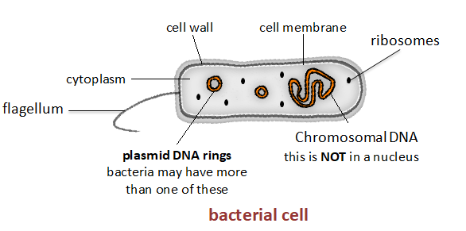
  Cell structure part 1 - Animal, plant cells and bacterial cells
You will need to know the differences between plant, animal and bacterial cells.
Bacterial cells are much smaller than plant and animal cells.
Long hair like structure which aids movement

Slide 6
  Cell structure part 1 - Animal, plant cells and bacterial cells
Cell part | Function | Animal | Plant | Bacteria
Nucleus | Contains genetic material which controls the activities of the cell | ✔ | ✔
Cytoplasm | Most chemical processes take place here, controlled by enzymes | ✔ | ✔ | ✔
Cell membrane | Controls movement of substances into and out of cell | ✔ | ✔ | ✔
Mitochondria | Most energy is released by respiration here | ✔ | ✔
Ribosomes | Protein synthesis happens here | ✔ | ✔ | ✔
Cell wall | Strengthens the cell – made of cellulose (not bacteria) algal cells also have a cell wall |  | ✔ | ✔
Chloroplasts | Contain chlorophyll, absorbs light energy for photosynthesis |  | ✔
Permanent vacuole | Filled with cell sap to help keep the cell turgid |  | ✔
Chromosomal DNA | Loop of DNA NOT found in a nucleus |  |  | ✔
Plasmid (DNA) | Small ring of DNA often used as a vector in genetic modification |  |  | ✔

Slide 7
QuestionIT!
Cell structure
Part 1
Eukaryotes and prokaryotes
Animal and plant cells
Number, size and scale

Slide 8
  Cell structure part 1 – QuestionIT
1. Where is the genetic material in a prokaryotic cell?
2. Where is the genetic material in a eukaryotic cell?
3. Copy and complete the table.
4. Why do scientists use prefixes?
Prefix | Multiple | Standard form
centi (cm) |  | x 10 ⁻²
 | 1 mm = 0.001 m | x 10 ⁻³
micro (𝛍m) | 1 𝛍m = 0.000 001 m
nano (nm) |  | x 10 ⁻⁹

Slide 9
  Cell structure part 1 – QuestionIT
5. Name the structures A to L on the diagrams below and label cells 1, 2 and 3.
n.

Slide 10
  Cell structure part 1 – QuestionIT
6. Copy and complete the table and tick the correct column for each one.
Cell part | Function | Animal | Plant | Bacteria
 | Contains genetic material which controls the activities of the cell
Cytoplasm
 | Controls the movement of substances into and out of the cell
 | Most energy is released by respiration here
Ribosomes | Protein synthesis happens here
 | Strengthens the cell – made of cellulose
Chloroplasts
 | Filled with cell sap to help keep the cell turgid
 | Loop of DNA NOT found in a nucleus
Plasmid (DNA)

Slide 11

AnswerIT!
Cell structure
Part 1
Eukaryotes and prokaryotes
Animal and plant cells
Number, size and scale

Slide 12
  Cell structure – AnswerIT
Where is the genetic material in a prokaryotic cell?
In a bacterial DNA loop and there may be one or more plasmid rings.
2. Where is the genetic material in a eukaryotic cell?
The DNA is in chromosomes enclosed in a nucleus.
3. Copy and complete the table.
4. Why do scientists use prefixes?
To make very small numbers more manageable
Prefix | Multiple | Standard form
centi (cm) | 1 cm = 0.01 m | x 10 ⁻²
milli (mm) | 1 mm = 0.001 m | x 10 ⁻³
micro (𝛍m) | 1 𝛍m = 0.000 001 m | x 10 ⁻⁶
nano (nm) | 1 nm = 0.000 000 001 m | x 10 ⁻⁹

Slide 13
  Cell structure – AnswerIT
5. Name the structures A to L on the diagrams below and label cells 1, 2 and 3.
n. flagellum

Slide 14
  Cell structure – AnswerIT
6. Copy and complete the table and tick the correct column for each one.
Cell part | Function | Animal | Plant | Bacteria
Nucleus | Contains genetic material which controls the activities of the cell | ✔ | ✔
Cytoplasm | Most chemical processes take place here, controlled by enzymes | ✔ | ✔ | ✔
Cell membrane | Controls the movement of substances into and out of the cell | ✔ | ✔ | ✔
Mitochondria | Most energy is released by respiration here | ✔ | ✔
Ribosomes | Protein synthesis happens here | ✔ | ✔
Cell wall | Strengthens the cell – made of cellulose |  | ✔ | ✔
Chloroplasts | Contain chlorophyll, absorbs light energy for photosynthesis |  | ✔
Permanent vacuole | Filled with cell sap to help keep the cell turgid |  | ✔
Bacterial DNA | Loop of DNA NOT found in a nucleus |  |  | ✔
Plasmid (DNA) | Small ring of DNA often used as a vector in genetic modification |  |  | ✔
✔

Slide 15
LearnIT!
KnowIT!
Cell structure
Part 2 (1.2)
Cell specialisation

Slide 16
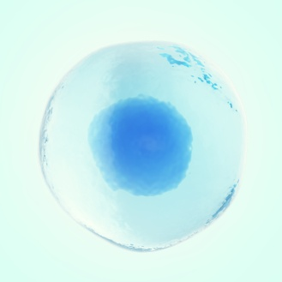
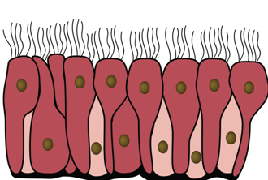
  Cell structure part 2 - Animal cell specialisation
The structure of different cells helps them to carry out a particular function within the organism. These cells are called specialised cells.
Name of animal cell | Diagram | Adaptation to function
Sperm |  | Function is to fertilise an egg Streamlined with a long tail to swim to the egg Acrosome in the head containing enzymes to digest the egg cell membrane Large number of mitochondria in the mid section to release energy for movement Ribosomes for protein synthesis
Egg |  | Function is to fuse with sperm and develop into embryo Nutrients in the cytoplasm for respiration and cell division Haploid nucleus Cell membrane changes to prevent further sperm entry
Ciliated epithelium |  | Function is movement of substances Surface contains cilia (microscopic hairs) to sweep substances e.g. mucus Large number of mitochondria to release energy

Slide 17
QuestionIT!
Cell structure
Part 2
Cell specialisation

Slide 18
  Cell structure part 2 – QuestionIT
1. Name animal cells A, B and C and describe their structure and function.
Name of animal cell | Diagram | Structure and function
A.
B.
C.

Slide 19
AnswerIT!
Cell structure
Part 2
Cell specialisation

Slide 20
  Cell structure – AnswerIT
1. Name animal cells A, B and C and describe their structure and function.
Name of animal cell | Diagram | Structure and function
A. Sperm |  | Function is to fertilise an egg. Streamlined with a long tail to swim to the egg. Acrosome in the head containing enzymes to digest the egg cell membrane. Large number of mitochondria in the mid section to release energy for movement. Ribosomes for protein synthesis
B. Egg |  | Function is to fuse with sperm and develop into embryo. Nutrients in the cytoplasm for respiration and cell division Haploid nucleus Cell membrane changes after fertilisation to prevent second sperm from fertilising egg
C. Ciliated epithelial |  | Function is movement of substances. Surface contains cilia to sweep substance e.g. mucus Large number of mitochondria to release energy

Slide 21
LearnIT!
KnowIT!
Cell structure
Part 3 (1.3-1.6)
Microscopy

Slide 22
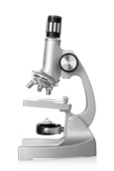
  Cell structure part 3- Microscopy
light microscope
First used in 1590’s
electron microscope
First used in 1960’s
Feature | Light (optical) microscope | Electron microscope
Radiation used | Light rays | Electron beams
Max magnification | ~ 1500 times | ~ 2 000 000 times
Resolution | 200nm | 0.2nm
Size of microscope | Small and portable | Very large and not portable
Cost | ~£100 for a school one | Several £100,000 to £1 million plus
Resolution: The shortest distance between two objects that can be seen clearly.
Video - Types of microscopes

Slide 23
  Cell structure part 3 - Microscopy
Electron microscopes have a higher magnification and resolution than light microscopes. This means that scientists can see more sub- cellular structures (structures within the cells) with greater clarity.
nucleus
mitochondria
mitochondrion
Light microscopes image
can let us see structures like nuclei and mitochondria.
Electron microscopes image
can let us see the internal structures of a chloroplast and mitochondrion.

Slide 24
  Cell structure part 3 - Microscopy
You can calculate the magnification of an image by using the equation:
MAGNIFICATION: the number of times bigger the image looks compared to the object
IMAGE: what is viewed through the microscope lenses
OBJECT: the ACTUAL specimen under microscope.
Make sure the image and object size have the same units.
magnification M = size of image I
real size of the object A
WORKED EXAMPLE 1:
A magnified animal cell structure has a diameter of 6 mm.
The actual diameter of the structure is 0.15mm.
Calculate how many times the structure has been magnified.
IMAGE
OBJECT
M = I
M = 6
M = 40
You may need to write your answers in standard form.
A
0.15
You may need to be able rearrange to change the subject of the equation.

Slide 25
  Cell structure part 3- Microscopy
magnification M = size of image I
real size of the object A
WORKED EXAMPLE 2:
The actual length of a cell structure is 30𝛍m.
It is magnified 40 times.
Calculate the length of the magnified cell structure in mm.
Rearrange the equation to make I the subject
OBJECT (A)
OBJECT (A)
MAGNIFICATION (M)
You may need to to write your answers in standard form.
A x
x A
M = I
Multiply both sides by A
A
Cancel out the As
To convert to mm you need to divide by 1000
I = M x A
Put I on the left of the equation
I = 40 x 30
I = 1200 𝛍m
I = 1.2mm

Slide 26
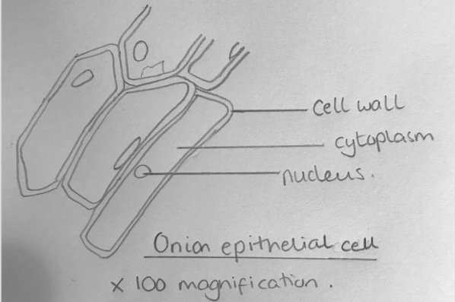
  Cell structure part 3 – Microscopy
Making a wet mount slide e.g. onion cells
Place a thin section of the specimen onto slide.
Place a drop of water in the middle of the slide or stain the specimen.
Gently lower cover slip onto the specimen without trapping air bubbles.
Soak up any excess liquid with a paper towel.
Switch on the light source and place your slide on the stage.
Use the lowest objective lens and turn the focusing wheel to move the lens close to the slide.
Slowly adjust the focusing wheel until you can see a clear image.
Increase the magnification by changing the objective lens and re-focus.
Drawing what you see
Clear line drawing – no shading
Label main cell structures
Add a title and the magnification.
See GCSE Practical Guide - Biology – Microscopy on Huddle - Microscopy Practical guide

Slide 27
QuestionIT!
Cell structure
Part 3
Microscopy

Slide 28
  Cell structure part 3 – QuestionIT
1. Define the term ‘resolution’.
2. Copy and complete the table below.
3. What are the advantages of the electron microscope?
4. Name the smallest cell structures that can be seen by the light microscope?
5. What are the smallest cell structures that can be seen by the electron microscope?
Feature | Light (optical) microscope | Electron microscope
Radiation used
Max magnification
Resolution
Size of microscope
Cost

Slide 29
  Cell structure part 3 – QuestionIT
6. Write down the magnification equation.
7. Rearrange the equation to change the subject for the two other factors.
8. A magnified cell structure has a diameter of 375𝛍m.
  The actual diameter of the structure is 2.5𝛍m.
  Calculate how many times the structure has been magnified.
9. The actual length of a cell structure is 3𝛍m.
  It is magnified 1,500 times.
  Calculate the length of the magnified cell structure in mm.

Slide 30
  Cell structure part 3 – QuestionIT
10. Name the parts of the light microscope in the diagram below.
11. How would you make an onion cell slide?
12. How would you use the light microscope to view onion cells?

Slide 31
AnswerIT!
Cell structure
Part 3
Microscopy

Slide 32
  Cell structure part 3 – QuestionIT
Define the term resolution.
The shortest distance between two objects that can be seen clearly.
2. Copy and complete the table below.
3. What are the advantages of the electron microscope? Electron microscopes have a higher magnification and resolution than light microscopes; scientists can see more sub-cellular structures.
4. Name the smallest cell structures that can be seen by the light microscope?
Nuclei and mitochondria
5. What are the smallest cell structures that can be seen by the electron microscope? Internal structures of mitochondria and chloroplasts.
Feature | Light (optical) microscope | Electron microscope
Radiation used | Light rays | Electron beams
Max magnification | ~ 1500 times | ~ 2 000 000 times
Resolution | 200nm | 0.2nm
Size of microscope | Small and portable | Very large and not portable
Cost | ~£100 for a school one | Several £100,000 to £1 million plus

Slide 33
  Cell structure part 3 – AnswerIT
6. Write down the magnification equation.
7. Rearrange the equation to change the subject for the two other factors.
8. A magnified cell structure has a diameter of 375𝛍m.
The actual diameter of the structure is 2.5𝛍m.
Calculate how many times the structure has been magnified.
M = I/A M = 375/2.5 = 150 M = 150 times
9. The actual length of a cell structure is 3𝛍m.
It is magnified 1,500 times.
Calculate the length of the magnified cell structure in mm.
I = M x A I = 1500 x 3 I = 4500 𝛍m 4500 / 1000 = 4.5mm
magnification (M) = size of image (I)
real size of the object (A)
size of image (I) = magnification (M) x real size of the object (A)
real size of the object (A) = size of image (I)
magnification (M)

Slide 34
  Cell structure part 3 – QuestionIT
10. Name the parts of the light microscope in the diagram below.

Slide 35
  Cell structure part 3 – QuestionIT
11. Describe how you would make an onion cell slide.
Place thin section of onion epidermis onto slide.
Place a drop of iodine in the middle of the slide to stain the onion.
Gently lower cover slip onto the onion without trapping air bubbles.
Soak up any excess liquid with a paper towel.
12. Describe how you would use the light microscope to view onion cells.
Switch on the light source and place your slide on the stage.
Use the lowest objective lens and turn the focusing wheel to move the lens close to the slide.
Slowly adjust the focusing wheel until you can see a clear image.
Increase the magnification by changing the objective lens and re-focus.

Slide 36
LearnIT!
KnowIT!
Key concepts in biology
Part 4 (1.7-1.14B)
Enzymes
Food tests (biology)
Food calorimetry (biology)

Slide 37
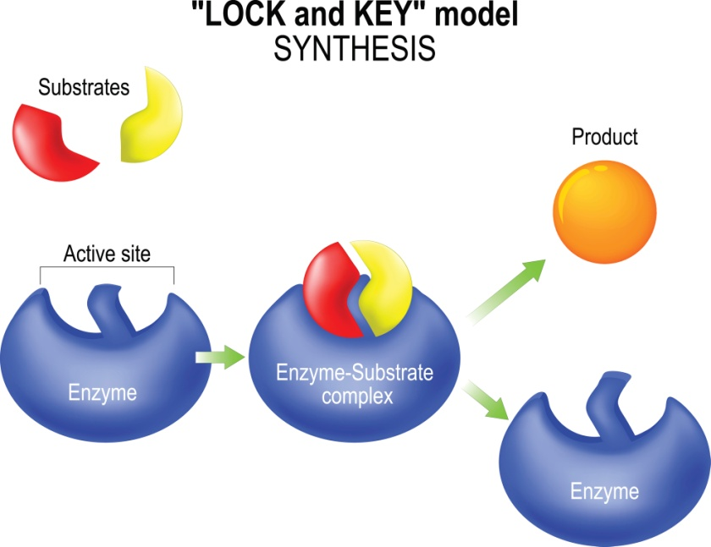
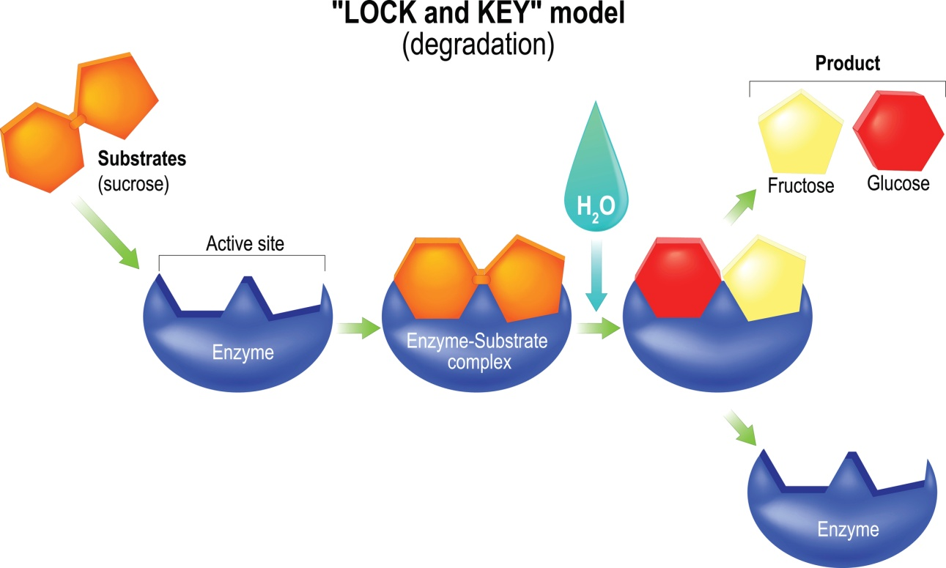
  Key Concepts in biology part 4- Enzymes
‘Lock and Key theory’ is a model to explain enzyme action.
Enzymes are made of proteins and are biological catalysts - substances that increase the rate of chemical reactions without being used up. The shape of the active site of the enzyme is specific for each substrate (substance the enzyme acts on).
Video - Enzymes
The products of digestion are used to build new carbohydrates, lipids and proteins in the body. Some glucose is used in respiration.
PiXL - Required Practical Guides - Enzymes
Notes:
http://www.bbc.co.uk/education/clips/zpk9wmn

Slide 38
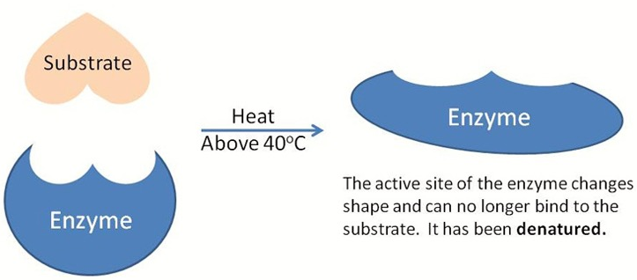

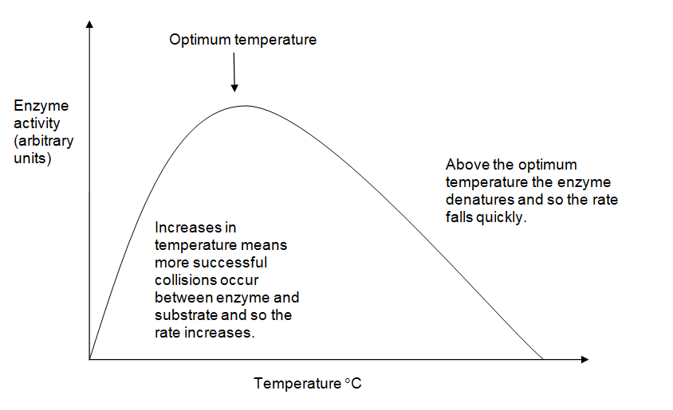
  Key Concepts in biology part 4- Enzymes
Enzyme activity is affected by temperature and by pH. Specific conditions are needed to keep enzymes working at their best. OPTIMUM CONDITIONS! Enzymes control the chemical reactions in the body, this is known as metabolism.
In enzyme reactions, increasing the temperature will initially increase the rate of reaction due to increased collisions between the enzyme and substrates. BUT if the temperature is too high the enzyme will denature (NB: denature, NOT die/killed) because some of the bonds in the protein break so changing its shape.
DENATURED
The active site has changed shape so the substrate cannot fit.
If the temperature is too low then enzymes do not work effectively. If the metabolic rate of an organism falls too low then the organism may die. The enzymes become inactive but they are not killed.

Slide 39
  Key Concepts in biology part 4- Enzymes
The digestive system is an example of an organ system where different organs work together to digest and absorb food.
Digestion is where large insoluble molecules are broken down into smaller soluble ones that can be absorbed into the bloodstream. Digestion occurs in the GUT (tube from the mouth to the anus) and it relies on ENZYMES (biological catalysts).
Activity - Digestive Enzymes
Digestive Enzyme | Where released? | Breakdown what?
Carbohydrase (amylase) | Salivary glands and pancreas | Carbohydrates into simple sugars (maltose)
Protease | Stomach and pancreas | Proteins into amino acids
Lipase | Pancreas | Fats and oils (lipids) into fatty acids and glycerol
Video - Digestion and Enzymes
PiXL - Required Practical Guide Food Tests
Notes:
http://www.bbc.co.uk/education/clips/z6nwmp3
Activity
http://www.bbc.co.uk/education/guides/zwqycdm/activity

Slide 40
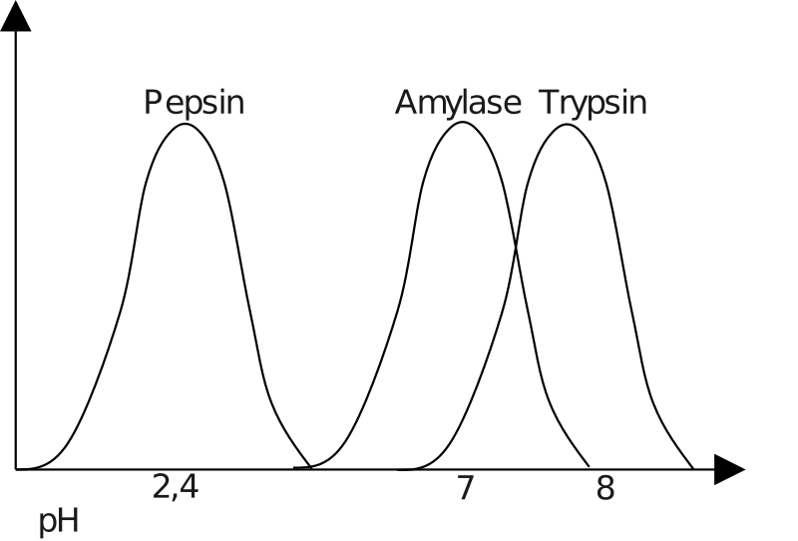
  Key Concepts in biology part 4- Enzymes
Digestion and pH. The stomach releases acid. The enzymes made in the stomach work best in acidic conditions. The enzymes made in the pancreas and small intestine work best in alkaline conditions.
Rate of enzyme controlled reaction (arbitrary units)
pH
This sketch graph shows that different enzymes have a different optimum pH.
Bile is made in the liver and stored in
the gall bladder. It is alkaline to
neutralise hydrochloric acid from
the stomach. It also emulsifies fat
to form small droplets which
increases the surface area.
The alkaline conditions and large surface area increase the rate of fat breakdown by lipase.
Substrate concentration will affect the rate of enzyme activity. The higher the amount of substrate present, the faster the reaction will occur until all active sites are full and vice versa.

Slide 41
  Key Concepts in biology part 4- Enzymes
Substrate concentration will affect the rate of enzyme activity.
The higher the amount of substrate present the faster the reaction will occur until all active sites are full.
Once all the active sites are full the reaction cannot proceed any faster.
All active sites full
Rate of enzyme controlled reaction (arbitrary units)
Substrate concentration (arbitrary units)

Slide 42
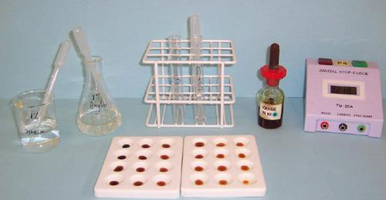
Practical procedure: Amylase and pH
Video 1
Video 2
Amylase is an enzyme which breaks down starch into maltose.
Starch can be detected using iodine solution.
If starch is present, the iodine solution turns from a browny red colour to a blue black colour.
Image from: http://www.nuffieldfoundation.org/practical-biology/investigating-effect-ph-amylase-activity
Notes:
Click on each of the tabs to take you to a YouTube clip. Please note these are external sites to PiXL, PiXL does not control the content of these sites.
https://www.youtube.com/watch?v=7wJItifm9Ws
https://www.youtube.com/watch?v=8Yqbu56ImXk&t=11s

Slide 43

  Key Concepts in biology part 4- Enzymes
Rate is a measurement of how something changes over a
period of time.
We can calculate the rate of reaction for an enzyme experiment using the formula: The units are s⁻¹.
Buffer pH | Time taken for amylase to break down starch (s) | Rate of reaction 1 time ( s⁻¹ )
9 | 180 | 1÷180 = 0.006
7 | 90 | 1÷90 = 0.011
4 | 150 | 1÷150 = 0.007
1 | 210 | 1÷210 = 0.005

Slide 44
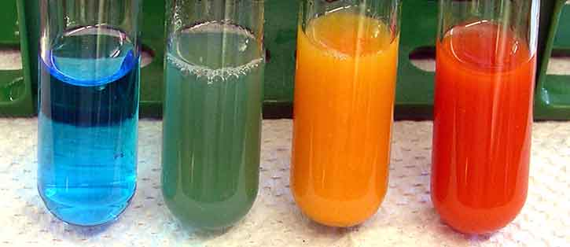
Practical procedure: Food tests (biology)
Video 1
Video 2
Notes:
Click on each of the tabs to take you to a YouTube clip. Please note these are external sites to PiXL, PiXL does not control the content of these sites.

Slide 45
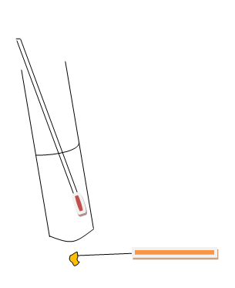
  Key Concepts in biology part 4- Food calorimetry (biology)
Weigh a small amount of the food and place on the mounted needle.
Measure out 25cm³ of water and place it in a boiling tube.
Measure the temperature of the water.
Set the food alight using a Bunsen burner.
Hold the burning food under the water until it goes out.
Try to relight the food and hold it under the water.
Measure the final temperature of the water.
Food calorimetry can be used to see how much energy certain foods contain.
Calculate how many joules of energy the food contained:
Energy in food (J) = Mass of water (g) x temperature change of water (°C) x 4.2
1 g of water is the same as 1 cm³ of water.
In order to compare the energy values of different food you must calculate how many joules are in each gram of food.
Energy per gram of food = energy in food (J) ÷ mass of food (g)

Slide 46
QuestionIT!
Key concepts in biology
Part 4 (1.7-1.14B)
Enzymes
Food tests (biology)
Food calorimetry (biology)

Slide 47
  Key concepts in biology part 4 – QuestionIT
1. What is digestion?
2. What is an enzyme?
3. Complete the table below:
4. What biological molecule are enzymes made of?
5. What is the active site of an enzyme?
6. What is a substrate?
Digestive Enzyme | Where released? | Breakdown what?
Amylase
Protease
Lipase

Slide 48
  Key concepts in biology part 4 – QuestionIT
7. What are the products of digestion used for in the body?
8. What does denatured mean?
9. How does increasing the temperature affect enzyme activity?
10. How does pH affect enzyme activity?
11. What is the role of bile in digestion?
12. Enzymes are also required to catalyse the synthesis of larger molecules.
Complete the table to show what complex molecules are being made:
Monomers | Polymers synthesised with the aid of enzymes.
Amino acids
Fatty acids and glycerol
Glucose

Slide 49
  Key concepts in biology part 4 – QuestionIT
Biology Only
What reagent is used to identify the presence of starch?
Which reagent is used to identify the presence of a reducing sugar?
Which test is used to identify if protein is present?
Which flammable reagent is used in the emulsion test for lipids?
List the equipment needed to find out how much energy is in 1g of peanuts.

Slide 50
AnswerIT!
Key concepts in biology
Part 4 (1.7-1.14B)
Enzymes
Food tests (biology)
Food calorimetry (biology)

Slide 51
  Key concepts in biology part 4 – AnswerIT
1. What is digestion? Large insoluble molecules are broken down into smaller soluble ones.
2. What is an enzyme? A biological catalyst – they speed up the rate of reaction without being used up.
3. Complete the table below:
4. What biological molecule are enzymes made of? Proteins.
5. What is the active site of an enzyme? It is where the substrate binds.
6. What is a substrate? Substance (chemical) that the enzyme acts on.
Digestive Enzyme | Where released? | Breakdown what?
Amylase | Salivary glands and pancreas | Carbohydrates into simple sugars
Protease | Stomach and pancreas | Proteins into amino acids
Lipase | Pancreas | Fats and oils (lipids) into fatty acids and glycerol

Slide 52
  Key Concepts in biology Part 4 – AnswerIT
7. What are the products of digestion used for in the body? They are used to synthesize carbohydrates, lipids and proteins in the body. Glucose is used in respiration.
8. What does denatured mean? That the active site of the enzyme has changed shape so the substrate cannot fit.
9. How does increasing the temperature affect enzyme activity? Initially it increases the rate of reaction due to increased collisions between the enzyme and substrates, but if the temperature is too high the enzyme will denature.
10. How does pH affect enzyme activity? Enzymes have optimum pH conditions, if these are too alkaline or acidic the enzyme denatures.
11. What is the role of bile in digestion? It neutralises stomach (hydrochloric) acid and emulsifies fats.

Slide 53
  Key Concepts in biology Part 4 – AnswerIT
12. Enzymes are also required to catalyse the synthesis of larger molecules.
Complete the table to show what complex molecules are being made:
Biology Only
What reagent is used to identify the presence of starch? Iodine solution
Which reagent is used to identify the presence of a reducing sugar? Benedict's solution
Which test is used to identify if protein is present? Biuret
Which flammable reagent is used in the emulsion test for lipids? Ethanol
List the equipment needed to find out how much energy is in 1g of peanuts. Balance, boiling tube, measuring cylinder, mounted needle, Bunsen burner, mat, clamp stand and clamp, thermometer, safety glasses.
Monomers | Polymers synthesised with the aid of enzymes.
Amino acids | Proteins
Fatty acids and glycerol | Lipids (Fats)
Glucose | Carbohydrates (Starch)
Monomers | Polymers synthesised with the aid of enzymes.
Amino acids
Fatty acids and glycerol
Glucose

Slide 54
LearnIT!
KnowIT!
Transport in cells
Part 5 (1.15-1.17)
  Diffusion
  Osmosis
  Active transport

Slide 55
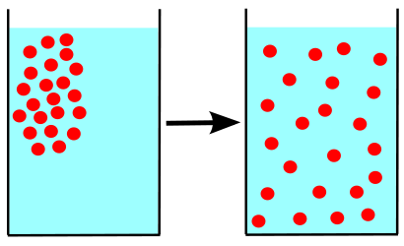
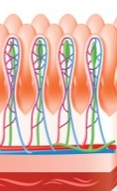
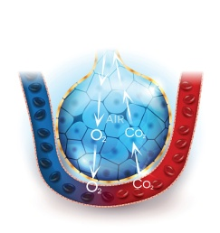
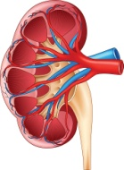
  Key concepts in biology part 5 - Diffusion
Diffusion is the spreading of the particles of a gas or substances in solution, resulting in a net movement of particles from a region where they are of a higher concentration to an area of lower concentration.
Diffusion can occur in: Air – smells from perfume etc.
Solution – tea from a tea bag, dye in water etc.
Through membranes – small intestines, blood cells etc.
Substances that are transported in and out of cells in humans
Location | Particles move | From | To
Small Intestine | Digested food e.g. glucose, amino acids | Small intestine | Blood in capillary of villus
Lungs | Oxygen | Alveolar air space | Blood circulating around the lungs
Kidneys | Urea | Cells | Blood plasma

Slide 56
  Key concepts in biology part 5 - Diffusion
The larger the difference in concentration the faster the rate of diffusion.
Factors which affect the rate of diffusion.
The concentration gradient:
A difference in concentration between
two areas next to each other. Particles
will move down the concentration
gradient from high to low.
The temperature:
As the temperature increases, the particles
in a gas or liquid gain more energy
so they move faster. The hotter it is the
faster the rate of diffusion.
The surface area of the membrane:
A single-celled organism has a
large surface area compared to its
volume. This allows sufficient transport of
molecules into and out of the cell
to meet the needs of the organism.
Beetroot in different temperatures of water

Slide 57
  Key concepts in biology part 5 - Osmosis
Osmosis in plant and animal cells:
Osmosis is the diffusion of water from a dilute solution to a concentrated solution through a partially permeable membrane.
The rate of osmosis changes depending on the concentration gradient and temperature.
Partially permeable membrane – a membrane that lets some but not all substances through.
Hypertonic – more concentrated solution than in the cells.
Isotonic – same concentration as the solution in the cell.
Hypotonic – more dilute than the solution in the cells.

Slide 58
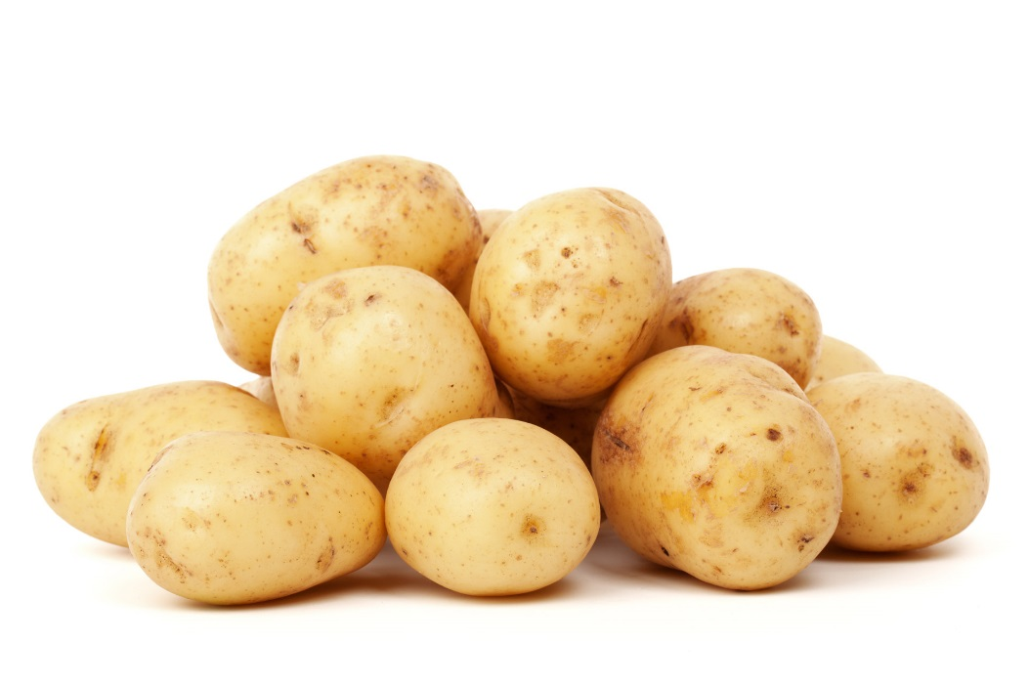
Practical procedure: Osmosis in potato
Video 1
Video 2
Notes:
Click on each of the tabs to take you to a YouTube clip. Please note these are external sites to PiXL, PiXL does not control the content of these sites.

Slide 59


Osmosis results:
Work out the percentage change in mass for each chip. This means you can compare the effect of the sucrose concentrations on potato chips which did not have the same initial mass.
To calculate percentage change use the formula:
Concentration of sucrose solution (M) | Initial mass of potato chip (g) A | Final mass of potato chip (g) B | Percentage change in mass (g)
0.0 | 1.82 | 2.10
0.1 | 1.79 | 1.92
0.2 | 1.78 | 1.79
0.3 | 1.88 | 1.73
0.4 | 1.70 | 1.43
0.5 | 1.98 | 1.45
15.38
7.26
0.56
-7.98
Negative numbers mean the potato chip has lost mass.
-15.88
-26.77

Slide 60
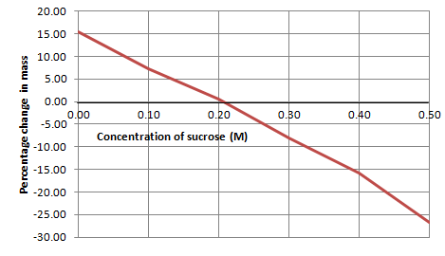
  Transport in cells – QuestionIT
At points above the x axis the water concentration of the sucrose solution is higher than in the potato chip. Water enters the potato chip by osmosis and it gains mass.
At the point when the line crosses the x axis the sucrose solution and the fluid in the potato chip have the same concentration (isotonic). There is no net gain or loss of water by osmosis.
At points below the x axis the water concentration of the sucrose solution is lower than in the potato chip. Water leaves the potato chip by osmosis and it loses mass.

Slide 61
  Key concepts in biology part 5 – Active Transport
Active transport occurs in root hair cells.
Active transport moves substances from a more dilute solution to a more concentrated solution (against a concentration gradient). The energy is provided by respiration.
The minerals are at a higher concentration in the root hair cell than in the soil. So the minerals move into the cell against the concentration gradient.
Active transport also occurs in the gut (small intestines); sugar (glucose) molecules are absorbed from lower concentrations in the gut into the blood which has a higher sugar concentration.
The glucose is used for respiration.

Slide 62
QuestionIT!
Transport in cells
  Diffusion
  Osmosis
  Active transport

Slide 63
  Transport in cells part 5 – QuestionIT
Define ‘diffusion’.
State two places where diffusion occurs in the body.
What is a concentration gradient?
What three factors affect the concentration gradient?
5. Define ‘osmosis’.
What is a ‘partially permeable membrane’?
What happens to an animal cell in a hypertonic solution?
What happens to an animal cell in a hypotonic solution?
Define ‘active transport’.
Why does active transport need to occur in root hair cells?
Why is percentage change in mass calculated for osmosis results?

Slide 64
AnswerIT!
Transport in cells
  Diffusion
  Osmosis
  Active transport

Slide 65
  Transport in cells part 5 – AnswerIT
Define ‘diffusion’?
The spreading of particles from a region where they are of a higher concentration to an area of lower concentration.
2. State three places where diffusion occurs in the body. Small intestines, lungs, kidneys.
3. What is a concentration gradient? The difference in concentration between two areas next to each other.
4. What three factors affect rate of diffusion? Concentration gradient, temperature, surface area.

Slide 66
  Transport in cells part 5 – AnswerIT
5. Define osmosis? Osmosis is the diffusion of water from a dilute solution to a concentrated solution through a partially permeable membrane.
6. What is a partially permeable membrane? A membrane that lets some but not all substances through.
7. What happens to an animal cell in a hypertonic solution? It will lose water by osmosis and shrivel.
8. What happens to an animal cell in a hypotonic solution? It will absorb water by osmosis and get bigger/burst.
9. Define active transport. Active transport moves substances from a more dilute solution to a more concentrated solution (against a concentration gradient) using energy from respiration.
10. Why does active transport need to occur in root hair cells? Because the minerals are at a higher concentration in the roots than in the soil.
11. Why is percentage change in mass calculated for osmosis results? So that the effect of different sucrose concentrations can be compared for potato chips which did not have the same initial mass.

