Slide 1


The PiXL Club The PiXL Club The PiXL Club The PiXL Club The PiXL Club The PiXL Club The PiXL Club The PiXL Club The PiXL Club The PiXL Club The PiXL Club The PiXL Club The PiXL Club The PiXL Club The PiXL Club The PiXL Club The PiXL Club The PiXL Club The PiXL Club The PiXL Club The PiXL Club The PiXL Club The PiXL Club The PiXL Club The PiXL Club The PiXL Club The PiXL Club The PiXL Club The PiXL Club The PiXL Club The PiXL Club The PiXL Club The PiXL Club The PiXL Club The PiXL Club The PiXL Club The PiXL Club The PiXL Club The PiXL Club The PiXL Club The PiXL Club The PiXL Club The PiXL Club The PiXL Club The PiXL Club XL Club The PiXL Club The PiXL Club The PiXL Club The PiXL Club The PiXL Club The PiXL Club The PiXL Club The PiXL Club The PiXL Club The PiXL Club The PiXL Club The PiXL Club The PiXL Club The PiXL Club The PiXL Club The PiXL Club The PiXL Club The PiXL Club The PiXL Club The PiXL Club The PiXL Club The PiXL Club The PiXL Club The PiXL Club The PiXL Club The PiXL Club The PiXL Club The PiXL Club The PiXL Club The PiXL Club The PiXL Club The PiXL Club The PiXL Club The PiXL Club The PiXL Club The PiXL Club The PiXL Club The PiXL Club The PiXL Club The PiXL Club The PiXL Club The PiXL Club The PiXL Club The PiXL Club The PiXL Club The PiXL Club The PiXL Club The PiXL Club The PiXL Club The PiXL Club The PiXL Club The PiXL Club The PiXL Club The PiXL Club The PiXL Club The PiXL Club The PiXL Club The PiXL Club The PiXL Club The PiXL Club The PiXL Club The PiXL Club The PiXL Club The PiXL Club The PiXL Club The PiXL Club The PiXL Club The PiXL Club The PiXL Club The PiXL Club The PiXL Club The PiXL Club The PiXL Club The PiXL Club The PiXL Club The PiXL Club The PiXL Club The PiXL Club The PiXL Club The PiXL Club The PiXL Club The PiXL Club The PiXL Club The PiXL Club The PiXL Club The PiXL Club The PiXL Club The PiXL Club The PiXL Club The PiXL Club The PiXL Club The PiXL Club The PiXL Club The PiXL Club The PiXL Club The PiXL Club The PiXL Club The PiXL Club The PiXL Club The PiXL Club The PiXL Club The PiXL Club The PiXL Club The PiXL Club The PiXL Club The PiXL Club The PiXL Club The PiXL Club The PiXL Club The PiXL Club The PiXL Club The PiXL Club The PiXL Club The PiXL Club The PiXL Club The PiXL Club The PiXL Club The PiXL Club The PiXL Club The PiXL Club The PiXL Club The PiXL Club The PiXL Club The PiXL Club The PiXL Club The PiXL Club The PiXL Club The PiXL Club The PiXL Club The PiXL Club The PiXL Club The PiXL Club The PiXL Club The PiXL Club The PiXL Club The PiXL Club The PiXL Club The PiXL Club The PiXL Club The PiXL Club The PiXL Club The PiXL Club The PiXL Club The PiXL Club The PiXL Club The PiXL Club The PiXL Club The PiXL Club The PiXL Club The PiXL Club The PiXL Club The PiXL Club The PiXL Club The PiXL Club The PiXL Club The PiXL Club The PiXL Club The PiXL Club The PiXL Club The PiXL Club The PiXL Club The PiXL Club The PiXL Club The PiXL Club The PiXL Club The PiXL Club The PiXL Club The PiXL Club The PiXL Club The PiXL Club The PiXL Club The PiXL Club The PiXL Club The PiXL Club The PiXL Club The PiXL Club The PiXL Club The PiXL Club The PiXL Club The PiXL Club The PiXL Club The PiXL Club The PiXL Club The PiXL Club The PiXL Club The PiXL Club The PiXL Club The PiXL Club The PiXL Club The PiXL Club The PiXL Club The PiXL Club The PiXL Club The PiXL Club The PiXL Club The PiXL Club The PiXL Club The PiXL Club The PiXL Club The PiXL Club The PiXL Club The PiXL Club The PiXL Club The PiXL Club The PiXL Club The PiXL Club The PiXL Club The PiXL Club The PiXL Club The PiXL Club The PiXL Club The PiXL Club The PiXL Club The PiXL Club The PiXL Club The PiXL Club The PiXL Club The PiXL Club The PiXL Club The PiXL Club The PiXL Club The PiXL Club The PiXL Club The PiXL Club The PiXL Club The PiXL Club The PiXL Club The PiXL Club The PiXL Club The PiXL Club The PiXL Club The PiXL Club The PiXL Club The PiXL Club The PiXL Club The PiXL Club The PiXL Club The PiXL Club The PiXL Club The PiXL Club The PiXL Club The PiXL Club The PiXL Club The PiXL Club The PiXL Club The PiXL Club The PiXL Club The PiXL Club The PiXL Club The PiXL Club The PiXL Club The PiXL Club The PiXL Club The PiXL Club The PiXL Club The PiXL Club The PiXL Club The PiXL Club The PiXL Club The PiXL Club The PiXL Club The PiXL Club The PiXL Club The PiXL Club The PiXL Club The PiXL Club The PiXL Club The PiXL Club The PiXL Club The PiXL Club The PiXL Club The PiXL Club The PiXL Club The PiXL Club The PiXL Club The PiXL Club The PiXL Club The PiXL Club The PiXL Club The PiXL Club The PiXL Club The PiXL Club The PiXL Club The PiXL Club The PiXL Club The PiXL Club The PiXL Club The PiXL Club The PiXL Club The PiXL Club The PiXL Club The PiXL Club The PiXL Club The PiXL Club The PiXL Club The PiXL Club The PiXL Club The PiXL Club The PiXL Club The PiXL Club The PiXL Club The PiXL Club The PiXL Club The PiXL Club The PiXL Club The PiXL Club The PiXL Club The PiXL Club The PiXL Club The PiXL Club The PiXL Club The PiXL Club The PiXL Club The PiXL Club The PiXL Club The PiXL Club The PiXL Club The PiXL Club The PiXL Club The PiXL Club The PiXL Club The PiXL Club The PiXL Club The PiXL Club The PiXL Club The PiXL Club The PiXL Club The PiXL Club The PiXL Club The PiXL Club The PiXL Club The PiXL Club The PiXL Club The PiXL Club The PiXL Club The PiXL Club The PiXL Club The PiXL Club The PiXL Club The PiXL Club The PiXL Club The PiXL Club The PiXL Club The PiXL Club The PiXL Club The PiXL Club The PiXL Club The PiXL Club The PiXL Club The PiXL Club The PiXL Club The PiXL Club The PiXL Club The PiXL Club The PiXL Club The PiXL Club The PiXL Club The PiXL Club The PiXL Club The PiXL Club The PiXL Club The PiXL Club The PiXL Club The PiXL Club The PiXL Club The PiXL Club The PiXL Club The PiXL Club The PiXL Club The PiXL Club The PiXL Club The PiXL Club The PiXL Club The PiXL Club The PiXL Club The PiXL Club The PiXL Club The PiXL Club The PiXL Club The PiXL Club The PiXL Club The PiXL Club The PiXL Club The PiXL Club The PiXL Club The PiXL Club The PiXL Club The PiXL Club The PiXL Club The PiXL Club The PiXL Club The PiXL Club The PiXL Club The PiXL Club The PiXL Club The PiXL Club The PiXL Club The PiXL Club The PiXL Club The PiXL Club The PiXL Club The PiXL Club The PiXL Club The PiXL Club The PiXL Club The PiXL Club The PiXL Club The PiXL Club The PiXL Club The PiXL Club The PiXL Club The PiXL Club The PiXL Club The PiXL Club The PiXL Club The PiXL Club The PiXL Club The PiXL Club The PiXL Club The PiXL Club The PiXL Club The PiXL Club The PiXL Club The PiXL Club The PiXL Club The PiXL Club The PiXL Club The PiXL Club The PiXL Club The PiXL Club The PiXL Club The PiXL Club The PiXL Club The PiXL Club The PiXL Club The PiXL Club The PiXL Club The PiXL Club The PiXL Club The PiXL Club The PiXL Club The PiXL Club The PiXL Club The PiXL Club The PiXL Club The PiXL Club The PiXL Club The PiXL Club The PiXL Club The PiXL Club The PiXL Club The PiXL Club The PiXL Club The PiXL Club The PiXL Club The PiXL Club The PiXL Club The PiXL Club The PiXL Club The PiXL Club The PiXL Club The PiXL Club The PiXL Club The PiXL Club The PiXL Club The PiXL Club The PiXL Club The PiXL Club The PiXL Club The PiXL Club The PiXL Club The PiXL Club The PiXL Club The PiXL Club The PiXL Club The PiXL Club The PiXL Club The PiXL Club The PiXL Club The PiXL Club The PiXL Club The PiXL Club The PiXL Club The PiXL Club The PiXL Club The PiXL Club The PiXL Club The PiXL Club The PiXL Club The PiXL Club The PiXL Club The PiXL Club The PiXL Club The PiXL Club The PiXL Club The PiXL Club The PiXL Club The PiXL Club The PiXL Club The PiXL Club The PiXL Club The PiXL Club The PiXL Club The PiXL Club The PiXL Club The PiXL Club The PiXL Club The PiXL Club The PiXL Club The PiXL Club The PiXL Club The PiXL Club The PiXL Club The PiXL Club The PiXL Club The PiXL Club The PiXL Club The PiXL Club The PiXL Club The PiXL Club The PiXL Club The PiXL Club The PiXL Club The PiXL Club The PiXL Club The PiXL Club The PiXL Club The PiXL Club The PiXL Club The PiXL Club The PiXL Club The PiXL Club The PiXL Club The PiXL Club The PiXL Club The PiXL Club The PiXL Club The PiXL Club The PiXL Club The PiXL Club The PiXL Club The PiXL Club The PiXL Club The PiXL Club The PiXL Club The PiXL Club The PiXL Club The PiXL Club The PiXL Club The PiXL Club The PiXL Club The PiXL Club The PiXL Club The PiXL Club The PiXL Club The PiXL Club The PiXL Club The PiXL Club The PiXL Club The PiXL Club The PiXL Club The PiXL Club The PiXL Club The PiXL Club The PiXL Club The PiXL Club The PiXL Club The PiXL Club The PiXL Club The PiXL Club The PiXL Club The PiXL Club The PiXL Club The PiXL Club The PiXL Club The PiXL Club The PiXL Club The PiXL Club The PiXL Club The PiXL Club The PiXL Club The PiXL Club The PiXL Club The PiXL Club The PiXL Club The PiXL Club The PiXL Club The PiXL Club The PiXL Club The PiXL Club The PiXL Club The PiXL Club The PiXL Club The PiXL Club The PiXL Club The PiXL Club The PiXL Club The PiXL Club The PiXL Club The PiXL Club The PiXL Club The PiXL Club The PiXL Club The PiXL Club The PiXL Club The PiXL Club The PiXL Club The PiXL Club The PiXL Club The PiXL Club The PiXL Club The PiXL Club The PiXL Club The PiXL Club The PiXL Club The PiXL Club The PiXL Club The PiXL Club The PiXL Club The PiXL Club The PiXL Club The PiXL Club The PiXL Club The PiXL Club The PiXL Club The PiXL Club The PiXL Club The PiXL Club The PiXL Club The PiXL Club The PiXL Club The PiXL Club The PiXL Club The PiXL Club The PiXL Club The PiXL Club The PiXL Club The PiXL Club The PiXL Club The PiXL Club The PiXL Club The PiXL Club The PiXL Club The PiXL Club The PiXL Club The PiXL Club The PiXL Club The PiXL Club The PiXL Club The PiXL Club The PiXL Club The PiXL Club The PiXL Club The PiXL Club The PiXL Club The PiXL Club The PiXL Club The PiXL Club The PiXL Club The PiXL Club The PiXL Club The PiXL Club The PiXL Club The PiXL Club The PiXL Club The PiXL Club The PiXL Club The PiXL Club The PiXL Club The PiXL Club The PiXL Club The PiXL Club The PiXL Club The PiXL Club The PiXL Club The PiXL Club The PiXL Club The PiXL Club The PiXL Club The PiXL Club The PiXL Club The PiXL Club The PiXL Club The PiXL Club The PiXL Club The PiXL Club The PiXL Club The PiXL Club The PiXL Club The PiXL Club The PiXL Club The PiXL Club The PiXL Club The PiXL Club The PiXL Club The PiXL Club The PiXL Club The PiXL Club The PiXL Club The PiXL Club
PiXL KnowIT!
GCSE Biology
Edexcel Topic 5 – Health, disease and the development of medicines.
© Copyright The PiXL Club Ltd, 2017
This resource is strictly for the use of member schools for as long as they remain members of The PiXL Club. It may not be copied, sold nor transferred to a third party or used by the school after membership ceases. Until such time it may be freely used within the member school.
All opinions and contributions are those of the authors. The contents of this resource are not connected with nor endorsed by any other company, organisation or institution.
www.pixl.org.uk The PiXL Club Ltd, Company number 07321607

Slide 2
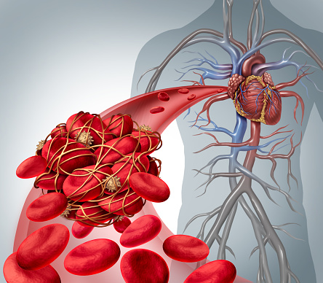
Overview
Health, disease and the development of medicines.
  Health and disease
  Definition of health
  Difference between communicable and non-communicable diseases
  Common infections, pathogens and how they are spread
  Lifecycle of a virus
Plant disease
  Plant defence mechanisms
  Detection and identification of plant diseases (Higher Tier)
Human body defence responses
  Physical barriers and chemical defences
  Role of the specific immune system
  Immunisation
  Antibiotics
  Culturing microorganisms
  Development of new medicines
  Production and use of monoclonal antibodies
  Effect of lifestyle
  Exercise, diet and BMI
  Alcohol on liver disease
  Smoking on cardio vascular disease
  Evaluation of treatments for cardiovascular disease

Slide 3
LearnIT!
KnowIT!
Health and Disease Part 1 (5.1 – 5.8)
  Definition of health
  Difference between communicable and non-communicable diseases
  Common infections, pathogens and how they are spread
  Lifecycle of a virus (biology)

Slide 4
  Health, disease and the development of medicines part 1- Health and disease
The World Health Organisation definition:
Health is a state of complete physical, mental and social well-being and not merely the absence of disease or infirmity.
Disease can be:
Communicable – these are infectious diseases caused by viruses, bacteria, protists and fungi and are spread in animals (and plants) e.g. malaria, measles, athletes foot
Non-communicable – these diseases are not caused by infection and cannot be spread e.g. heart disease, diabetes, Alzheimer's, asthma
Different types of disease may interact (work together) to make a person more susceptible to other diseases.
Defects in the immune system mean that an individual is more likely to suffer from infectious diseases
Viruses living in cells can be the trigger for cancers to form
Immune reactions initially caused by a pathogen can trigger allergies such as skin rashes and asthma
Severe physical ill health can lead to depression and other mental illness

Slide 5
  Health, disease and the development of medicines part 1- Health and disease
Pathogens are micro organisms that cause infectious disease.
Pathogens may infect plants or animals and can be spread by
direct contact or indirect contact. Indirect contact happens when microorganisms are carried to the person by water or by air or by animal vectors.
Pathogens depend on the host to provide the suitable conditions and nutrients that they need to grow and reproduce.
Pathogens can be bacteria, viruses, fungi or protists.
Viral diseases
Viruses may reproduce rapidly
Viruses live and reproduce inside cells causing damage
Bacterial diseases
Bacteria may reproduce rapidly
Bacteria may produce toxins that damage tissues and make us feel ill

Slide 6

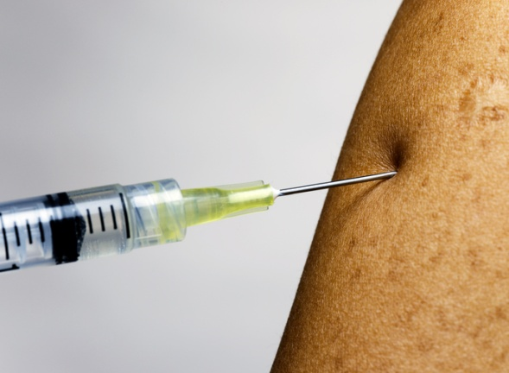
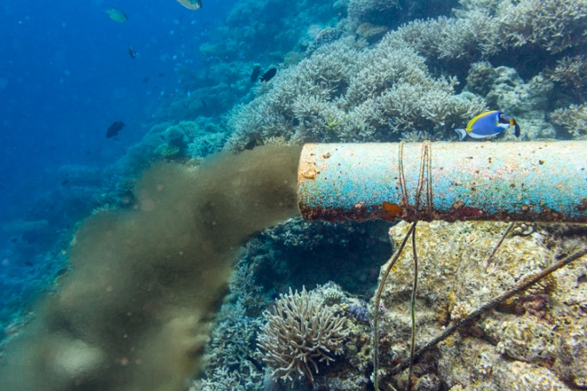
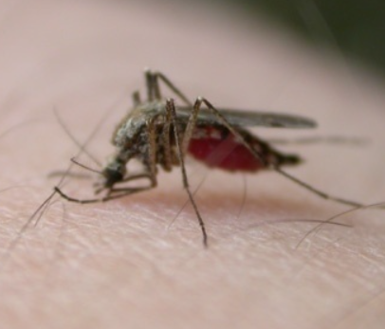
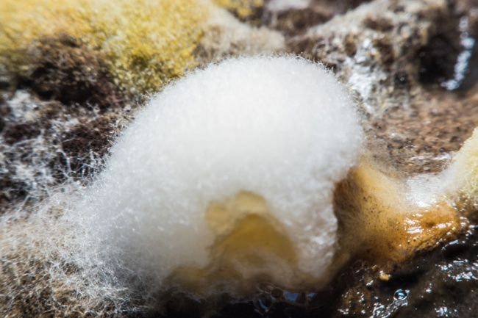
  Health, disease and the development of medicines part 1- Health and disease
Pathogens may infect plants or animals and can be spread by direct contact (D), by water (W) or by air (A)or animal vectors (V).
A
W
D
W
D
V
A

Slide 7
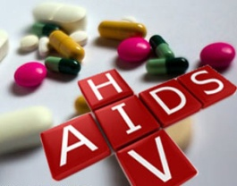
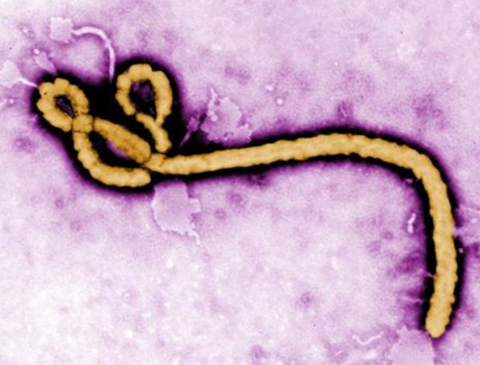
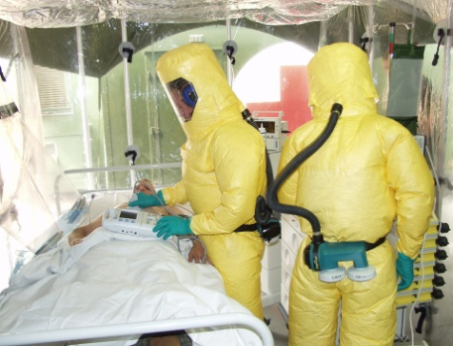
  Health, disease and the development of medicines part 1- Health and disease
Examples of Viral Diseases
HIV (human immunodeficiency virus)
HIV is a sexually transmitted infection (STI)
Initially causes a flu-like illness and spread by sexual contact or exchange of body fluids such as blood when drug users share needles.
Unless HIV is successfully controlled with antiretroviral drugs, the virus will destroy white blood cells leading to the onset of AIDS.
Late stage HIV or AIDS occurs when the body’s immune system can no longer deal with other infections or cancers.
Ebola virus (biology only)
People are infected when they have direct contact through broken skin with the bodily fluids of a person with Ebola.
Initial symptoms of Ebola include fever and joint pain.
The symptoms develop into haemorrhagic fever which includes internal and external bleeding causing multiple organ failure.
Ebola virus

Slide 8
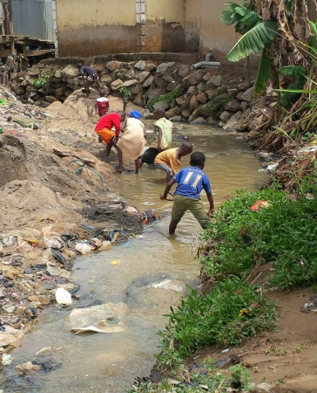
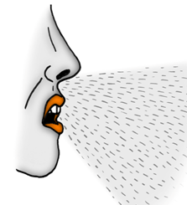
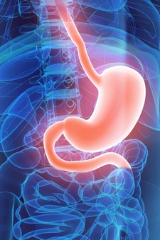
Health, disease and the development of medicines part 1- Health and disease
Examples of Bacterial Diseases
Cholera
Cholera is a disease which is spread via contaminated drinking water.
Cholera causes diarrhoea and can kill if left untreated.
Cholera is often a consequence of a humanitarian crisis.
Clean drinking water and good sanitation reduces the spread of cholera.
Tuberculosis
Tuberculosis (TB) bacteria are spread through the air in tiny droplets when an infected person sneezes or coughs.
It can cause lung damage.
A vaccination programme is in place to reduce the spread.
Helicobacter (biology only)
The presence of Helicobacter has been found to be a contributory factor in development of stomach ulcers.
It is transmitted orally through saliva.
To reduce the spread: do not share food / cutlery or cups, avoid saliva exchange with an infected person.

Slide 9
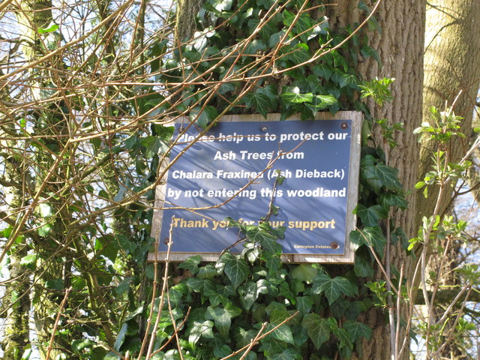
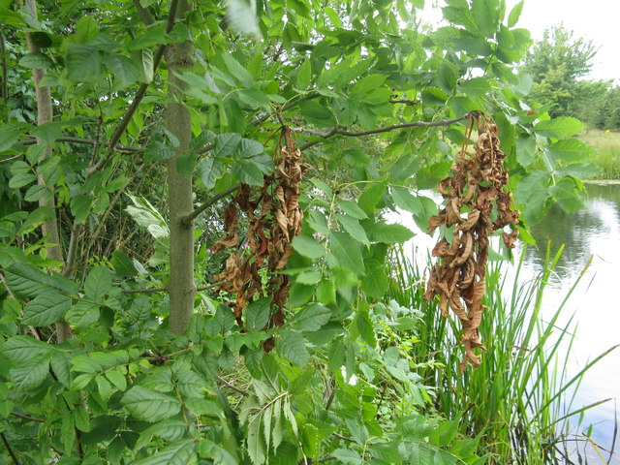
Health, disease and the development of medicines part 1- Health and disease
Example of a Fungal Disease
Chalara ash dieback
Chalara causes leaf loss and lesions in the bark. Trees usually die from the infection or become weakened to attacks by other pests or pathogens.
There is no cure known for this disease.
Chalara ash dieback is spread through airborne transmission of fungal spores.
Infected leaves fall to the ground during autumn and spores are carried on the wind and deposited on healthy ash trees.
To reduce the spread of the pathogen:
Clean machinery, tools, vehicles and footwear when moving between sites.
Burn or compost infected leaves on site.
Warn all land users so they can also take precautions.

Slide 10
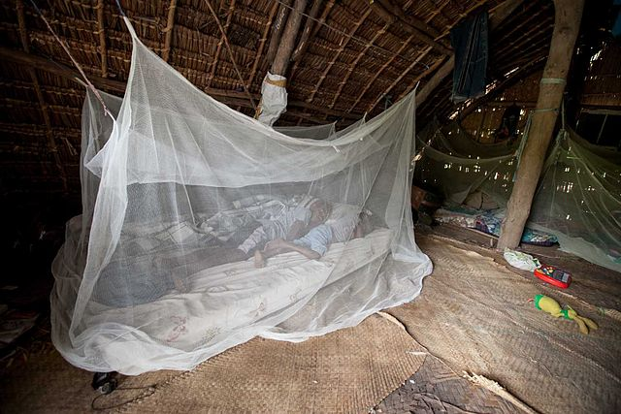
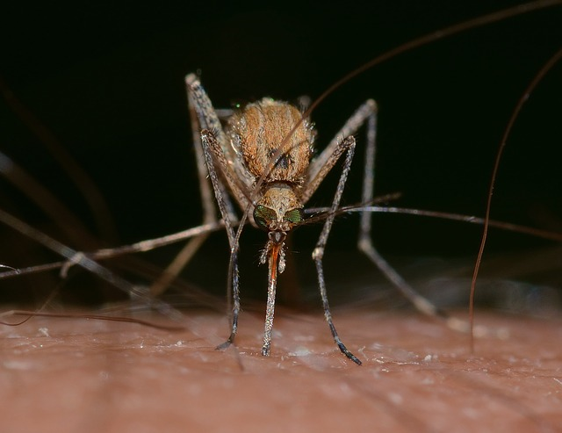
Health, disease and the development of medicines part 1- Health and disease
Example of a Protist Disease
Malaria
The malaria causing protist is spread by mosquitoes feeding on infected blood and then biting a human.
Mosquitoes are animal vectors as they pass on malaria but do not suffer themselves.
Malaria causes damage to blood and the liver. It can be fatal.
Control the spread by preventing mosquitoes breeding and use mosquito nets to avoid being bitten.

Slide 11
  Health, disease and the development of medicines part 1- Health and disease
Disease | Symptom | Method of transmission | Control spread of disease by: | Caused by:
Malaria | Recurrent fever | Animal vector | Preventing breeding of mosquitoes or use of a net to prevent being bitten. | Protist
Chalara ash dieback | Leaf loss and bark lesions | Airborne | Remove infected leaf litter. Clean all tools, vehicles and footwear. | Fungus
Cholera | Diarrhoea | Waterborne | Clean drinking water and good hygiene and sanitation. | Bacteria
Tuberculosis | Lung damage | Airborne | Vaccination programme. Treat infection with antibiotics. | Bacteria
HIV | Flu like illness | Sexual contact or bodily fluids. Direct contact. | Use of condoms / clean needles. Treat infection with antiretroviral drugs. | Virus
Ebola (biology only) | Haemorrhagic fever | Bodily fluid - direct contact | Avoid contact with people infected with Ebola. | Virus

Slide 12
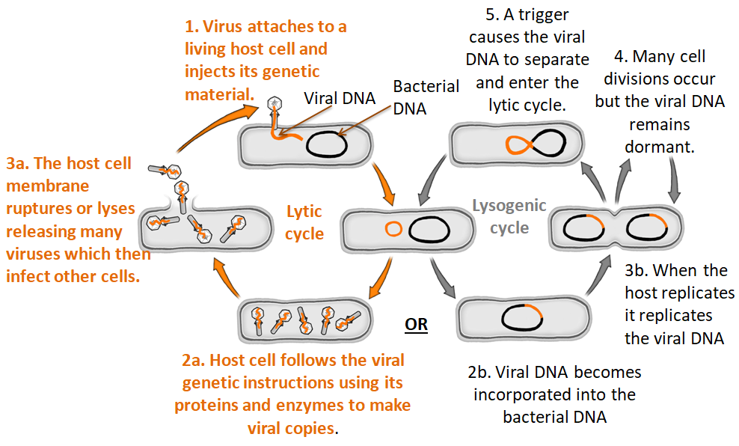
  Health, disease and the development of medicines part 1- Lifecycle of a virus (Biology)
Viruses are not living organisms and cannot reproduce without a host cell.

Slide 13
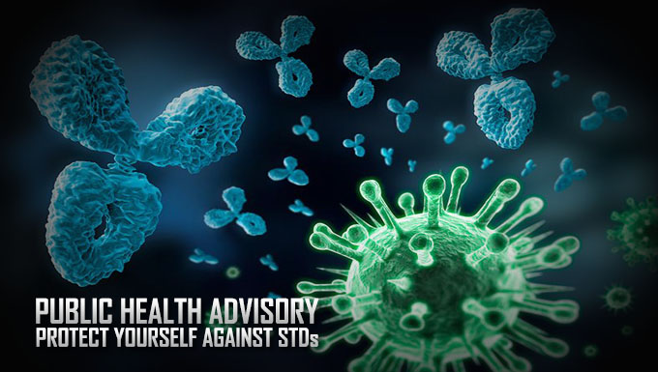
  Health, disease and the development of medicines part 1- Health and disease
Sexually transmitted infections (STI) are passed from one person to another through unprotected sex or genital contact. HIV is an STI which is spread via infected bodily fluids. Spread can be reduced by wearing a condom, not sharing needles if a drug user and use of medication to prevent an infected person passing on the STI to another e.g. a mother to her unborn child.
Chlamydia is the most common STI in the UK. It is a bacterial infection. The bacteria are spread through infected bodily fluids. To reduce the chance of catching Chlamydia, people should use barrier methods of contraception such as a condom.
Most people have no symptoms and so do not know they are infected. In women, Chlamydia can cause pain or a burning sensation when urinating, vaginal discharge, pain in the lower abdomen and heavy periods.
In men, Chlamydia can cause pain or a burning sensation when urinating, a discharge from the tip of the penis and pain in the testicles.
Chlamydia can be detected using a urine test or a swab of the affected area. It can be treated with antibiotics. Chlamydia can be passed by an infected pregnant woman to her unborn baby.
If left untreated, Chlamydia can cause long term health problems and infertility.

Slide 14
QuestionIT!
Health and disease
Part 1
  Definition of health
  Difference between communicable and non-communicable diseases
  Common infections, pathogens and how they are spread
  Lifecycle of a virus (biology)

Slide 15
  Health, disease and the development of medicines part 1 – QuestionIT
1. Complete the table by filling in the missing information.
Disease | Symptom | Method of transmission | Control spread of disease by: | Caused by:
Malaria | Recurrent fever |  | Preventing breeding of mosquitoes or use of a net to prevent being bitten.
Chalara ash dieback | Leaf loss and bark lesions | Airborne |  | Fungus
Cholera | Diarrhoea | Waterborne |  | Bacteria
HIV | Flu like illness |  |  | Virus
Ebola (biology only) | Haemorrhagic fever | Bodily fluid - direct contact

Slide 16
  Health, disease and the development of medicines part 1 – QuestionIT
2. Define the word health.
3. What are communicable diseases?
4. What are non-communicable diseases?
5. What does the term ‘susceptible to other diseases’ mean?
6. What is the definition of a pathogen?
7. How can the spread of Chlamydia be reduced?
8. What disease does HIV cause eventually if it is not successfully managed?
9. What type of pathogen causes Chlamydia?

Slide 17
  Health, disease and the development of medicines part 1– QuestionIT
Biology Only
10. What are the two pathways involved in the lifecycle of a virus?
11. Which pathway involves the assimilation of lots of new active viral particles?

Slide 18

AnswerIT!
Health and disease
Part 1
  Definition of health
  Difference between communicable and non-communicable diseases
  Common infections, pathogens and how they are spread
  Lifecycle of a virus (biology)

Slide 19
  Health, disease and the development of medicines part 1 – AnswerIT
1. Complete the table by filling in the missing information.
Disease | Symptom | Method of transmission | Control spread of disease by: | Caused by:
Malaria | Recurrent fever | Animal vector | Preventing breeding of mosquitoes or use of a net to prevent being bitten. | Protist
Chalara ash dieback | Leaf loss and bark lesions | Airborne | Remove infected leaf litter. Clean all tools, vehicles and footwear. | Fungus
Cholera | Diarrhoea | Waterborne | Clean drinking water and good hygiene and sanitation. | Bacteria
HIV | Flu like illness | Sexual contact or bodily fluids. Direct contact. | Use of condoms / clean needles. Treat infection with antiretroviral drugs. | Virus
Ebola | Haemorrhagic fever | Bodily fluid - direct contact | Avoid contact with people infected with Ebola. | Virus

Slide 20
  Animal tissues, organs and organ systems Part 3 – AnswerIT
2. Define the word health. A state of complete physical, mental and social well-being and not merely the absence of disease or infirmity.
3. What are communicable diseases? Infectious diseases caused by microbes that can be spread.
4. What are non-communicable diseases? Diseases not caused by infections and cannot be spread.
5. What does the term ‘susceptible to other diseases’ mean? An increased likelihood of developing other diseases.
6. What is the definition of a pathogen? A disease causing organism including bacteria, viruses, fungi and protists.
7. How can the spread of Chlamydia be reduced? Wearing a condom, being tested to see if a person has the disease and can be treated or avoiding sex.
8. What disease does HIV cause eventually if it is not successfully managed? AIDS
9. What type of pathogen causes Chlamydia? Bacterium

Slide 21
  Animal tissues, organs and organ systems Part 3 – QuestionIT
Biology Only
10. What are the two pathways involved in the lifecycle of a virus?
Lytic
Lysogenic
11. Which pathway involves the assimilation of lots of new active viral particles?
Lytic

Slide 22
LearnIT!
KnowIT!
Plant disease
Part 2 (5.9B- 5.11B)
Plant defence mechanisms (biology)
Detection and identification of plant diseases (biology higher Tier)

Slide 23
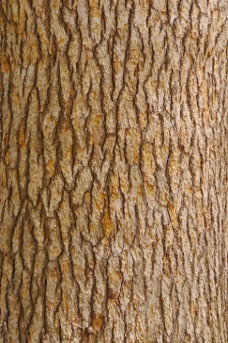


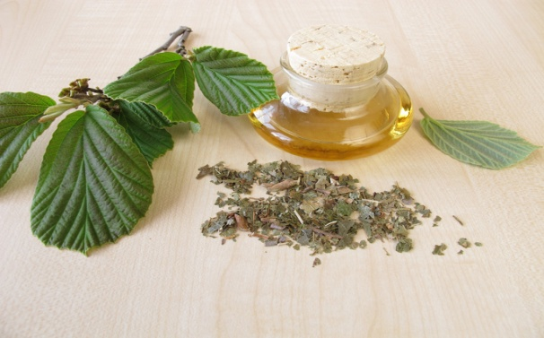
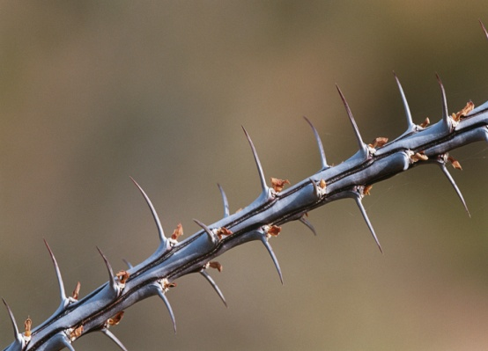

  Health, disease and the development of medicines part 2-Plant disease (Biology)
video
Physical
Mechanical
Bark, thick waxy cuticles, tough cellulose cell walls defend the plant from pathogen entry.
Plants have several ways of defending themselves from pathogens and to deter herbivores.
Touch can make Mimosa leaves suddenly curl which frightens animals.
Antibacterial and other toxic chemicals come from plants e.g. menthol from mint, digoxin from foxgloves, aspirin from willow. Humans use these to treat disease and relieve symptoms.
Chemical
Mechanical
Thorns make plants painful if eaten by herbivores.

Slide 24
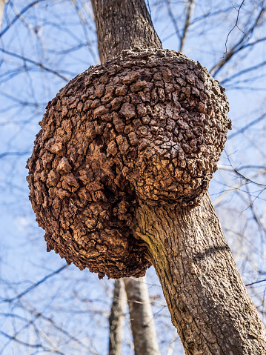
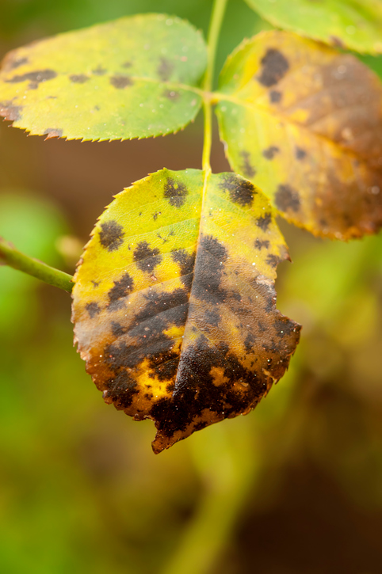

  Health, disease and the development of medicines part 2-Plant disease (Biology)
Plants suffer from a range of infections caused by pathogens or insect pests. We can detect a plant is diseased by observing these visible signs in the field:
Unusual growths
Spots or discoloured leaves
Malformed leaves or stems

Slide 25
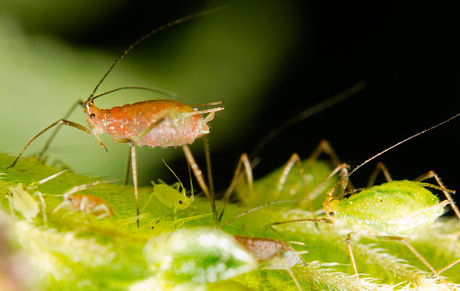
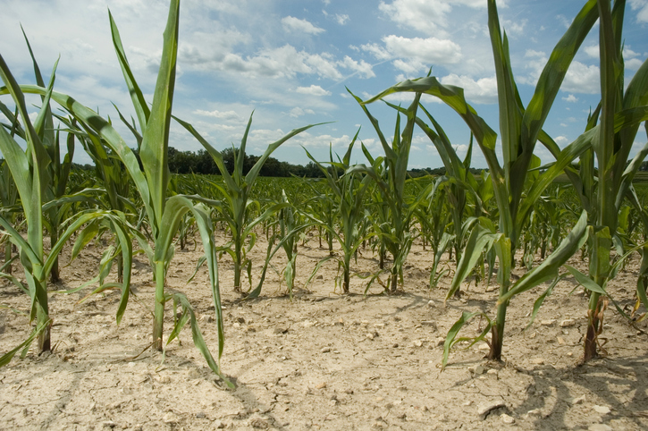
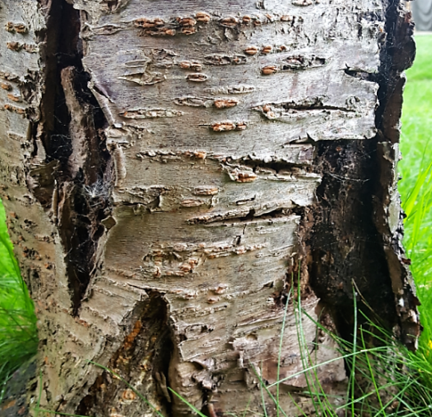
  Health, disease and the development of medicines part 2-Plant disease (Biology Higher tier)
If a plant disease is suspected then it may be identified using:
    Gardening manuals
    Gardening websites
    Test kits containing monoclonal antibodies
    Taking infected plants to a laboratory to identify the pathogen
The presence of pests
Stunted growth
Areas of decay (rot)

Slide 26
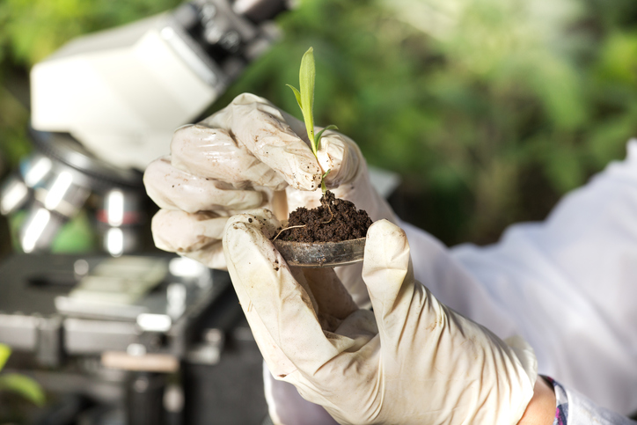
  Health, disease and the development of medicines part 2-Plant disease (Biology Higher tier)
Plants can often appear to be diseased because they look unhealthy e.g. yellow leaves, stunted growth.
This can be due to environmental causes such as ion deficiencies in the soil that the plants have been grown in.
Nitrate ions = healthy growth
Lack of nitrate = stunted growth
Magnesium = healthy chlorophyll
Lack of magnesium = chlorosis (yellowing of leaves due to lack of chlorophyll)

Slide 27
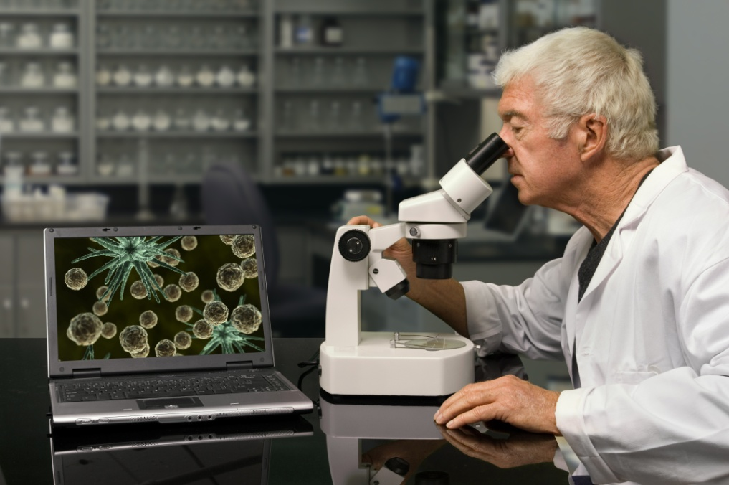
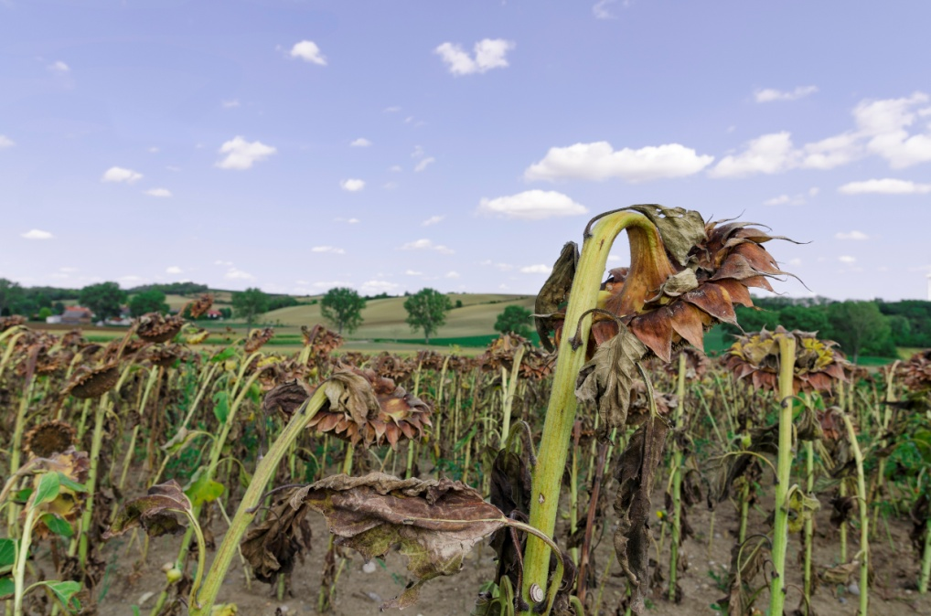
  Health, disease and the development of medicines part 2-Plant disease (Biology Higher tier)
Pathogens can be spread in different ways.
A scientist specialising in plant disease is called a plant pathologist.
Plant pathologists analyse the distribution of plants with a disease to identify the likely pathogen.
Air borne pathogens often cause a random distribution of diseased plants.
If plants in a very localised area have become diseased, then the pathogen responsible is more likely to be found in the soil.
When a plant is infected by a pathogen, the pathogen’s DNA can be identified from plant tissue samples sent for diagnostic testing in the laboratory.

Slide 28
QuestionIT!
Plant disease
Part 2 (5.9B- 5.11B)
Plant defence mechanisms (Biology only)
Detection and identification of plant diseases (Biology higher tier only)

Slide 29
  Plant disease (Biology) - QuestionIT
List three ways a plant can defend itself against the attack of pests and pathogens.
2. Name two chemicals produced by plants which humans can use to relieve disease symptoms.
Higher tier
3. What information might a distributional analysis of a plant disease produce?
4. List two other ways plant diseases can be identified.
5. What ion is needed for healthy growth in plants?
6. If a plant had yellow leaves what mineral ion is likely to be absent?

Slide 30
AnswerIT!
Plant disease
Part 2
Plant defence mechanisms (Biology only)
Detection and identification of plant diseases (Biology higher tier only)

Slide 31
  Plant disease (Biology) – AnswerIT
List three ways a plant can defend itself against the attack of pests and pathogens.
Thick cell wall
Thick leaf cuticle
Producing chemicals
Prickly spines
2. Name two chemicals produced by plants which humans can use to relieve disease symptoms.
Aspirin
Digoxin
Menthol
Higher Tier
3. What information might a distributional analysis of a plant disease produce?
The pattern of plants which have become diseased may indicate if the pathogen is air borne or in the soil.

Slide 32
  Plant disease (Higher tier biology)– AnswerIT
4. List two other ways plant diseases can be identified.
Visible symptoms
Diagnostic testing
5. What ion is needed for healthy growth in plants?
Nitrate
6. If a plant had yellow leaves what mineral ion is likely to be absent?
Magnesium

Slide 33
LearnIT!
KnowIT!
Human body defence responses.
Part 3 (5.12- 5.19B)
  Physical barriers and chemical defences
  Role of the specific immune system
  Immunisation
  Antibiotics
  Culturing microorganisms (biology)

Slide 34
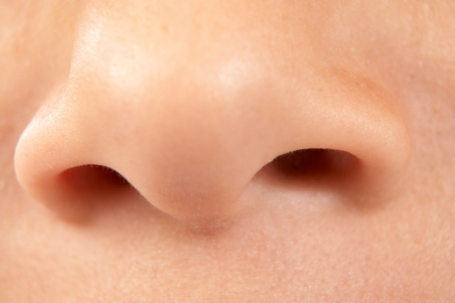
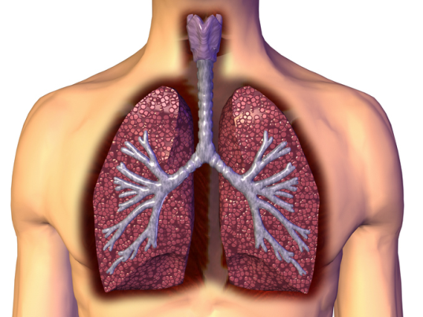

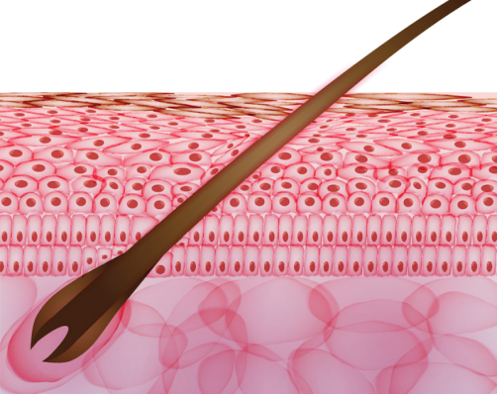

  Health, disease and the development of medicines part 3 –
  Human body defence responses
nose
trachea
Physical barriers
video
Physical barriers
bronchus
Nasal hairs, sticky mucus and cilia prevent pathogens entering through the nostrils.
The human body has several non specific ways of defending itself from pathogens getting in.
Respiratory system is lined with mucus to trap dust and pathogens. Cilia move the mucus upwards to be swallowed.
skin
Chemical defence
Physical barriers
Chemical defence
stomach
Tears, saliva and mucus contain an enzyme called lysozyme which destroys microorganisms.
Hard to penetrate waterproof barrier. Glands secrete oil which kill microbes.
Hydrochloric acid (pH1) kills most ingested pathogens.
Notes:
http://www.bbc.co.uk/education/clips/z2mcd2p

Slide 35
  Health, disease and the development of medicines part 3 –
  Human body defence responses
The specific immune system defends the human body against disease by:
Detection
The body is exposed to the pathogen which enters the body. Antigens (foreign proteins on the surface of the pathogen) are detected by the immune system.
Activation
The antigens trigger an immune response which causes the lymphocytes to produce specific antibodies which destroy the pathogens.
Memory
The antigen triggers the production of memory lymphocytes. If the body is re-infected with the same pathogen the memory lymphocytes respond by producing antibodies much more rapidly. This is called the secondary response to the antigen.

Slide 36
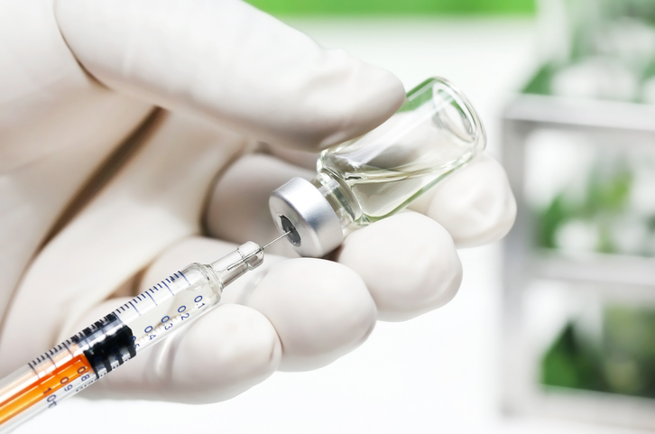

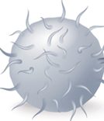
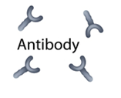
  Health, disease and the development of medicines part 3 –
  Human body defence responses
Communicable diseases can be dangerous leading to epidemics or pandemics. Vaccination can be used to enhance the immune system and reduce the chances of this happening. A vaccine contains a small amount of dead or inactive form of the pathogen that can be introduced into the body and cause an immune response.
Lymphocyte
pathogen
White blood cells detect inactive pathogens from the vaccine.
Antibodies are released into the blood.
Pathogens are destroyed by antibodies.

Slide 37
  Health, disease and the development of medicines part 3 –
  Human body defence responses
If the body becomes re-infected with the same pathogen then the white blood cells are prepared.
The white blood cells can respond much more quickly and make more of the right type of antibodies much more quickly.
White blood cells detect pathogens.
Antibodies are made and released into the blood much faster and in larger amounts.
Pathogens are destroyed by the antibodies much faster.
This means that the person is unlikely to suffer the symptoms of the harmful disease.
Infection has been prevented by enhancing the immune system.

Slide 38
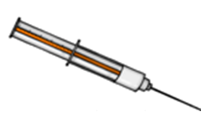
  Health, disease and the development of medicines part 3 –
  Vaccinations (biology)
Advantages of vaccinations:
The chances of falling ill or dying from a disease might be far greater than the chance of experiencing a side effect.
Vaccination is cheaper than treating a seriously ill person.
When fewer people are vaccinated the number of cases of the disease increases.
If enough people in a community are vaccinated against a pathogen it makes it difficult for the disease to spread because there are so few susceptible people left to infect.
This is called herd immunity. It is crucial for protecting people who cannot be vaccinated such as very young children, people with immune system problems and those who are too ill such as cancer patients.
Immunisation means that a person has become resistant to a pathogen.
Immunisation can be a result of natural exposure to a pathogen or artificial by being given a vaccination containing the pathogen. These both require the body to react by producing antibodies and so are called active immunity.
Passive immunity can also occur when a baby receives antibodies in the mothers milk or when an injection contains antibodies.
Disadvantages of vaccinations:
There are risks that come with vaccinations. Some people have side effects.
People do not like having vaccinations.

Slide 39
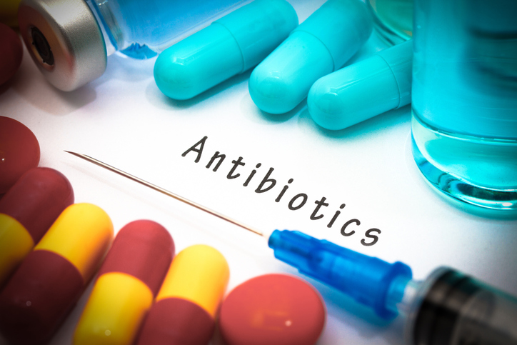
  Health, disease and the development of medicines part 3 –
  Antibiotics
An antibiotic is a drug that helps to cure a bacterial disease by only inhibiting cell processes in the infective bacteria inside the body, without affecting the host organism.
Different bacterial infections need a different antibiotic.
Antibiotics cannot be used to treat viral pathogens.
Penicillin is a well known antibiotic medicine.
It is difficult to develop drugs to kill viruses without harming body tissues because viruses live and reproduce inside cells.
Using antibiotics has greatly reduced deaths.

Slide 40
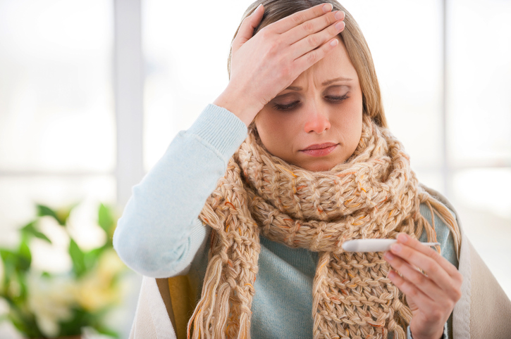
  Health, disease and the development of medicines part 3 –
  Antibiotics
A doctor will not prescribe antibiotics for a viral infection as they do not work.
Antibiotics can only be used for bacterial infections
Painkillers, steroids or anti inflammatory medicines can be used to relieve the symptoms of viral infections. Symptoms may include: fever, muscle ache, headache or a runny nose.
Painkillers do not kill pathogens.

Slide 41
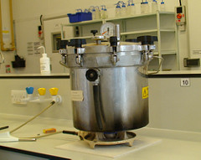
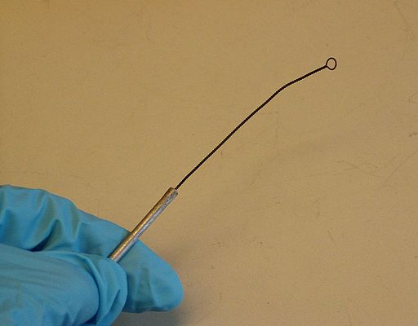
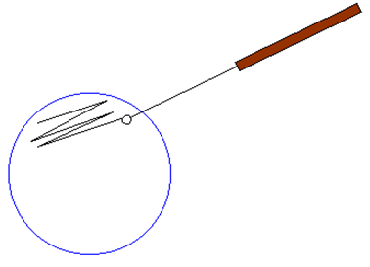
  Health, disease and the development of medicines part 3 –
  Culturing microorganisms (Biology)
Bacteria multiply by binary fission (a type of cell division where two identical cells are formed). In the right conditions, cells can divide as often as every 20 minutes.
Bacteria can be grown in the lab using aseptic (sterile) techniques.
A growth medium (agar) used containing an energy source (carbohydrate) and minerals.
Petri dishes and agar must be sterilised in an autoclave before use to kill microorganisms.
Inoculating loops used to transfer bacteria after being heated in a Bunsen flame to sterilise them.
The lid of the Petri dish should be sealed with tape to stop other microorganisms getting in (must not be fully sealed so oxygen can get in). All Petri dishes and vials must be kept covered when not in use to reduce the risk of contamination.
In school, Petri dishes are incubated at 25°C to reduce risk of growth of pathogens that might be harmful.
An autoclave
An inoculating loop
Transfer of bacteria to the growth medium
Notes:
https://www.flickr.com/photos/biologycourses/7006411072 autoclave image

Slide 42
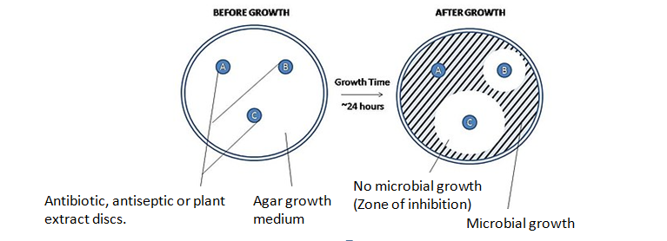
  Health, disease and the development of medicines part 3 –
  Culturing microorganisms (biology)
Core practical : Effectiveness of antiseptics, antibiotics or plant extracts on microbial cultures experiment.
Use aseptic techniques.
Sterile agar growth medium inoculated with microorganisms.
Paper discs containing antiseptics, antibiotics or plant extracts placed on microbial culture and left to grow.
Water disc used as a CONTROL.
If microorganisms don’t grow around the disc then the chemical is effective at killing the microorganism.
Area where bacteria don’t grow is called ZONE OF INHIBITION.
Video

Slide 43
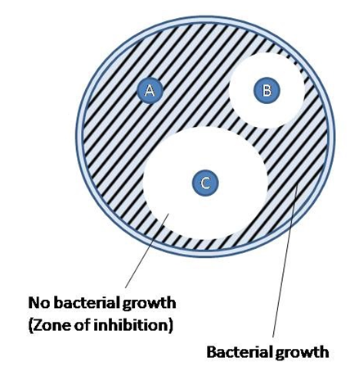
  Health, disease and the development of medicines part 3 –
  Culturing microorganisms (biology)
Calculating the cross sectional area of the zone of inhibition.
Measure the radius of the clear zone.
Use the formula πr² to calculate the cross sectional area.
If the radius of the zone of inhibition for disc B was 12mm, then the cross sectional area is:
3.14 x 12² = 452mm²
12mm

Slide 44
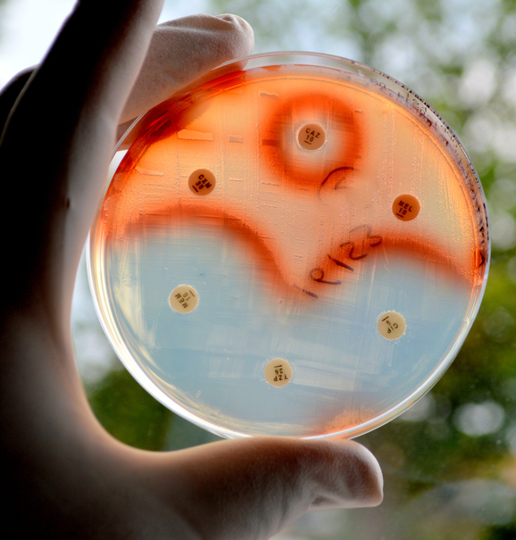
  Health, disease and the development of medicines part 3 –
  Culturing microorganisms (biology)
Bacteria can mutate.
Sometimes this makes them resistant to antibiotic drugs.
The mutated bacteria are not killed. Increasing numbers of different bacteria are becoming resistant and this is of concern.
A
Red = bacteria colonies
Bacteria are resistant to antibiotic A
A
Disc soaked in antibiotic
B
Bacteria are killed by antibiotic B
Clear = no bacterial colonies

Slide 45
QuestionIT!
Human body defence responses.
Part 3 (5.12- 5.19B)
  Physical barriers and chemical defences
  Role of the specific immune system
  Immunisation
  Antibiotics
  Culturing microorganisms (biology)

Slide 46
  Human body defences – QuestionIT
Name three physical barriers of the human body which protect the body from pathogens.
What is lysozyme?
Name the chemical found in the stomach which acts as a chemical defence against pathogens.
What is an antigen?
What is an antibody?
What does a memory lymphocyte do?
What is meant by the secondary response to an antigen?
What does a vaccine contain?

Slide 47
  Human body defences – QuestionIT
9. Which type of pathogen would doctors treat with antibiotics?
Biology only
What does the term herd immunity mean?
What does aseptic mean?
What does an autoclave do?
13. Why should Petri dishes and culture vials be kept covered?
14. What formula is used to calculate the cross sectional area of a bacterial culture?

Slide 48
AnswerIT!
Human body defence responses.
Part 3 (5.12- 5.19B)
  Physical barriers and chemical defences
  Role of the specific immune system
  Immunisation
  Antibiotics
  Culturing microorganisms

Slide 49
  Human body defences – QuestionIT
Name three physical barriers of the human body which protect the body from pathogens.
Skin
Mucus
Cilia
What is lysozyme? An enzyme secreted in tears which destroys pathogens.
Name the chemical found in the stomach which acts as a chemical defence against pathogens. Hydrochloric acid.
What is an antigen? An antigen is a substance which stimulates the production of antibodies.
What is an antibody? A protein which is produced in response to an antigen which it then neutralises.

Slide 50
  Human body defences – AnswerIT
What does a memory lymphocyte do?
This type of white blood cell remain in the blood for a long time. These will rapidly trigger the production of antibodies if the body is re-infected.
What is meant by the secondary response to an antigen?
A secondary response occurs when a second exposure to the antigen triggers an immune response. Antibodies are made in a much shorter period of time meaning the body has a rapid response to the pathogen the second time around.
What does a vaccine contain?
A weakened or dead form of the pathogen
9. Which type of pathogen would doctors treat with antibiotics?
Bacteria

Slide 51
  Human body defences – AnswerIT
Biology only
What does the term herd immunity mean? Herd immunity is an indirect protection from communicable diseases which occurs when a large percentage of the population has become immune to the disease through vaccination.
11. What does aseptic mean?
Sterile
12. What does an autoclave do? Sterilises equipment or substances using steam and high pressure.
13. Why should Petri dishes and culture vials be kept covered? To reduce the chance of contamination of the culture medium from the air.
14. What formula is used to calculate the cross sectional area of a bacterial culture?
πr²

Slide 52
LearnIT!
KnowIT!
Development of new
medicines
Part 4 (5.20 - 5.22B)
Process of developing
new medicines
Monoclonal antibodies (biology HT)

Slide 53
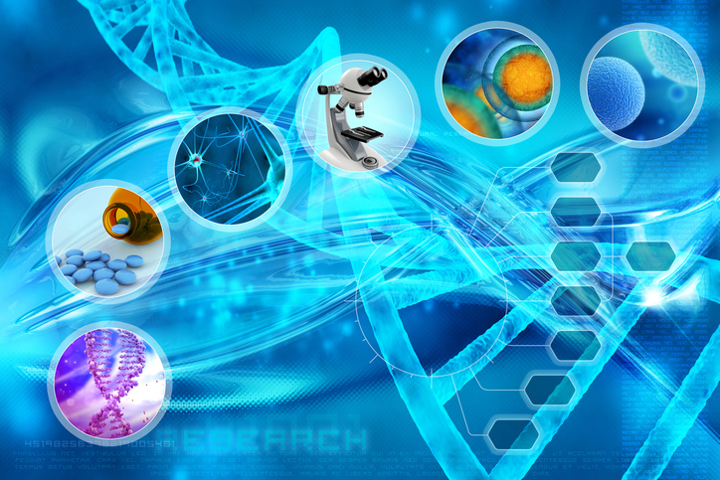
  Health, disease and the development of medicines part 4 –
  Development of new drugs
The initial chemical used to make a drug may have been discovered from a plant. Most new drugs are developed and synthesised (made) in a laboratory by chemists in the pharmaceutical industry.
New drugs must be tested and trialled to check:
Efficacy - that the drugs work
Toxicity - that the drug is not poisonous
Dose - the most suitable amount to take
Preclinical tests must be carried out before humans are allowed to take the drug.
These preclinical tests are done on cells, tissue samples and live animals.

Slide 54
  Health, disease and the development of medicines part 4 –
  Development of new drugs
If successful the new drug will proceed to clinical testing.
The stages of a clinical trial are:
Stage 1
Healthy volunteers try small doses of the drug to check it is safe and has no side effects
Stage 2
A small number of patients try the drug at a low dose to see if it works
Stage 3
A larger number of patients take the new drug and different doses are trialled to find the optimum dose
Stage 4
A double blind trial will occur to see how effective the new drug is. The patients are divided into groups
video

Slide 55
  Health, disease and the development of medicines part 4 –
  Development of new drugs
A double blind trial is carried out on patients who have the disease to make sure that it is actually the drug which is having an effect on the patients and not anything else.
The details of everyone taking part in the trial is entered into a computer database. The computer groups people randomly.
Each person receives a unique code and they receive the medicine which is labelled with the matching code.
No-one knows who is receiving the real drug or a placebo until the end of the trial.
The placebo is often the drug the patient was originally taking so they still receive medical treatment.

Slide 56
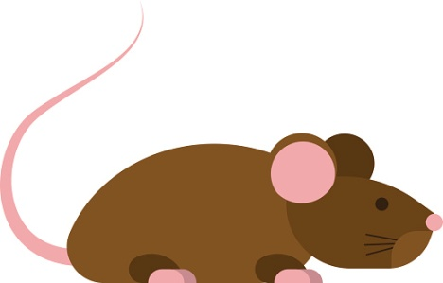
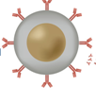
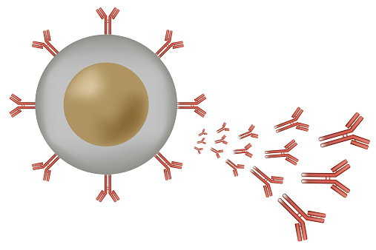
  Health, disease and the development of medicines part 4 –
  Monoclonal antibodies (biology HT)
Monoclonal antibodies are identical copies of one type of antibody produced in a laboratory.
How to produce monoclonal antibodies:
1. A mouse is injected with a pathogen.
2. White blood cells called lymphocytes produce antibodies but they do not divide.
3. Lymphocytes are removed from the mouse and fused with rapidly dividing mouse tumour cells.
4. The new cells are called hybridomas.
5. The hybridomas divide rapidly and release lots of antibodies which are then collected.
Mono = one

Slide 57
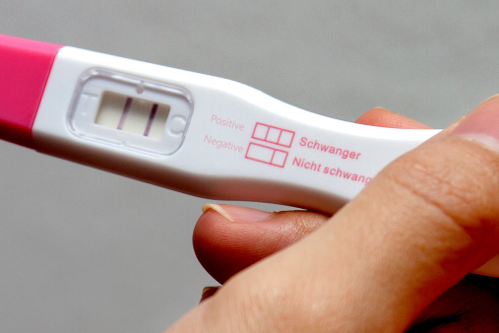
  Health, disease and the development of medicines part 4 –
  Monoclonal antibodies (biology HT)
Monoclonal antibodies are specific to one binding site on the antigen. This means that we can use monoclonal antibodies to target a specific chemical or specific cells in the body. They can be used to locate blood clots and cancer cells.
During pregnancy, a hormone called HCG is released into the blood. Monoclonal antibodies can detect the presence of this chemical at low levels and are used in pregnancy testing kits.

Slide 58

  Development of new medicines part 4 – Monoclonal antibodies (Biology HT)
Monoclonal antibody research has raised some concerns about their ethical use.
Mice are injected with pathogens and so they will experience the disease symptoms.
Mice provide antibody producing cells and tumour cells. Mice are induced with cancer to get the tumour cells.
Monoclonal antibodies have been successful in treating some cancers and diabetes. But there have been deaths when used to treat patients with multiple sclerosis (MS).
Herceptin is used for breast cancer. It is not toxic and is specific to breast cancer cells so few side effects. But it is costly.

Slide 59
  Health, disease and the development of medicines part 4 –
  Monoclonal antibodies (biology HT)
Monoclonal antibodies are used in diagnosis to locate blood clots and cancer cells. They are used in treating some cancers. They target specific cells causing minimal damage to the rest of the body cells around the tumour unlike other drugs or radiotherapy.
The monoclonal antibodies are specific to the antigen on the cancer cells.
A chemical which stops cells dividing can be bound to the monoclonal antibodies.
The patient is given the monoclonal antibodies and they attach to receptors on the cancer cells.
The chemical stops the cancer cells growing and dividing.

Slide 60
QuestionIT!
Development of new medicines.
Part 4 (5.20 - 5.22B)
Process of developing
new medicines
Monoclonal antibodies (biology HT)
Part 4

Slide 61
  Development of new medicines – QuestionIT
1. Any potential new drug has to go through a series of tests.
What is meant by the following terms?
  Efficacy b) Toxicity c) Optimum dose
2. Number these statements to show how drugs are tested.
  Drugs are trialled on live animals
  Drugs are trialled on people with the disease the drug is for
  Drugs are trialled in laboratories on cells and tissue cultures
  Drugs are trialled on healthy volunteers
3. Drugs companies often use a placebo in their trials.
  a. What is a placebo? b. Why is it used?

Slide 62
  Development of new medicines – QuestionIT
  Questions for Biology HT only
  4. Place the statements in the correct order to show how monoclonal antibodies are produced.
  Mouse lymphocytes produce antibodies.
  The antibodies are collected and purified.
  Mouse lymphocytes are collected.
  Mouse is injected with a pathogen.
  Hybridoma cells are separated and cultured to form a clone.
  Mouse lymphocyte and mouse tumour cell are fused.
  The clone produces large quantities of antibody.

Slide 63
  Infection and Response – QuestionIT
5. What are the applications of monoclonal antibodies?
6. Why do some people feel the use of monoclonal antibodies is unethical?
7. Why would a test kit containing monoclonal antibodies be useful to detect plant disease?

Slide 64
AnswerIT!
Development of new medicines.
Part 4 (5.20 - 5.22B)
Process of developing
new medicines
Monoclonal antibodies (biology HT)

Slide 65
  Development of new medicines– AnswerIT
1. What is meant by the following terms?
  Efficacy how effective the drug is
  Toxicity how poisonous the drug is
  Optimum dose minimum amount of the drug which provides the best response
2. Number these statements to show the process of drug testing.
  2. Drugs are trialled on live animals
  4. Drugs are trialled on people with the disease the drug is for
  1. Drugs are trialled in laboratories on cells and tissue cultures
  3. Drugs are trialled on healthy volunteers

Slide 66
  Development of new medicines– AnswerIT
  3. Drug companies often use a placebo in their trials.
  a. What is a placebo?
  A medicine that does not contain the drug that is being trialled.
  b. Why is it used?
  A placebo is used to check that there are no other factors which
  may cause the patient‘s condition to improve without the drug.

Slide 67
  Development of new medicines– AnswerIT
  Questions for Biology HT only
  4. Place the statements in the correct order to show how monoclonal antibodies are produced.
  2. Mouse lymphocytes produce antibodies.
  7. The antibodies are collected and purified.
  3. Mouse lymphocytes are collected.
  1. Mouse is injected with a pathogen.
  5. Hybridoma cells are separated and cultured to form a clone.
  4. Mouse lymphocyte and mouse tumour cell are fused.
  6. The clone produces large quantities of antibody.

Slide 68
  Development of new medicines – AnswerIT
5. What are the applications of monoclonal antibodies?
Pregnancy testing
Used to measure levels of hormones and other chemicals in blood
Treat some cancers by delivering a toxic drug to the cancer cells
To find various molecules in cells or tissues by binding to them with a fluorescent dye
6. Why do some people feel the use of monoclonal antibodies is unethical?
Mouse has to suffer the disease deliberately
Mouse is induced to have cancer
Treatment not always safe
It’s very expensive and money could be better used

Slide 69
  Development of new medicines – AnswerIT
7. Why would a test kit containing monoclonal antibodies be useful to detect plant disease?
The monoclonal antibodies can be used to detect a particular chemical which is only present in one type of pathogen. This would then show whether the plant was infected with this disease or not.

Slide 70
LearnIT!
KnowIT!
Effect of lifestyle
Part 5 (5.23 – 5.25)
  Exercise, diet and BMI
  Alcohol on liver disease
  Smoking and cardio vascular
  disease
  Evaluation of treatments for cardiovascular disease

Slide 71
  Health, disease and the development of medicines part 5 –
  Effect of lifestyle
Non-communicable diseases (NCDs) can have a significant human and financial cost for individuals, local communities, nationally and globally.
Video - NCDs
WHO Factsheet data link
Non-communicable diseases (NCDs) kill 40 million people each year, equivalent to 70% of all deaths globally
Each year, 15 million people die from a NCD between the ages of 30 and 69 years; over 80% of these "premature" deaths occur in low- and middle-income countries
Cardiovascular diseases account for most NCD deaths, or 17.7 million people annually, followed by cancers (8.8 million), respiratory diseases (3.9million), and diabetes (1.6 million)
Human cost: lower quality of life, shorter lifespan and the families of the sufferer are also affected due to caring responsibilities, parental/partner death etc.
Financial cost: cost of health care, research into diseases, awareness campaigns. Reduced income due to inability to work, personal care costs, adaptations to the home and buying specialist equipment e.g. wheelchairs, mobility scooters etc.
Also if many people are unable to work due to NCDs the economy can be affected.
Notes:
https://www.youtube.com/watch?v=UTSf09Huz70&list=PL3FB3D1EAAD2DBE57
WHO factsheet last accessed 21/8/2107 http://www.who.int/mediacentre/factsheets/fs355/en/

Slide 72
  Health, disease and the development of medicines part 5 –
  Effect of lifestyle
There are lifestyle factors that can also affect health and increase the risk of getting a non communicable disease, these can be:
aspects of a persons lifestyle
  e.g. lack of exercise, stress levels, exposure to too much sunlight, exposure to ionising radiation (e.g. X-rays, gamma rays)
substances (chemicals) taken:
  into a persons body – e.g. high fat/sugar diet, cigarette smoke, alcohol
  in their environment - e.g. air/water pollution, asbestos, ionising radiation
  These are called RISK FACTORS
RISK FACTOR
HAZARD
HARM
The potential source of harm e.g. smoking, lack of exercise
The combination of the chances of the hazard causing harm and the severity of that harm
The damage to health or a disease that can occur
MANY DISEASES ARE CAUSED BY THE INTERACTION OF A NUMBER OF RISK FACTORS

Slide 73
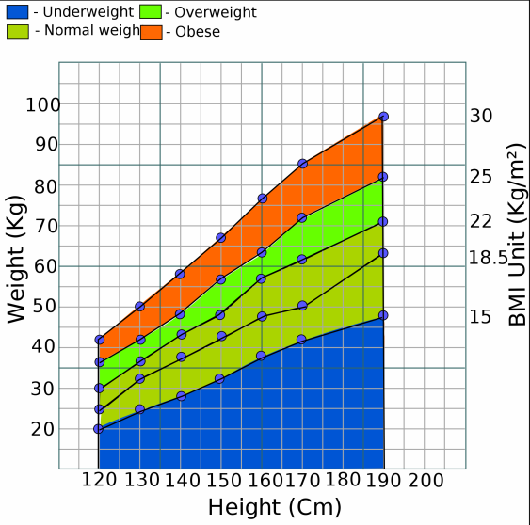

  Health, disease and the development of medicines part 5 –
  Effect of lifestyle
Excess weight (obesity) can make a person at risk of cardiovascular disease, a stroke and Type 2 diabetes. If there are no underlying health concerns then obesity is best tackled through a combination of a healthy balanced diet and exercise.
A tool called the Body Mass Indicator (BMI) can be used to calculate whether a persons weight lies within a healthy range.
BMI calculator
Being underweight (malnourished) can also be of concern. This can indicate a person is not getting sufficient food of a good nutritional quality or indicate medical problems such as an overactive thyroid gland.
A person who is suffering from malnutrition may have a weakened immune system and be at risk of developing fragile bones, fertility problems and a lack of energy.
Notes:
https://www.nhs.uk/Livewell/loseweight/Pages/BodyMassIndex.aspx

Slide 74
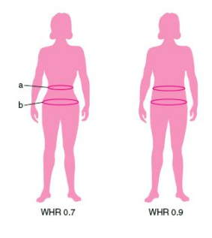
  Health, disease and the development of medicines part 5 –
  Effect of lifestyle
The use of BMI has limitations because it simply shows if a person is carrying too much weight. It does not calculate if this is excess fat, muscle or bone.
Very muscular adults and athletes may be classed as overweight or obese even though their body fat is low.
The waist to hip ratio should be considered alongside the BMI figure.
Male (waist : hip ratio) | Female (waist : hip ratio) | Health risk based on Waist : hip ratio
0. 95 or below | 0.80 or below | Low risk
0.96 to 1.0 | 0.81 to 0.85 | Moderate risk
1.1 or more | 0.86 or more | High risk
Notes:
https://upload.wikimedia.org/wikipedia/commons/thumb/1/13/Body_mass_index_simplified.svg/2000px-Body_mass_index_simplified.svg.png
https://www.nhs.uk/Tools/Pages/Healthyweightcalculator.aspx

Slide 75



  Health, disease and the development of medicines part 5 –
  Effect of lifestyle
Many non communicable diseases are caused by the interaction of a number of factors.
CARDIOVASCULAR disease can be affected by a number of lifestyle risk factors:
Diet – a diet high in saturated fats can increase the levels of LDL (low density lipoproteins – cholesterol plus a protein that can cause atherosclerosis).
Smoking – tobacco smoke damages the lining of the arteries leading to atherosclerosis, carbon monoxide in tobacco smoke reduces the amount of oxygen in the blood so the heart has to pump harder, the nicotine in tobacco smoke causes the heart to beat faster and raises blood pressure.
Lack of exercise – exercising regularly lowers blood pressure and stress.

Slide 76



  Effect of lifestyle Part 5 - non-communicable diseases
Many non-communicable diseases are caused by the interaction of a number of factors:
OBESITY is a lifestyle risk factor for Type 2 diabetes:
Type 2 diabetes – is where the cells in the body are less sensitive or resistant to insulin so the body cannot control the concentration of glucose in the blood correctly.
Video - Type 2 Diabetes
Obesity increases the risk of developing Type 2 diabetes, the more fat you have around your abdomen
Alcohol is a lifestyle risk factor for Liver disease and Brain damage:
Liver disease – the liver breaks down toxins in alcohol. If you have too much alcohol, the first stage of liver disease is when the liver becomes fatty. Eventually cirrhosis of the liver develops if you continue to drink too much alcohol.
Brain function damage – alcohol affects the way the nerve cells in the brain work and the cells then become damaged. The brain mass may also shrink Video
Notes:
https://www.
https://www.youtube.com/watch?v=Sw9OGC7IJWwyoutube.com/watch?v=YoPyFGYcr7s
https://www.youtube.com/watch?v=V2Aj-iJ6p38

Slide 77
  Health, disease and the development of medicines part 5 –
  Effect of lifestyle
Many non-communicable diseases are caused by the interaction of a number of factors:
SMOKING is a lifestyle risk factor for Lung disease:
COPD – describes a group of lung diseases that make it difficult for people to move air in and out of the lungs
Two examples of these are:
  Bronchitis – the bronchi and bronchioles are inflamed (swollen) and excess mucus is produced
  Emphysema – this affects the alveoli. The walls are broken down and they then trap excess air
COPD narrows the airways and makes it difficult to get rid of CO₂ and get in the O₂ needed for respiration. Smoking is the main cause of COPD and is responsible for 9 out of 10 cases. Video - COPD
Notes:
https://www.youtube.com/watch?v=cQuARMhr9lo

Slide 78
  Health, disease and the development of medicines part 5 –
  Effect of lifestyle
Many non-communicable diseases are caused by the interaction of a number of factors:
SMOKING is a lifestyle risk factor for Lung cancer:
Lung cancer - is one of the most common and serious types of cancer. Around 44,500 people are diagnosed with the condition every year in the UK (NHS)
Symptoms include:
  a persistent cough
  frequent chest infections
  coughing up blood
  breathlessness
Causes: most cases of lung cancer are linked to smoking 85% (NHS). Tobacco smoke contains over 60 toxic chemicals and some of these substances are known to be carcinogenic (cancer causing)
If you smoke more than 25 cigarettes a day, you are 25 times more likely to get lung cancer than a non-smoker. Some people who have never smoked can get lung cancer too.
All cigarettes must now by law be sold in plain packaging and with graphic images and health warnings.

Slide 79

  Health, disease and the development of medicines part 5 –
  Effect of lifestyle
20 minutes: heart rate and blood pressure reduce
Within 2-12 weeks the circulation and lung function begin to improve.
Between 5 to 15 years, the risk of a stroke falls to be approximately the same as someone who has never smoked.
Benefits of stopping smoking on cardio vascular disease.
Within 12 hours the levels of carbon monoxide in the blood fall.
After 1 year of stopping smoking, the risk of CVD falls to approximately half that of a smoker.
After 10 years the risk of lung cancer falls to about half that of a smoker.
Notes:
https://www.nhs.uk/conditions/cardiovascular-disease/

Slide 80



  Health, disease and the development of medicines part 5 –
  Effect of lifestyle
Many non-communicable diseases are caused by the interaction of a number of factors:
CARCINOGENS increase the risk for cancer:
Carcinogen - a substance or form of radiation that can cause cancer. Some carcinogens cause cancer by damaging the DNA directly, others can speed up cell division making mutations more likely
Tobacco - smoke can cause cancers in the lungs, oesophagus, larynx (voice box), mouth, throat, kidney, bladder, pancreas, stomach and cervix
Alcohol - is a risk factor in the following cancers - mouth, larynx, oesophagus, liver and breast
Occupational carcinogens – there are over 40 known carcinogens in the work environment and these need to be carefully controlled so that workers don’t get too exposed to them e.g. asbestos causes lung cancer
Notes:
https://www.youtube.com/watch?v=gV4a_9Kh3ts

Slide 81


  Health, disease and the development of medicines part 5 –
  Effect of lifestyle
Cardiovascular disease (CVD) is a general term for disease which involve the heart or blood vessels. Atherosclerosis is a cause of coronary heart disease where layers of fatty material build up inside the coronary arteries, narrowing them. This reduces the flow of blood through the coronary arteries, resulting in a lack of oxygen for the heart muscle.
coronary arteries
Video - Coronary Heart Disease

Slide 82


  Health, disease and the development of medicines part 5 –
  Effect of lifestyle
Atherosclerosis can be treated in two main ways by placing a stent in the coronary artery and/or using lifelong medication called statins. Lifestyle changes such as a healthy diet, exercise and no smoking are also vital in reducing the risk of CVD.
Stents are metal cylinder grids which can be inserted into an artery to maintain blood flow by keeping the artery open so that the heart continues to receive enough oxygen to function effectively.
Statins are drugs that lower harmful cholesterol in the blood and stop the liver producing too much cholesterol and reduce the rate at which it is deposited. Patients should change their lifestyle and have a healthy diet. This reduces the risk of heart disease.
Video - Stent Insertion Animation
Notes:
Heart stent animation https://www.youtube.com/watch?v=icAN3dglyLQ

Slide 83

  Health, disease and the development of medicines part 5 –
  Effect of lifestyle
Heart disease can lead to heart failure. Patients with heart failure can be given heart or heart and lung transplants. Donor hearts come from a person who has died. These only have a few hours to get to the person needing the heart. Often hearts and lungs are transplanted together. In this country you have to give consent for your organs to be donated.
Video - Heart Transplant (graphic)
Conditions that may require a heart transplant include:
Atherosclerosis (coronary heart disease) – a build-up of fatty substances in the arteries supplying the heart
Cardiomyopathy – where the walls of the heart have become stretched, thickened or stiff
Congenital heart disease – birth defects that affect the normal workings of the heart
Artificial hearts are occasionally used to keep patients alive whilst waiting for a heart transplant, or to allow the heart to rest as an aid to recovery. Artificial hearts can only be used as a short term measure.
Notes:
Sensitivity needed for video shows a real heart transplant https://www.youtube.com/watch?v=yDDpGpbJAlU

Slide 84
QuestionIT!
Effect of lifestyle
Part 5 (5.23 – 5.25)
  Exercise, diet and BMI
  Alcohol on liver disease
  Smoking and cardio vascular
  disease
  Evaluation of treatments for cardiovascular disease

Slide 85
  Effect of lifestyle part 5 – QuestionIT
How do you calculate BMI?
What other information could also be used to indicate if a person is overweight?
Name a lifestyle risk factor for developing liver disease.
List three lifestyle risk factors which are likely to increase the chance of developing cardiovascular disease.
Name three methods of treatment for cardiovascular disease.
What is a statin?
What is a stent used for?

Slide 86
AnswerIT!
Effect of lifestyle
Part 5 (5.23 – 5.25)
  Exercise, diet and BMI
  Alcohol on liver disease
  Smoking and cardio vascular
  disease
  Evaluation of treatments for cardiovascular disease

Slide 87
  Effect of lifestyle part 5 – AnswerIT
How do you calculate BMI?
What other information could also be used to indicate if a person is overweight? Waist: hip ratio
Name a lifestyle risk factor for developing liver disease.
Alcohol
4. List three lifestyle risk factors which are likely to increase the chance of developing cardiovascular disease.
Smoking
Unhealthy diet
Lack of exercise
5. Name three methods of treatment for cardiovascular disease.
Lifestyle change
Lifetime medication
Surgery

Slide 88
  Effect of lifestyle part 5 – AnswerIT
What are statins? Statins are drugs that lower harmful cholesterol in the blood and stop the liver producing too much cholesterol and reduce the rate at which it is deposited.
What is a stent used for?
Stents are metal cylinder grids which can be inserted into an artery to maintain blood flow by keeping the artery open so that the heart continues to receive enough oxygen to function effectively.

